Slide 1
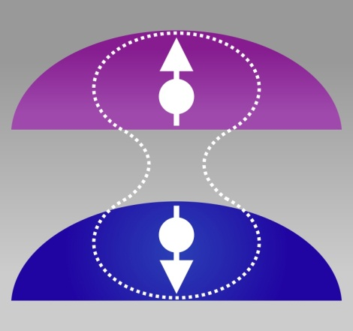


Coherence between spin singlet and triplet states in a coupled quantum dot
Jeroen Elzerman
Kathi Weiss
Yves Delley
Javier Miguel-Sanchez
Ataç Imamoğlu
University College London

Slide 2
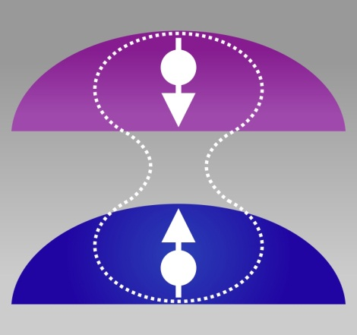
Coherence between spin singlet and triplet states in a coupled quantum dot
Jeroen Elzerman
Kathi Weiss
Yves Delley
Javier Miguel-Sanchez
Ataç Imamoğlu
University College London

Slide 3
Coherence between spin singlet and triplet states in a coupled quantum dot
Jeroen Elzerman
Kathi Weiss
Yves Delley
Javier Miguel-Sanchez
Ataç Imamoğlu
+
University College London

Slide 4
Motivation
Optically active self-assembled InGaAs quantum dots:
Fill with single electron/hole spin (Warburton et al. Nature 2000)
Use resonant lasers to perform spin
initialization (Atature et al. Science 2006, Xu et al. PRL 2007)
ps manipulation (Greilich et al. PRL 2006, Press et al. Nature 2008)
readout (Kim et al. PRL 2008, Vamivakas et al. Nature 2010)
Electrons: T₂* ~ ns (limited by nuclear spins via hyperfine interaction)

Slide 5
Motivation
Optically active self-assembled InGaAs quantum dots:
Fill with single electron/hole spin (Warburton et al. Nature 2000)
Use resonant lasers to perform spin
initialization (Atature et al. Science 2006, Xu et al. PRL 2007)
ps manipulation (Greilich et al. PRL 2006, Press et al. Nature 2008)
readout (Kim et al. PRL 2008, Vamivakas et al. Nature 2010)
Electrons: T₂* ~ ns (limited by nuclear spins via hyperfine interaction)
Holes: T₂* ~ ns (limited by charge fluctuations via spin-orbit interaction)
Spin echo: T₂ ~ μs (electrons: Press et al. Nature Photonics 2010,
holes: De Greve et al. Nature Physics 2011)
Reduce nuclear spin fluctuations (Latta et al., Nature Physics 2009)
Xu et al., Nature 2009, …)

Slide 6
Motivation
Optically active self-assembled InGaAs quantum dots:
Fill with single electron/hole spin (Warburton et al. Nature 2000)
Use resonant lasers to perform spin
initialization (Atature et al. Science 2006, Xu et al. PRL 2007)
ps manipulation (Greilich et al. PRL 2006, Press et al. Nature 2008)
readout (Kim et al. PRL 2008, Vamivakas et al. Nature 2010)
Electrons: T₂* ~ ns (limited by nuclear spins via hyperfine interaction)
Holes: T₂* ~ ns (limited by charge fluctuations via spin-orbit interaction)
Spin echo: T₂ ~ μs (electrons: Press et al. Nature Photonics 2010,
holes: De Greve et al. Nature Physics 2011)
Reduce nuclear spin fluctuations (Latta et al., Nature Physics 2009)
Xu et al., Nature 2009, …)
Controllably couple two quantum dots via tunneling!
Perform 2-qubit gates (Kim et al. Nature Physics 2010,
Greilich et al. Nature Photonics 2011)
Make 2-electron qubit robust against nuclear spin & charge fluctuations (Lidar, Chuang, Whaley, PRL 1998)

Slide 7
Outline
Introduction to two-electron spin states in coupled quantum dots
Two coupled electron spins with fast relaxation via electron reservoir:
Laser amplification (gain)
JME, K. Weiss, J. Miguel-Sanchez & A. Imamoglu,
PRL 107, 017401 (2011)
Two coupled electron spins decoupled from electron reservoir:
Coherence between singlet and triplet states probed with CPT
K. Weiss, JME, Y.L. Delley, J. Miguel-Sanchez & A. Imamoglu,
PRL 109, 107401 (2012)
Conclusions

Slide 8
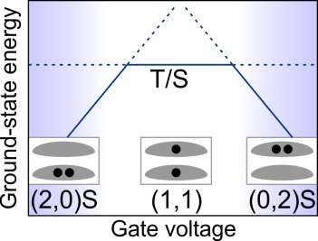
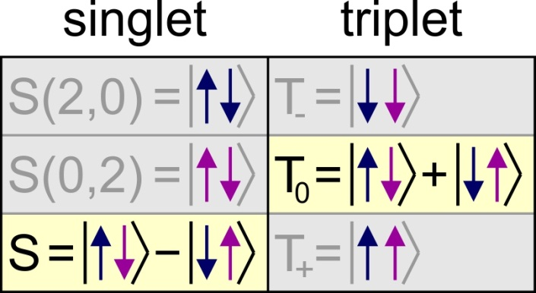
Two-electron spin states
No tunneling: delocalized S and T degenerate (localized S and T not)

Slide 9
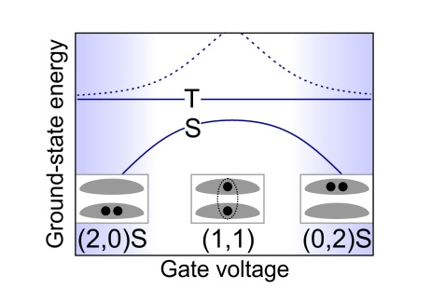
Two-electron spin states
No tunneling: delocalized S and T degenerate (localized S and T not)
With tunneling: S and T split by V-dependent exchange energy

Slide 10
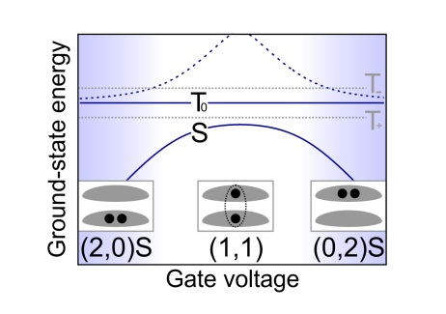
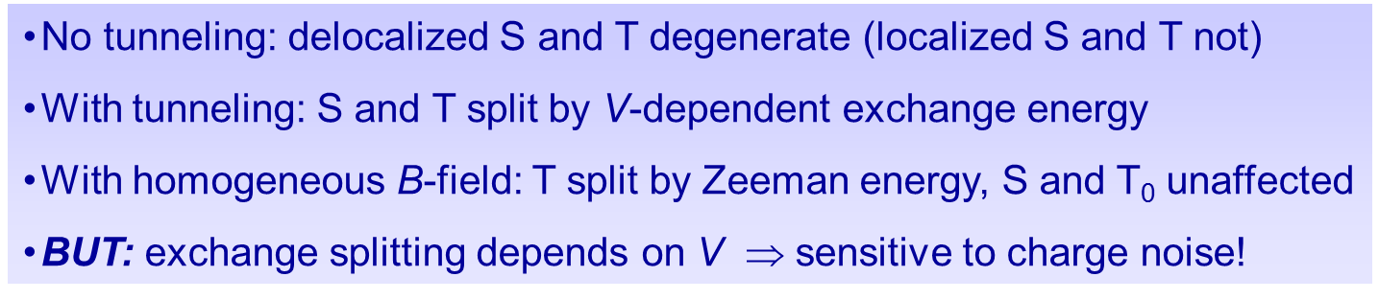
Two-electron spin states
No tunneling: delocalized S and T degenerate (localized S and T not)
With tunneling: S and T split by V-dependent exchange energy
With homogeneous B-field: T split by Zeeman energy, S and T₀ unaffected
BUT: exchange splitting depends on V $ $ sensitive to charge noise!

Slide 11
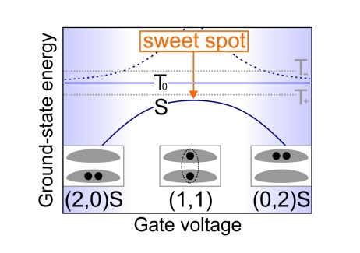

Two-electron spin states
At “sweet spot”:
singlet/triplet qubit states (to first order) insensitive to charge fluctuations!
Vion et al., Science (2002)
Koch et al., PRA (2007)
No tunneling: delocalized S and T degenerate (localized S and T not)
With tunneling: S and T split by V-dependent exchange energy
With homogeneous B-field: T split by Zeeman energy, S and T₀ unaffected
BUT: exchange splitting depends on V $ $ sensitive to charge noise!

Slide 12
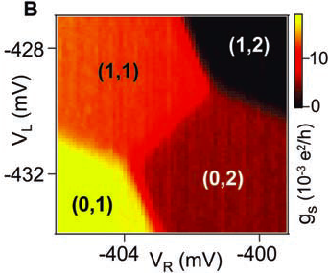
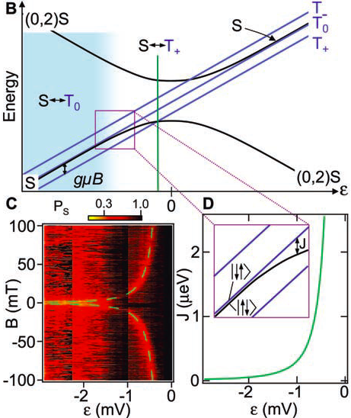
ST qubits in electrically defined CQDs
Petta et al., Science (2005)
Operate in spin blockade regime (1,1)↔(0,2) far away from sweet spot
ST splitting smaller than hyperfine (gradient) fields
Necessary for manipulation!

Slide 13
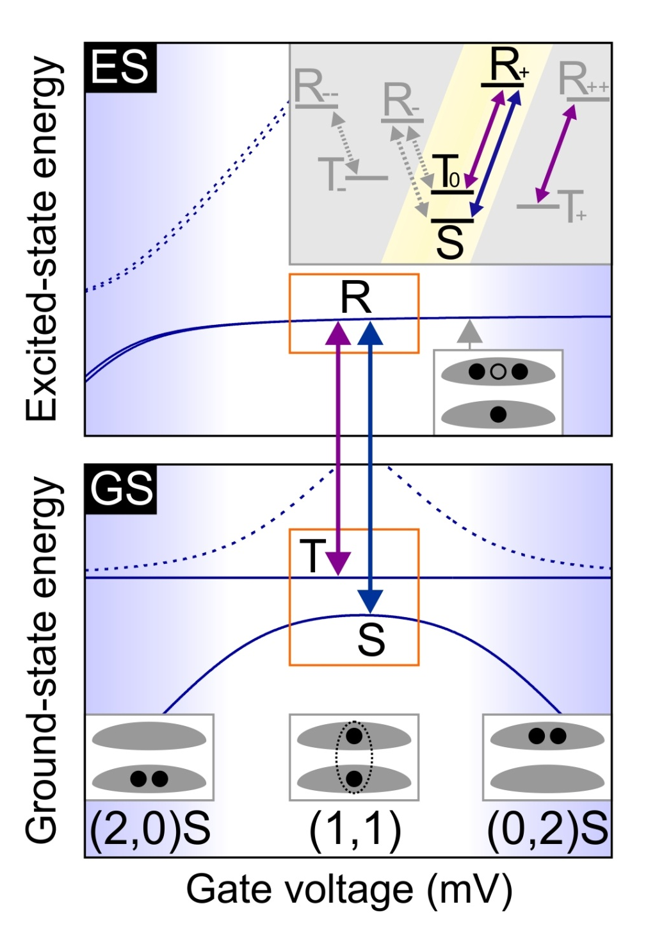


Lambda system using 2-electron S & T states
S and T share common excited states R (in red top dot) and B (in blue bottom dot)
Anticrossings in optically excited states outside (1,1) regime
B ~ 100 mT: Zeeman splittings lift T and R degeneracies and suppress hyperfine mixing ⇒ isolate single lambda scheme

Slide 14
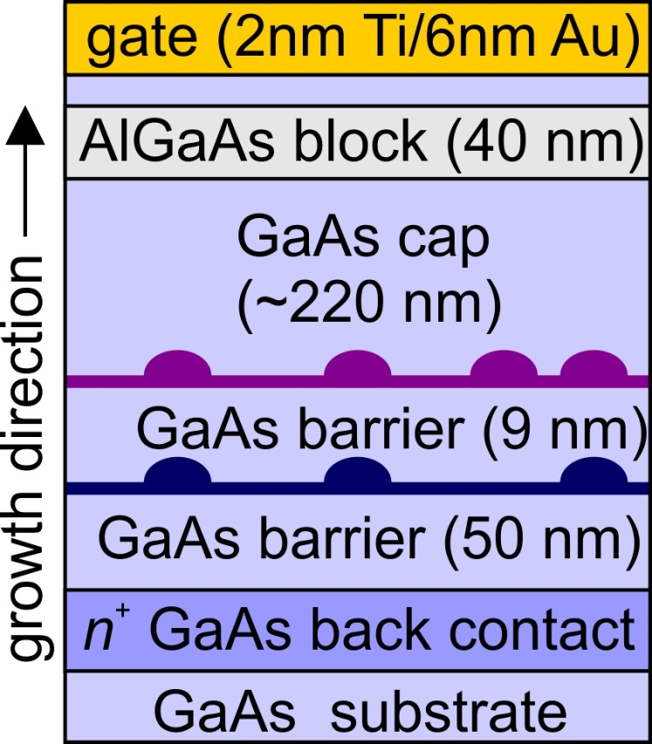
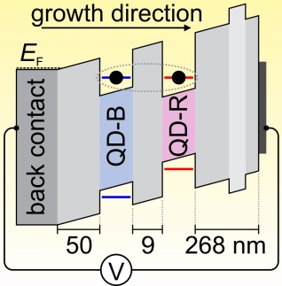
Device layout and bandstructure
2 layers of self-assembled In(Ga)As QDs in GaAs Schottky diode
QDs in top and bottom layers form vertical stacks due to strain
Emission QD-B ~940 nm and QD-R ~970 nm (shifted by PCI technique)
Tune gate voltage to charge each QD with single electron: (1,1) regime
Requires accurate design of QD-B & QD-R wavelengths
Strong tunnel coupling due to thin GaAs tunnel barrier
Notes:
% CQDEnergiesFinal
% Author : Jeroen Elzerman
% Date : 2009.07.31
% Version : 0.1
% Plots the transition energies for a set of inital and a set of final
% states in a double dot. Includes B-field dependence. Hole can sit in either blue
% or red QD.
addpath('D:\Scripts\ScriptsNew3\Functions');
clc;
close all;
%%%%%%%%%%%%%%%%%%%%%%%%%%%%%%%%%%%%%%%%%%%%%%%%%%%%%%%%%%
n = 1000; % number of points on gate voltage-axis
nE = 5000; % number of points on energy-axis
Vg1 = -580; % transition from X0 to X-1 in gate voltage [mVg]
Vg2 = -220; % transition from X-1 to X-2 in gate voltage [mVg]
Vg3 = -180; % transition from X-2 to X-3 in gate voltage [mVg]
s_id = 0.05; % indirect transition strength (compared to direct)
s_d = 0.05; % dark transition strength (compared to bright)
s_b = 0.5; % blue transition strenght (compared to red)
leverarm = 9/175; % leverarm determining detuning between two dots
Vgate = linspace(-600,600,n); % gate voltage [mV]
Ed = -Vgate*leverarm; % energy detuning [meV] between dots (Eright - Eleft, with E-right = 0)
index1 = min(find(Vgate>Vg1)); % index of Vgate-array corresponding to Vg1
index2 = min(find(Vgate>Vg2)); % index of Vgate-array corresponding to Vg2
index3 = min(find(Vgate>Vg3)); % index of Vgate-array corresponding to Vg3
B = linspace(0,4,n)'; % B-field [T]
%Ze1 = 0.6*B*0.5*56.8E-3; % half the Zeeman splitting [meV] for the electron (g-factor ~ 0.6)
%Zh2 = 1.3*B*0.5*56.8E-3; % half the Zeeman splitting [meV] for the hole (g-factor ~ 1.2)
Ze1 = 0.0; % half the Zeeman splitting [meV at 1T] for an electron in dot 1
Ze2 = 0.0; % half the Zeeman splitting [meV at 1T] for an electron in dot 2
Zh1 = 0.0; % half the Zeeman splitting [meV at 1T] for a hole in dot 1
Zh2 = 0.0; % half the Zeeman splitting [meV at 1T] for a hole in dot 2
X0R = 1290; % X0R energy [meV]
X0B = 1310; % X0B energy [meV]
HWHM = 0.05; % transition energy width [meV]
E = linspace(X0R-10,X0B-15,nE); % range for plotting transition energies [meV]
%%%%%%%%%%%%%%%%%%%%%%%%%%%%%%%%%%%%%%%%%%%%%%%%%%%%%%%%%%
th_1h = 0.1; % 1h
te_1e = 0.5; % 1e
Ed1_1e = 0; % 1e
ER_1e = 0; % 1e
EB_1e = 0; % 1e
VRR_ee = 20; % 2e
VBB_ee = 22; % 2e
VBR_ee = 10; % 2e
J_ee = 0.0; % 2e (= VBRBR)
VBBBR_ee = 0; % 2e
t_ee = sqrt(2)*(te_1e+VBBBR_ee);% 2e
Ed1_ee = VBB_ee - VBR_ee; % 2e
Ed2_ee = -VRR_ee + VBR_ee; % 2e
ER_ee = VBR_ee; % 2e
te_3e = te_1e; % 3e
Ed1_3e = VBB_ee - VRR_ee; % 3e
ER_3e = VBB_ee + 2*VBR_ee; % 3e
VBRRR_eh = 0; % 1e1h
VBR_eh = 10; % 1e1h
VRR_eh = 24; % 1e1h
VBB_eh = 26; % 1e1h
d0RR = 0.2; % 1e1h
d0BB = 0.2; % 1e1h
d0BR = d0RR/1000; % 1e1h
d1RR = 0.01; % 1e1h
d1BB = 0.01; % 1e1h
d1BR = d1RR/1000; % 1e1h
d2RR = 0.02; % 1e1h
d2BB = 0.02; % 1e1h
d2BR = d2RR/1000; % 1e1h
te_eh = te_1e - VBRRR_eh; % 1e1h
th_eh = th_1h - VBRRR_eh; % 1e1h
Ed1_eh = VRR_eh - VBR_eh; % 1e1h
Ed2_eh = -VBB_eh + VBR_eh; % 1e1h
ER_eh = X0R; % 1e1h
EB_eh = X0B; % 1e1h
te_2e1h = te_1e - VBBBR_ee - VBRRR_eh; % 2e1h
th_2e1h = th_1h - VBBBR_ee - VBRRR_eh; % 2e1h
Ed1_2e1h = VBB_ee - VBR_ee + VRR_eh - VBR_eh; % 2e1h
Ed2_2e1h = -VRR_ee + VBR_ee + VRR_eh - VBR_eh; % 2e1h
Ed3_2e1h = VBB_ee - VBR_ee - VBB_eh + VBR_eh; % 2e1h
Ed4_2e1h = -VRR_ee + VBR_ee - VBB_eh + VBR_eh; % 2e1h
ER_2e1h = X0R + EB_1e; % 2e1h
XmR = X0R + VRR_ee - VRR_eh; % 2e1h
XmB = X0B + VBB_ee - VBB_eh; % 2e1h
EB_2e1h = XmB + ER_1e; % 2e1h
te_3e1h = te_eh; % 3e1h
th_3e1h = th_eh; % 3e1h
Ed1_3e1h = VBB_ee - VRR_ee + VRR_eh - VBR_eh; % 3e1h
Ed2_3e1h = VBB_ee - VRR_ee - VBB_eh + VBR_eh; % 3e1h
ER_3e1h = XmR + ER_ee; % 3e1h VRR_ee-VRR_eh
EB_3e1h = XmB + ER_ee; % 3e1h VBB_ee-VBB_eh
th_4e1h = th_1h; % 4e1h
Ed1_4e1h = VBB_eh - VRR_eh - X0B + X0R; % 4e1h
ER_4e1h = XmR + ER_3e; % 4e1h
EB_4e1h = XmB + ER_3e; % 4e1h
% 0 %%%%%%%%%%%%%%%%%%%%%%%%%%%%%%%%%%%%%%%%%%%%%%%%%%%%%%%%%
E_0 = zeros(n,1);
Vec_0 = mat2cell(ones(1,n),1,linspace(1,1,n));
figure;
plot(Vgate,E_0,'b'); title('0','Fontsize',24);xlabel('Gate voltage (mV)','Fontsize',24);ylabel('Energy (meV)','Fontsize',24);set(gca,'Fontsize',18);
ylim([-15 15]);pbaspect([1.4 1 1]);
% 1e %%%%%%%%%%%%%%%%%%%%%%%%%%%%%%%%%%%%%%%%%%%%%%%%%%%%%%%%%
E_1e = cell(1,n);
Vec_1e = cell(1,n);
for i = 1:n
[E_temp,Vec_temp] = SolveH_1e(te_1e,Ze1,Ze2,ER_1e,Ed1_1e,Ed(i));
E_1e{i} = E_temp;
Vec_1e{i} = Vec_temp; % eigenvectors are columns in each cell (for calculating "gate sweeps" later)
end
E_1e = cell2mat(E_1e)';
figure;
plot(Vgate,E_1e,'b'); title('1e','Fontsize',24);xlabel('Gate voltage (mV)','Fontsize',24);ylabel('Energy (meV)','Fontsize',24);set(gca,'Fontsize',18);
ylim([ER_1e-15 ER_1e+15]);pbaspect([1.4 1 1]);
% 2e %%%%%%%%%%%%%%%%%%%%%%%%%%%%%%%%%%%%%%%%%%%%%%%%%%%%%%%%%
E_2e = cell(1,n);
Vec_2e = cell(1,n);
for i = 1:n
[E_temp,Vec_temp] = SolveH_2e(J_ee,t_ee,Ze1,Ze2,ER_ee,Ed1_ee,Ed2_ee,Ed(i));
E_2e{i} = E_temp;
Vec_2e{i} = Vec_temp; % eigenvectors are columns in each cell (for calculating "gate sweeps" later)
end
E_2e = cell2mat(E_2e)';
figure;
plot(Vgate,E_2e,'b'); title('2e','Fontsize',24);xlabel('Gate voltage (mV)','Fontsize',24);ylabel('Energy (meV)','Fontsize',24);set(gca,'Fontsize',18);
ylim([ER_ee-15 ER_ee+15]);pbaspect([1.4 1 1]);
% 3e %%%%%%%%%%%%%%%%%%%%%%%%%%%%%%%%%%%%%%%%%%%%%%%%%%%%%%%%%
E_3e = cell(1,n);
Vec_3e = cell(1,n);
for i = 1:n
[E_temp,Vec_temp] = SolveH_3e(te_3e,Ze1,Ze2,ER_3e,Ed1_3e,Ed(i));
E_3e{i} = E_temp;
Vec_3e{i} = Vec_temp; % eigenvectors are columns in each cell (for calculating "gate sweeps" later)
end
E_3e = cell2mat(E_3e)';
figure;
plot(Vgate,E_3e,'b'); title('3e','Fontsize',24);xlabel('Gate voltage (mV)','Fontsize',24);ylabel('Energy (meV)','Fontsize',24);set(gca,'Fontsize',18);
ylim([ER_3e-15 ER_3e+15]);pbaspect([1.4 1 1]);
% 1e1h %%%%%%%%%%%%%%%%%%%%%%%%%%%%%%%%%%%%%%%%%%%%%%%%%%%%%%%%
E_eh = cell(1,n);
Vec_eh = cell(1,n);
for i = 1:n
[E_temp,Vec_temp] = SolveH_1e1h(d0RR,d0BB,d0BR,d1RR,d1BB,d1BR,d2RR,d2BB,d2BR,te_eh,th_eh,Ze1,Ze2,Zh1,Zh2,ER_eh,EB_eh,Ed1_eh,Ed2_eh,Ed(i));
E_eh{i} = E_temp;
Vec_eh{i} = Vec_temp; % eigenvectors are columns in each cell (for calculating "gate sweeps" later)
end
E_eh = cell2mat(E_eh)';
figure;
plot(Vgate,E_eh,'b'); title('1e1h','Fontsize',24);xlabel('Gate voltage (mV)','Fontsize',24);ylabel('Energy (meV)','Fontsize',24);set(gca,'Fontsize',18);
ylim([ER_eh-5 ER_eh+25]);pbaspect([1.4 1 1]);
% 2e1h %%%%%%%%%%%%%%%%%%%%%%%%%%%%%%%%%%%%%%%%%%%%%%%%%%%%%%%%%
E_2e1h = cell(1,n);
Vec_2e1h = cell(1,n);
for i = 1:n
[E_temp,Vec_temp] = SolveH_2e1h(J_ee,te_2e1h,th_2e1h,d0RR,d0BB,d1RR,d1BB,d2RR,d2BB,Ze1,Ze2,Zh1,Zh2,ER_2e1h,EB_2e1h,Ed1_2e1h,Ed2_2e1h,Ed3_2e1h,Ed4_2e1h,Ed(i));
E_2e1h{i} = E_temp;
Vec_2e1h{i} = Vec_temp; % eigenvectors are columns in each cell (for calculating "gate sweeps" later)
end
E_2e1h = cell2mat(E_2e1h)';
figure;
plot(Vgate,E_2e1h,'b'); title('2e1h','Fontsize',24);xlabel('Gate voltage (mV)','Fontsize',24);ylabel('Energy (meV)','Fontsize',24);set(gca,'Fontsize',18);
ylim([ER_2e1h-10 ER_2e1h+20]);pbaspect([1.4 1 1]);
% 3e1h %%%%%%%%%%%%%%%%%%%%%%%%%%%%%%%%%%%%%%%%%%%%%%%%%%%%%%%%%
E_3e1h = cell(1,n);
Vec_3e1h = cell(1,n);
for i = 1:n
[E_temp,Vec_temp] = SolveH_3e1h(d0RR,d0BB,d0BR,d1RR,d1BB,d1BR,d2RR,d2BB,d2BR,te_3e1h,th_3e1h,Ze1,Ze2,Zh1,Zh2,ER_3e1h,EB_3e1h,Ed1_3e1h,Ed2_3e1h,Ed(i));
E_3e1h{i} = E_temp;
Vec_3e1h{i} = Vec_temp; % eigenvectors are columns in each cell (for calculating "gate sweeps" later)
end
E_3e1h = cell2mat(E_3e1h)';
figure;
plot(Vgate,E_3e1h,'b'); title('3e1h','Fontsize',24);xlabel('Gate voltage (mV)','Fontsize',24);ylabel('Energy (meV)','Fontsize',24);set(gca,'Fontsize',18);
ylim([ER_3e1h-5 ER_3e1h+25]);pbaspect([1.4 1 1]);
% 4e1h %%%%%%%%%%%%%%%%%%%%%%%%%%%%%%%%%%%%%%%%%%%%%%%%%%%%%%%%%
E_4e1h = cell(1,n);
Vec_4e1h = cell(1,n);
for i = 1:n
[E_temp,Vec_temp] = SolveH_4e1h(th_4e1h,Zh1,Zh2,ER_4e1h,Ed1_4e1h,Ed(i));
E_4e1h{i} = E_temp;
Vec_4e1h{i} = Vec_temp; % eigenvectors are columns in each cell (for calculating "gate sweeps" later)
end
E_4e1h = cell2mat(E_4e1h)';
figure;
plot(Vgate,E_4e1h,'b'); title('4e1h','Fontsize',24);xlabel('Gate voltage (mV)','Fontsize',24);ylabel('Energy (meV)','Fontsize',24);set(gca,'Fontsize',18);
ylim([ER_4e1h-20 ER_4e1h+10]);pbaspect([1.4 1 1]);
% 1e1h - 0 %%%%%%%%%%%%%%%%%%%%%%%%%%%%%%%%%%%%%%%%%%%%%%%%%%%%%%%%%
M_eh = [s_id 1 s_id 1 s_id*s_d s_d s_id*s_d s_d s_id*s_b s_b s_id*s_b s_b s_id*s_d*s_b s_d*s_b s_id*s_d*s_b s_d*s_b];
E_0 = TransitionEnergy(E_eh,zeros(n,1));
matrix0 = TransitionStrength(E_0,Vec_eh,Vec_0,M_eh,E,HWHM);
figure;plot(Vgate,E_0,'b'); title('X0','Fontsize',24);xlabel('Gate voltage (mV)','Fontsize',24);ylabel('Energy (meV)','Fontsize',24);set(gca,'Fontsize',18);
ylim([X0R-10 X0B+5]);pbaspect([1.4 1 1]);
PlotMatrix(matrix0,Vgate,E(1,:),'Gate voltage (mV)','Transition energy (meV)','X0',[-3E10 3E10]);pbaspect([1.4 1 1]);
PlotMatrix(log(abs(matrix0)),Vgate,E(1,:),'Gate voltage (mV)','Transition energy (meV)','X0',[-3E10 3E10]);pbaspect([1.4 1 1]);
% 2e1h - 1e %%%%%%%%%%%%%%%%%%%%%%%%%%%%%%%%%%%%%%%%%%%%%%%%%%%%%%%%%
M_2e1h = [ s_id 0 1 0 s_d 0 s_d*s_id 0 s_d 0 1 0 s_b 0 s_id*s_b 0 s_d*s_id 0 s_b*s_d 0 s_b*s_d*s_id 0 s_b*s_id 0;
0 1 0 s_id s_d*s_id 0 0 s_d 0 s_d*s_id s_id 0 s_b*0 s_b*s_id 0 s_b s_b*s_d 0 0 s_b*s_d*s_id 0 s_b*s_d s_b 0;
s_d*s_id 0 0 s_d 0 1 s_id 0 0 1 0 s_d s_b*s_d 0 0 s_b*s_d*s_id 0 s_b*s_id s_b 0 0 s_b*s_id 0 s_b*s_d*s_id;
0 s_d s_d*s_id 0 0 s_id 0 1 s_id 0 0 s_d*s_id 0 s_b*s_d*s_id s_b*s_d 0 0 s_b 0 s_b*s_id s_b 0 0 s_b*s_d ];
E_1 = TransitionEnergy(E_2e1h,E_1e);
matrix1 = TransitionStrength(E_1,Vec_2e1h,Vec_1e,M_2e1h,E,HWHM);
figure;
plot(Vgate,E_1,'b'); title('X1-','Fontsize',24);xlabel('Gate voltage (mV)','Fontsize',24);ylabel('Energy (meV)','Fontsize',24);set(gca,'Fontsize',18);
ylim([X0R-10 X0B+5]);pbaspect([1.4 1 1]);
PlotMatrix(matrix1,Vgate,E(1,:),'Gate voltage (mV)','Transition energy (meV)','X1-',[-3E10 3E10]);pbaspect([1.4 1 1]);
PlotMatrix(log(abs(matrix1)),Vgate,E(1,:),'Gate voltage (mV)','Transition energy (meV)','X1-',[-3E10 3E10]);pbaspect([1.4 1 1]);
% 3e1h - 2e %%%%%%%%%%%%%%%%%%%%%%%%%%%%%%%%%%%%%%%%%%%%%%%%%%%%%%%%%
M_3e1h = ones(6,16);
M_3e1h = [ 0 1 0 1 0 s_d 0 s_d s_b*s_id 0 s_b*s_id 0 s_b*s_d*s_id 0 s_b*s_d*s_id 0;
s_id 0 s_id 0 s_d*s_id 0 s_d*s_id 0 0 s_b 0 s_b 0 s_b*s_d 0 s_b*s_d;
0 s_id 1 0 s_d 0 0 s_d*s_id s_b 0 s_b*s_d s_b*s_id 0 s_b*s_d*s_id s_b*s_d 0;
1 0 0 s_id 0 s_d*s_id s_d 0 0 s_b*s_id s_b 0 s_b*s_d 0 0 s_b*s_d*s_id;
0 0 s_d s_d*s_id 1 s_id 0 0 0 0 s_b*s_d s_b*s_d*s_id s_b s_b*s_id 0 0;
s_d s_d*s_id 0 0 0 0 1 s_id s_b*s_d s_b*s_d*s_id 0 0 0 0 s_b s_b*s_id];
E_2 = TransitionEnergy(E_3e1h,E_2e);
matrix2 = TransitionStrength(E_2,Vec_3e1h,Vec_2e,M_3e1h,E,HWHM);
figure;
plot(Vgate,E_2,'b'); title('X2-','Fontsize',24);xlabel('Gate voltage (mV)','Fontsize',24);ylabel('Energy (meV)','Fontsize',24);set(gca,'Fontsize',18);
ylim([X0R-10 X0B+5]);pbaspect([1.4 1 1]);
PlotMatrix(matrix2,Vgate,E(1,:),'Gate voltage (mV)','Transition energy (meV)','X2-',[-3E10 3E10]);pbaspect([1.4 1 1]);
PlotMatrix(log(abs(matrix2)),Vgate,E(1,:),'Gate voltage (mV)','Transition energy (meV)','X2-',[-3E10 3E10]);pbaspect([1.4 1 1]);
% 4e1h - 3e %%%%%%%%%%%%%%%%%%%%%%%%%%%%%%%%%%%%%%%%%%%%%%%%%%%%%%%%%
M_4e1h = ones(4,4);
M_4e1h = [ s_b s_id s_b*s_d s_d*s_id;
s_b*s_id 1 s_b*s_d*s_id s_d;
s_b*s_d s_d*s_id s_b s_id;
s_b*s_d*s_id s_d s_b*s_id 1];
E_3 = TransitionEnergy(E_4e1h,E_3e);
matrix3 = TransitionStrength(E_3,Vec_4e1h,Vec_3e,M_4e1h,E,HWHM);
figure;
plot(Vgate,E_3,'b'); title('X3-','Fontsize',24);xlabel('Gate voltage (mV)','Fontsize',24);ylabel('Energy (meV)','Fontsize',24);set(gca,'Fontsize',18);
ylim([X0R-10 X0B+5]);pbaspect([1.4 1 1]);
PlotMatrix(matrix3,Vgate,E(1,:),'Gate voltage (mV)','Transition energy (meV)','X3-',[-3E10 3E10]);pbaspect([1.4 1 1]);
PlotMatrix(log(abs(matrix3)),Vgate,E(1,:),'Gate voltage (mV)','Transition energy (meV)','X3-',[-3E10 3E10]);pbaspect([1.4 1 1]);
% combined %%%%%%%%%%%%%%%%%%%%%%%%%%%%%%%%%%%%%%%%%%%%%%%%%%%%%%%%%
figure; title(['All transitions: Vg1 = ',num2str(Vg1),' mV; Vg2 = ',num2str(Vg2),' mV'],'Fontsize',24);
hold on;
plot(Vgate(1:index1),E_0(1:index1,:),'b');
plot(Vgate(index1+1:index2),E_1(index1+1:index2,:),'b');
plot(Vgate(index2+1:index3),E_2(index2+1:index3,:),'b');
plot(Vgate(index3+1:n),E_3(index3+1:n,:),'b');
ylim([X0R-10 X0B+5]);pbaspect([1.4 1 1]);
xlabel('Gate voltage (mV)','Fontsize',24);ylabel('Energy (meV)','Fontsize',24);set(gca,'Fontsize',18);
hold off;
matrix = [matrix0(1:index1,:);matrix1(index1+1:index2,:);matrix2(index2+1:index3,:);matrix3(index3+1:n,:)];
PlotMatrix(matrix,Vgate,E(1,:),'Gate voltage (mV)','Transition energy (meV)',['All transitions: Vg1 = ',num2str(Vg1),' mV; Vg2 = ',num2str(Vg2),' mV'],[-3E10 3E10]);pbaspect([1.4 1 1]);
PlotMatrix(log(abs(matrix)),Vgate,E(1,:),'Gate voltage (mV)','Transition energy (meV)',['All transitions: Vg1 = ',num2str(Vg1),' mV; Vg2 = ',num2str(Vg2),' mV'],[-3E10 3E10]);pbaspect([1.4 1 1]);
matrix = (matrix0+matrix1+matrix2+matrix3)/4;
PlotMatrix(matrix,Vgate,E(1,:),'Gate voltage (mV)','Transition energy (meV)','All transitions together:',[-3E10 3E10]);pbaspect([1.4 1 1]);
PlotMatrix(log(abs(matrix)),Vgate,E(1,:),'Gate voltage (mV)','Transition energy (meV)','All transitions together:',[-3E10 3E10]);pbaspect([1.4 1 1]);
% SAVE %%%%%%%%%%%%%%%%%%%%%%%%%%%%%%%%%%%%%%%%%%%%%%%%%%%%%%%%
% eval(['save ', 'D:\Temp\temp.dat', ' PLE -ascii']);

Slide 15
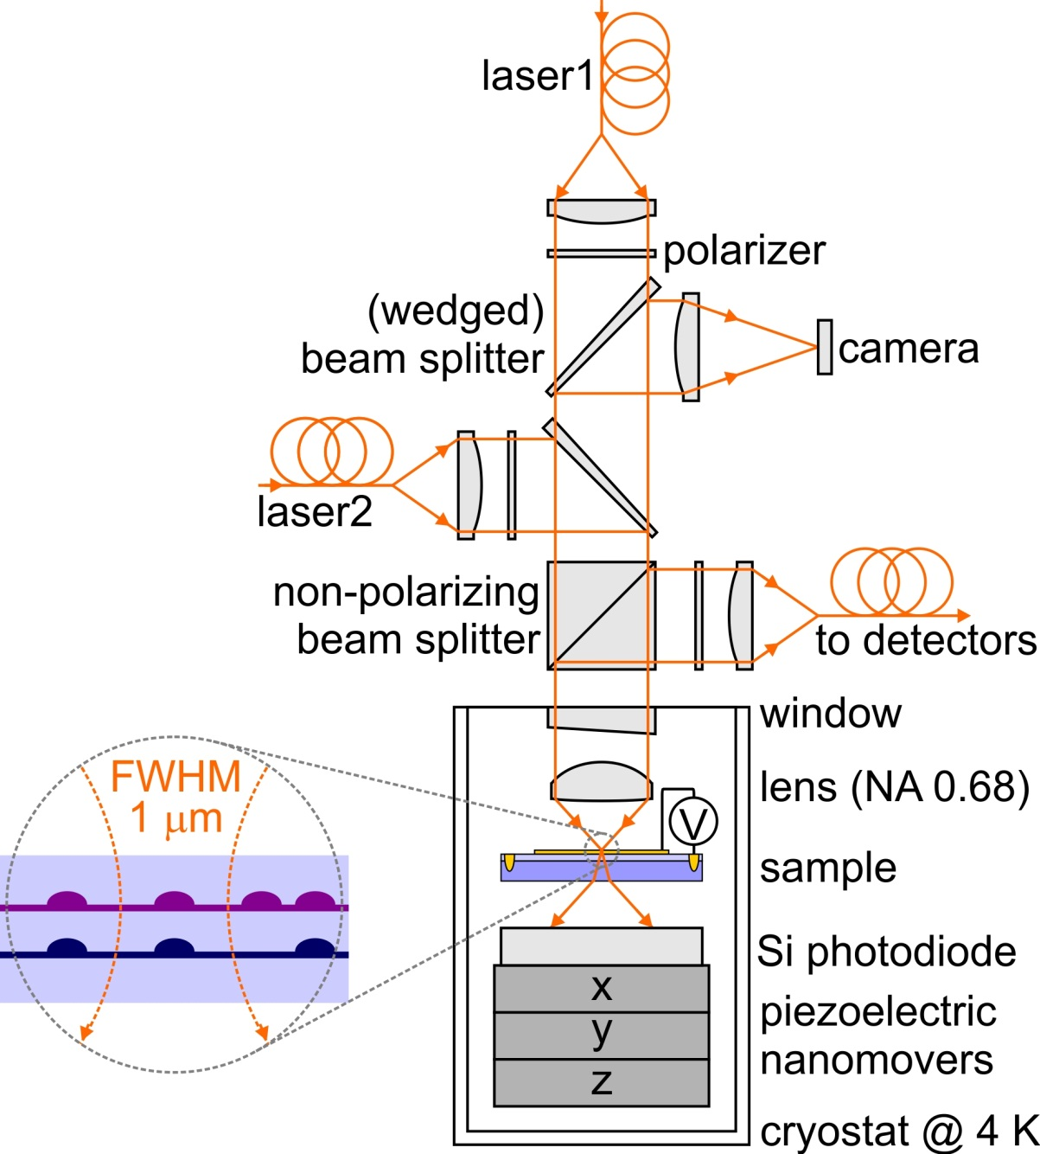
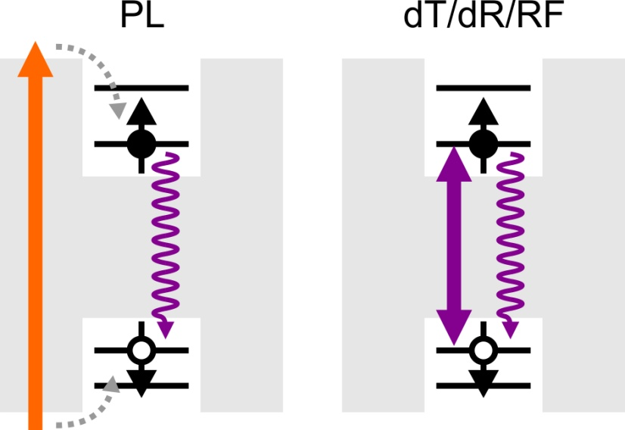
Experimental setup
Device in liquid-helium bath cryostat (4K) with B_{z} = 0 – 7 T
Confocal microscope setup
Nonresonant excitation (PL)
Resonant excitation (resonance fluorescence RF; differential transmission dT; differential reflection dR)
Notes:
% CQDEnergiesFinal
% Author : Jeroen Elzerman
% Date : 2009.07.31
% Version : 0.1
% Plots the transition energies for a set of inital and a set of final
% states in a double dot. Includes B-field dependence. Hole can sit in either blue
% or red QD.
addpath('D:\Scripts\ScriptsNew3\Functions');
clc;
close all;
%%%%%%%%%%%%%%%%%%%%%%%%%%%%%%%%%%%%%%%%%%%%%%%%%%%%%%%%%%
n = 1000; % number of points on gate voltage-axis
nE = 5000; % number of points on energy-axis
Vg1 = -580; % transition from X0 to X-1 in gate voltage [mVg]
Vg2 = -220; % transition from X-1 to X-2 in gate voltage [mVg]
Vg3 = -180; % transition from X-2 to X-3 in gate voltage [mVg]
s_id = 0.05; % indirect transition strength (compared to direct)
s_d = 0.05; % dark transition strength (compared to bright)
s_b = 0.5; % blue transition strenght (compared to red)
leverarm = 9/175; % leverarm determining detuning between two dots
Vgate = linspace(-600,600,n); % gate voltage [mV]
Ed = -Vgate*leverarm; % energy detuning [meV] between dots (Eright - Eleft, with E-right = 0)
index1 = min(find(Vgate>Vg1)); % index of Vgate-array corresponding to Vg1
index2 = min(find(Vgate>Vg2)); % index of Vgate-array corresponding to Vg2
index3 = min(find(Vgate>Vg3)); % index of Vgate-array corresponding to Vg3
B = linspace(0,4,n)'; % B-field [T]
%Ze1 = 0.6*B*0.5*56.8E-3; % half the Zeeman splitting [meV] for the electron (g-factor ~ 0.6)
%Zh2 = 1.3*B*0.5*56.8E-3; % half the Zeeman splitting [meV] for the hole (g-factor ~ 1.2)
Ze1 = 0.0; % half the Zeeman splitting [meV at 1T] for an electron in dot 1
Ze2 = 0.0; % half the Zeeman splitting [meV at 1T] for an electron in dot 2
Zh1 = 0.0; % half the Zeeman splitting [meV at 1T] for a hole in dot 1
Zh2 = 0.0; % half the Zeeman splitting [meV at 1T] for a hole in dot 2
X0R = 1290; % X0R energy [meV]
X0B = 1310; % X0B energy [meV]
HWHM = 0.05; % transition energy width [meV]
E = linspace(X0R-10,X0B-15,nE); % range for plotting transition energies [meV]
%%%%%%%%%%%%%%%%%%%%%%%%%%%%%%%%%%%%%%%%%%%%%%%%%%%%%%%%%%
th_1h = 0.1; % 1h
te_1e = 0.5; % 1e
Ed1_1e = 0; % 1e
ER_1e = 0; % 1e
EB_1e = 0; % 1e
VRR_ee = 20; % 2e
VBB_ee = 22; % 2e
VBR_ee = 10; % 2e
J_ee = 0.0; % 2e (= VBRBR)
VBBBR_ee = 0; % 2e
t_ee = sqrt(2)*(te_1e+VBBBR_ee);% 2e
Ed1_ee = VBB_ee - VBR_ee; % 2e
Ed2_ee = -VRR_ee + VBR_ee; % 2e
ER_ee = VBR_ee; % 2e
te_3e = te_1e; % 3e
Ed1_3e = VBB_ee - VRR_ee; % 3e
ER_3e = VBB_ee + 2*VBR_ee; % 3e
VBRRR_eh = 0; % 1e1h
VBR_eh = 10; % 1e1h
VRR_eh = 24; % 1e1h
VBB_eh = 26; % 1e1h
d0RR = 0.2; % 1e1h
d0BB = 0.2; % 1e1h
d0BR = d0RR/1000; % 1e1h
d1RR = 0.01; % 1e1h
d1BB = 0.01; % 1e1h
d1BR = d1RR/1000; % 1e1h
d2RR = 0.02; % 1e1h
d2BB = 0.02; % 1e1h
d2BR = d2RR/1000; % 1e1h
te_eh = te_1e - VBRRR_eh; % 1e1h
th_eh = th_1h - VBRRR_eh; % 1e1h
Ed1_eh = VRR_eh - VBR_eh; % 1e1h
Ed2_eh = -VBB_eh + VBR_eh; % 1e1h
ER_eh = X0R; % 1e1h
EB_eh = X0B; % 1e1h
te_2e1h = te_1e - VBBBR_ee - VBRRR_eh; % 2e1h
th_2e1h = th_1h - VBBBR_ee - VBRRR_eh; % 2e1h
Ed1_2e1h = VBB_ee - VBR_ee + VRR_eh - VBR_eh; % 2e1h
Ed2_2e1h = -VRR_ee + VBR_ee + VRR_eh - VBR_eh; % 2e1h
Ed3_2e1h = VBB_ee - VBR_ee - VBB_eh + VBR_eh; % 2e1h
Ed4_2e1h = -VRR_ee + VBR_ee - VBB_eh + VBR_eh; % 2e1h
ER_2e1h = X0R + EB_1e; % 2e1h
XmR = X0R + VRR_ee - VRR_eh; % 2e1h
XmB = X0B + VBB_ee - VBB_eh; % 2e1h
EB_2e1h = XmB + ER_1e; % 2e1h
te_3e1h = te_eh; % 3e1h
th_3e1h = th_eh; % 3e1h
Ed1_3e1h = VBB_ee - VRR_ee + VRR_eh - VBR_eh; % 3e1h
Ed2_3e1h = VBB_ee - VRR_ee - VBB_eh + VBR_eh; % 3e1h
ER_3e1h = XmR + ER_ee; % 3e1h VRR_ee-VRR_eh
EB_3e1h = XmB + ER_ee; % 3e1h VBB_ee-VBB_eh
th_4e1h = th_1h; % 4e1h
Ed1_4e1h = VBB_eh - VRR_eh - X0B + X0R; % 4e1h
ER_4e1h = XmR + ER_3e; % 4e1h
EB_4e1h = XmB + ER_3e; % 4e1h
% 0 %%%%%%%%%%%%%%%%%%%%%%%%%%%%%%%%%%%%%%%%%%%%%%%%%%%%%%%%%
E_0 = zeros(n,1);
Vec_0 = mat2cell(ones(1,n),1,linspace(1,1,n));
figure;
plot(Vgate,E_0,'b'); title('0','Fontsize',24);xlabel('Gate voltage (mV)','Fontsize',24);ylabel('Energy (meV)','Fontsize',24);set(gca,'Fontsize',18);
ylim([-15 15]);pbaspect([1.4 1 1]);
% 1e %%%%%%%%%%%%%%%%%%%%%%%%%%%%%%%%%%%%%%%%%%%%%%%%%%%%%%%%%
E_1e = cell(1,n);
Vec_1e = cell(1,n);
for i = 1:n
[E_temp,Vec_temp] = SolveH_1e(te_1e,Ze1,Ze2,ER_1e,Ed1_1e,Ed(i));
E_1e{i} = E_temp;
Vec_1e{i} = Vec_temp; % eigenvectors are columns in each cell (for calculating "gate sweeps" later)
end
E_1e = cell2mat(E_1e)';
figure;
plot(Vgate,E_1e,'b'); title('1e','Fontsize',24);xlabel('Gate voltage (mV)','Fontsize',24);ylabel('Energy (meV)','Fontsize',24);set(gca,'Fontsize',18);
ylim([ER_1e-15 ER_1e+15]);pbaspect([1.4 1 1]);
% 2e %%%%%%%%%%%%%%%%%%%%%%%%%%%%%%%%%%%%%%%%%%%%%%%%%%%%%%%%%
E_2e = cell(1,n);
Vec_2e = cell(1,n);
for i = 1:n
[E_temp,Vec_temp] = SolveH_2e(J_ee,t_ee,Ze1,Ze2,ER_ee,Ed1_ee,Ed2_ee,Ed(i));
E_2e{i} = E_temp;
Vec_2e{i} = Vec_temp; % eigenvectors are columns in each cell (for calculating "gate sweeps" later)
end
E_2e = cell2mat(E_2e)';
figure;
plot(Vgate,E_2e,'b'); title('2e','Fontsize',24);xlabel('Gate voltage (mV)','Fontsize',24);ylabel('Energy (meV)','Fontsize',24);set(gca,'Fontsize',18);
ylim([ER_ee-15 ER_ee+15]);pbaspect([1.4 1 1]);
% 3e %%%%%%%%%%%%%%%%%%%%%%%%%%%%%%%%%%%%%%%%%%%%%%%%%%%%%%%%%
E_3e = cell(1,n);
Vec_3e = cell(1,n);
for i = 1:n
[E_temp,Vec_temp] = SolveH_3e(te_3e,Ze1,Ze2,ER_3e,Ed1_3e,Ed(i));
E_3e{i} = E_temp;
Vec_3e{i} = Vec_temp; % eigenvectors are columns in each cell (for calculating "gate sweeps" later)
end
E_3e = cell2mat(E_3e)';
figure;
plot(Vgate,E_3e,'b'); title('3e','Fontsize',24);xlabel('Gate voltage (mV)','Fontsize',24);ylabel('Energy (meV)','Fontsize',24);set(gca,'Fontsize',18);
ylim([ER_3e-15 ER_3e+15]);pbaspect([1.4 1 1]);
% 1e1h %%%%%%%%%%%%%%%%%%%%%%%%%%%%%%%%%%%%%%%%%%%%%%%%%%%%%%%%
E_eh = cell(1,n);
Vec_eh = cell(1,n);
for i = 1:n
[E_temp,Vec_temp] = SolveH_1e1h(d0RR,d0BB,d0BR,d1RR,d1BB,d1BR,d2RR,d2BB,d2BR,te_eh,th_eh,Ze1,Ze2,Zh1,Zh2,ER_eh,EB_eh,Ed1_eh,Ed2_eh,Ed(i));
E_eh{i} = E_temp;
Vec_eh{i} = Vec_temp; % eigenvectors are columns in each cell (for calculating "gate sweeps" later)
end
E_eh = cell2mat(E_eh)';
figure;
plot(Vgate,E_eh,'b'); title('1e1h','Fontsize',24);xlabel('Gate voltage (mV)','Fontsize',24);ylabel('Energy (meV)','Fontsize',24);set(gca,'Fontsize',18);
ylim([ER_eh-5 ER_eh+25]);pbaspect([1.4 1 1]);
% 2e1h %%%%%%%%%%%%%%%%%%%%%%%%%%%%%%%%%%%%%%%%%%%%%%%%%%%%%%%%%
E_2e1h = cell(1,n);
Vec_2e1h = cell(1,n);
for i = 1:n
[E_temp,Vec_temp] = SolveH_2e1h(J_ee,te_2e1h,th_2e1h,d0RR,d0BB,d1RR,d1BB,d2RR,d2BB,Ze1,Ze2,Zh1,Zh2,ER_2e1h,EB_2e1h,Ed1_2e1h,Ed2_2e1h,Ed3_2e1h,Ed4_2e1h,Ed(i));
E_2e1h{i} = E_temp;
Vec_2e1h{i} = Vec_temp; % eigenvectors are columns in each cell (for calculating "gate sweeps" later)
end
E_2e1h = cell2mat(E_2e1h)';
figure;
plot(Vgate,E_2e1h,'b'); title('2e1h','Fontsize',24);xlabel('Gate voltage (mV)','Fontsize',24);ylabel('Energy (meV)','Fontsize',24);set(gca,'Fontsize',18);
ylim([ER_2e1h-10 ER_2e1h+20]);pbaspect([1.4 1 1]);
% 3e1h %%%%%%%%%%%%%%%%%%%%%%%%%%%%%%%%%%%%%%%%%%%%%%%%%%%%%%%%%
E_3e1h = cell(1,n);
Vec_3e1h = cell(1,n);
for i = 1:n
[E_temp,Vec_temp] = SolveH_3e1h(d0RR,d0BB,d0BR,d1RR,d1BB,d1BR,d2RR,d2BB,d2BR,te_3e1h,th_3e1h,Ze1,Ze2,Zh1,Zh2,ER_3e1h,EB_3e1h,Ed1_3e1h,Ed2_3e1h,Ed(i));
E_3e1h{i} = E_temp;
Vec_3e1h{i} = Vec_temp; % eigenvectors are columns in each cell (for calculating "gate sweeps" later)
end
E_3e1h = cell2mat(E_3e1h)';
figure;
plot(Vgate,E_3e1h,'b'); title('3e1h','Fontsize',24);xlabel('Gate voltage (mV)','Fontsize',24);ylabel('Energy (meV)','Fontsize',24);set(gca,'Fontsize',18);
ylim([ER_3e1h-5 ER_3e1h+25]);pbaspect([1.4 1 1]);
% 4e1h %%%%%%%%%%%%%%%%%%%%%%%%%%%%%%%%%%%%%%%%%%%%%%%%%%%%%%%%%
E_4e1h = cell(1,n);
Vec_4e1h = cell(1,n);
for i = 1:n
[E_temp,Vec_temp] = SolveH_4e1h(th_4e1h,Zh1,Zh2,ER_4e1h,Ed1_4e1h,Ed(i));
E_4e1h{i} = E_temp;
Vec_4e1h{i} = Vec_temp; % eigenvectors are columns in each cell (for calculating "gate sweeps" later)
end
E_4e1h = cell2mat(E_4e1h)';
figure;
plot(Vgate,E_4e1h,'b'); title('4e1h','Fontsize',24);xlabel('Gate voltage (mV)','Fontsize',24);ylabel('Energy (meV)','Fontsize',24);set(gca,'Fontsize',18);
ylim([ER_4e1h-20 ER_4e1h+10]);pbaspect([1.4 1 1]);
% 1e1h - 0 %%%%%%%%%%%%%%%%%%%%%%%%%%%%%%%%%%%%%%%%%%%%%%%%%%%%%%%%%
M_eh = [s_id 1 s_id 1 s_id*s_d s_d s_id*s_d s_d s_id*s_b s_b s_id*s_b s_b s_id*s_d*s_b s_d*s_b s_id*s_d*s_b s_d*s_b];
E_0 = TransitionEnergy(E_eh,zeros(n,1));
matrix0 = TransitionStrength(E_0,Vec_eh,Vec_0,M_eh,E,HWHM);
figure;plot(Vgate,E_0,'b'); title('X0','Fontsize',24);xlabel('Gate voltage (mV)','Fontsize',24);ylabel('Energy (meV)','Fontsize',24);set(gca,'Fontsize',18);
ylim([X0R-10 X0B+5]);pbaspect([1.4 1 1]);
PlotMatrix(matrix0,Vgate,E(1,:),'Gate voltage (mV)','Transition energy (meV)','X0',[-3E10 3E10]);pbaspect([1.4 1 1]);
PlotMatrix(log(abs(matrix0)),Vgate,E(1,:),'Gate voltage (mV)','Transition energy (meV)','X0',[-3E10 3E10]);pbaspect([1.4 1 1]);
% 2e1h - 1e %%%%%%%%%%%%%%%%%%%%%%%%%%%%%%%%%%%%%%%%%%%%%%%%%%%%%%%%%
M_2e1h = [ s_id 0 1 0 s_d 0 s_d*s_id 0 s_d 0 1 0 s_b 0 s_id*s_b 0 s_d*s_id 0 s_b*s_d 0 s_b*s_d*s_id 0 s_b*s_id 0;
0 1 0 s_id s_d*s_id 0 0 s_d 0 s_d*s_id s_id 0 s_b*0 s_b*s_id 0 s_b s_b*s_d 0 0 s_b*s_d*s_id 0 s_b*s_d s_b 0;
s_d*s_id 0 0 s_d 0 1 s_id 0 0 1 0 s_d s_b*s_d 0 0 s_b*s_d*s_id 0 s_b*s_id s_b 0 0 s_b*s_id 0 s_b*s_d*s_id;
0 s_d s_d*s_id 0 0 s_id 0 1 s_id 0 0 s_d*s_id 0 s_b*s_d*s_id s_b*s_d 0 0 s_b 0 s_b*s_id s_b 0 0 s_b*s_d ];
E_1 = TransitionEnergy(E_2e1h,E_1e);
matrix1 = TransitionStrength(E_1,Vec_2e1h,Vec_1e,M_2e1h,E,HWHM);
figure;
plot(Vgate,E_1,'b'); title('X1-','Fontsize',24);xlabel('Gate voltage (mV)','Fontsize',24);ylabel('Energy (meV)','Fontsize',24);set(gca,'Fontsize',18);
ylim([X0R-10 X0B+5]);pbaspect([1.4 1 1]);
PlotMatrix(matrix1,Vgate,E(1,:),'Gate voltage (mV)','Transition energy (meV)','X1-',[-3E10 3E10]);pbaspect([1.4 1 1]);
PlotMatrix(log(abs(matrix1)),Vgate,E(1,:),'Gate voltage (mV)','Transition energy (meV)','X1-',[-3E10 3E10]);pbaspect([1.4 1 1]);
% 3e1h - 2e %%%%%%%%%%%%%%%%%%%%%%%%%%%%%%%%%%%%%%%%%%%%%%%%%%%%%%%%%
M_3e1h = ones(6,16);
M_3e1h = [ 0 1 0 1 0 s_d 0 s_d s_b*s_id 0 s_b*s_id 0 s_b*s_d*s_id 0 s_b*s_d*s_id 0;
s_id 0 s_id 0 s_d*s_id 0 s_d*s_id 0 0 s_b 0 s_b 0 s_b*s_d 0 s_b*s_d;
0 s_id 1 0 s_d 0 0 s_d*s_id s_b 0 s_b*s_d s_b*s_id 0 s_b*s_d*s_id s_b*s_d 0;
1 0 0 s_id 0 s_d*s_id s_d 0 0 s_b*s_id s_b 0 s_b*s_d 0 0 s_b*s_d*s_id;
0 0 s_d s_d*s_id 1 s_id 0 0 0 0 s_b*s_d s_b*s_d*s_id s_b s_b*s_id 0 0;
s_d s_d*s_id 0 0 0 0 1 s_id s_b*s_d s_b*s_d*s_id 0 0 0 0 s_b s_b*s_id];
E_2 = TransitionEnergy(E_3e1h,E_2e);
matrix2 = TransitionStrength(E_2,Vec_3e1h,Vec_2e,M_3e1h,E,HWHM);
figure;
plot(Vgate,E_2,'b'); title('X2-','Fontsize',24);xlabel('Gate voltage (mV)','Fontsize',24);ylabel('Energy (meV)','Fontsize',24);set(gca,'Fontsize',18);
ylim([X0R-10 X0B+5]);pbaspect([1.4 1 1]);
PlotMatrix(matrix2,Vgate,E(1,:),'Gate voltage (mV)','Transition energy (meV)','X2-',[-3E10 3E10]);pbaspect([1.4 1 1]);
PlotMatrix(log(abs(matrix2)),Vgate,E(1,:),'Gate voltage (mV)','Transition energy (meV)','X2-',[-3E10 3E10]);pbaspect([1.4 1 1]);
% 4e1h - 3e %%%%%%%%%%%%%%%%%%%%%%%%%%%%%%%%%%%%%%%%%%%%%%%%%%%%%%%%%
M_4e1h = ones(4,4);
M_4e1h = [ s_b s_id s_b*s_d s_d*s_id;
s_b*s_id 1 s_b*s_d*s_id s_d;
s_b*s_d s_d*s_id s_b s_id;
s_b*s_d*s_id s_d s_b*s_id 1];
E_3 = TransitionEnergy(E_4e1h,E_3e);
matrix3 = TransitionStrength(E_3,Vec_4e1h,Vec_3e,M_4e1h,E,HWHM);
figure;
plot(Vgate,E_3,'b'); title('X3-','Fontsize',24);xlabel('Gate voltage (mV)','Fontsize',24);ylabel('Energy (meV)','Fontsize',24);set(gca,'Fontsize',18);
ylim([X0R-10 X0B+5]);pbaspect([1.4 1 1]);
PlotMatrix(matrix3,Vgate,E(1,:),'Gate voltage (mV)','Transition energy (meV)','X3-',[-3E10 3E10]);pbaspect([1.4 1 1]);
PlotMatrix(log(abs(matrix3)),Vgate,E(1,:),'Gate voltage (mV)','Transition energy (meV)','X3-',[-3E10 3E10]);pbaspect([1.4 1 1]);
% combined %%%%%%%%%%%%%%%%%%%%%%%%%%%%%%%%%%%%%%%%%%%%%%%%%%%%%%%%%
figure; title(['All transitions: Vg1 = ',num2str(Vg1),' mV; Vg2 = ',num2str(Vg2),' mV'],'Fontsize',24);
hold on;
plot(Vgate(1:index1),E_0(1:index1,:),'b');
plot(Vgate(index1+1:index2),E_1(index1+1:index2,:),'b');
plot(Vgate(index2+1:index3),E_2(index2+1:index3,:),'b');
plot(Vgate(index3+1:n),E_3(index3+1:n,:),'b');
ylim([X0R-10 X0B+5]);pbaspect([1.4 1 1]);
xlabel('Gate voltage (mV)','Fontsize',24);ylabel('Energy (meV)','Fontsize',24);set(gca,'Fontsize',18);
hold off;
matrix = [matrix0(1:index1,:);matrix1(index1+1:index2,:);matrix2(index2+1:index3,:);matrix3(index3+1:n,:)];
PlotMatrix(matrix,Vgate,E(1,:),'Gate voltage (mV)','Transition energy (meV)',['All transitions: Vg1 = ',num2str(Vg1),' mV; Vg2 = ',num2str(Vg2),' mV'],[-3E10 3E10]);pbaspect([1.4 1 1]);
PlotMatrix(log(abs(matrix)),Vgate,E(1,:),'Gate voltage (mV)','Transition energy (meV)',['All transitions: Vg1 = ',num2str(Vg1),' mV; Vg2 = ',num2str(Vg2),' mV'],[-3E10 3E10]);pbaspect([1.4 1 1]);
matrix = (matrix0+matrix1+matrix2+matrix3)/4;
PlotMatrix(matrix,Vgate,E(1,:),'Gate voltage (mV)','Transition energy (meV)','All transitions together:',[-3E10 3E10]);pbaspect([1.4 1 1]);
PlotMatrix(log(abs(matrix)),Vgate,E(1,:),'Gate voltage (mV)','Transition energy (meV)','All transitions together:',[-3E10 3E10]);pbaspect([1.4 1 1]);
% SAVE %%%%%%%%%%%%%%%%%%%%%%%%%%%%%%%%%%%%%%%%%%%%%%%%%%%%%%%%
% eval(['save ', 'D:\Temp\temp.dat', ' PLE -ascii']);

Slide 16
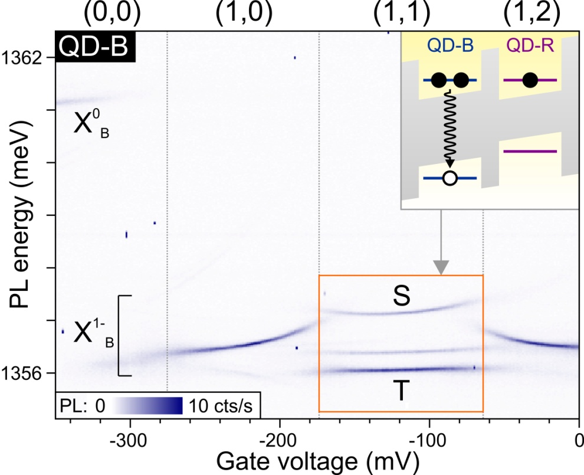
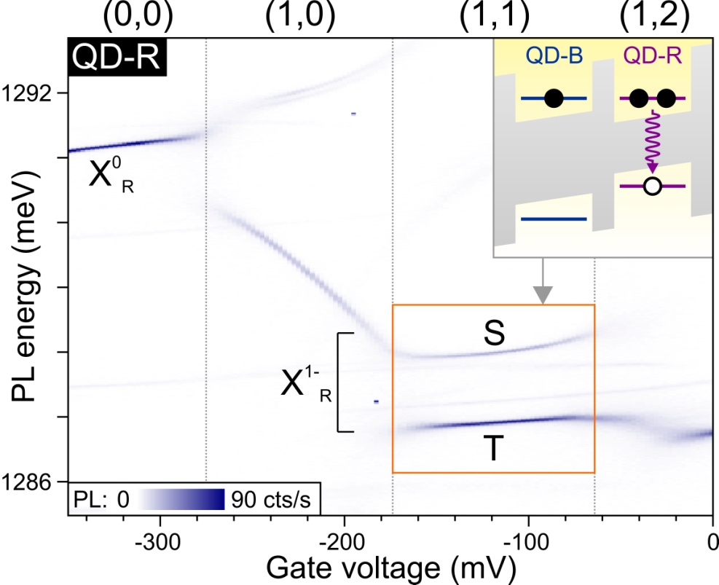
Identifying (1,1) charging regime using PL
PL versus gate voltage shows characteristic plateaus
Shape of plateau influenced by electrons in partner QD
Charging sequence:
(0,0) > (1,0) > (1,1) > (1,2)
(1,1)S shows typical curvature and 3 times lower PL intensity
Very large 1.1 meV exchange splitting between S and T
Sweet spot can be reached by tuning gate voltage!

Slide 17
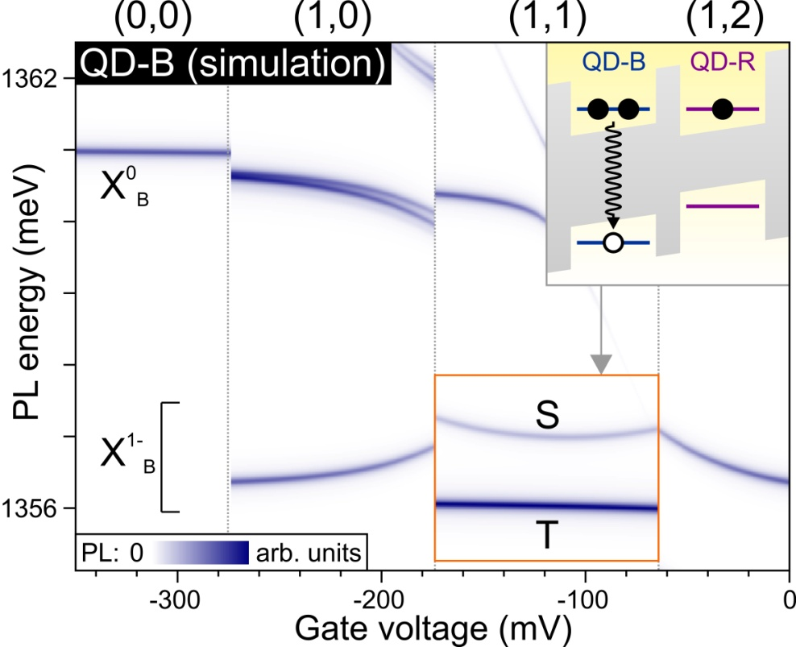
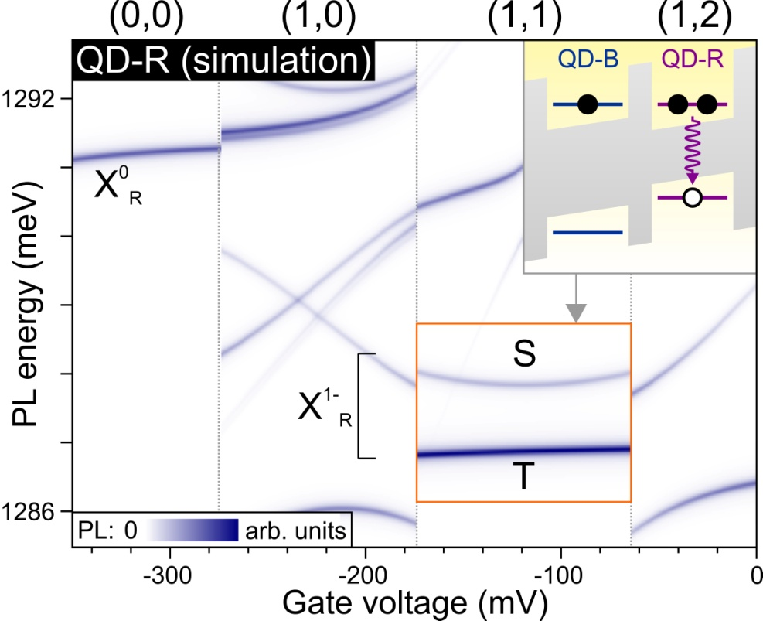
Numerical simulation of PL plateaus

Slide 18
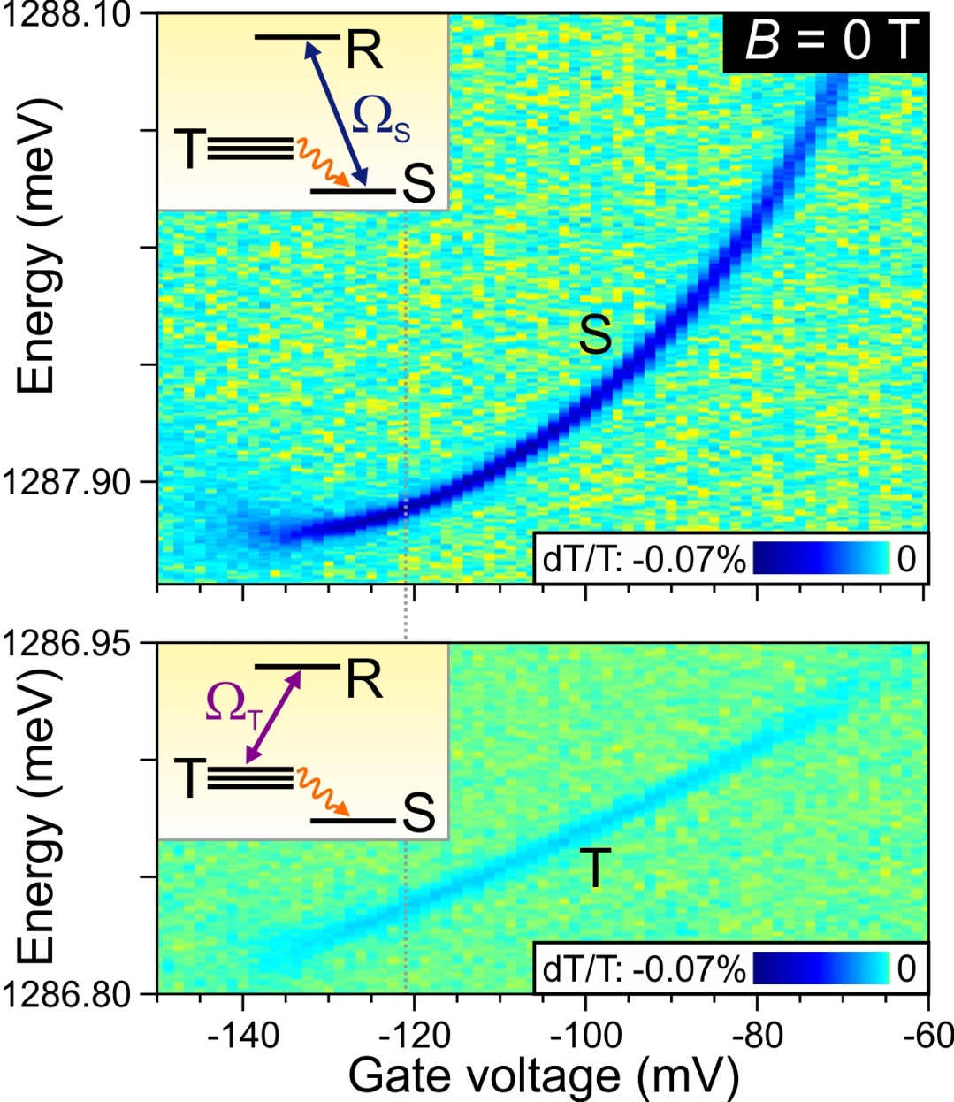
Resonant excitation with single laser
Pump with single laser on S or T resonance
Sweet spot can be reached
BUT:
no spin pumping in (1,1) regime
Indicates strong spin-flip cotunneling with back contact
CONCLUSION: sample not suitable for studying spin coherence between S & T
RESULT: laser amplification
JME, K. Weiss, J. Miguel-Sanchez & A. Imamoglu,
PRL 107, 017401 (2011)

Slide 19
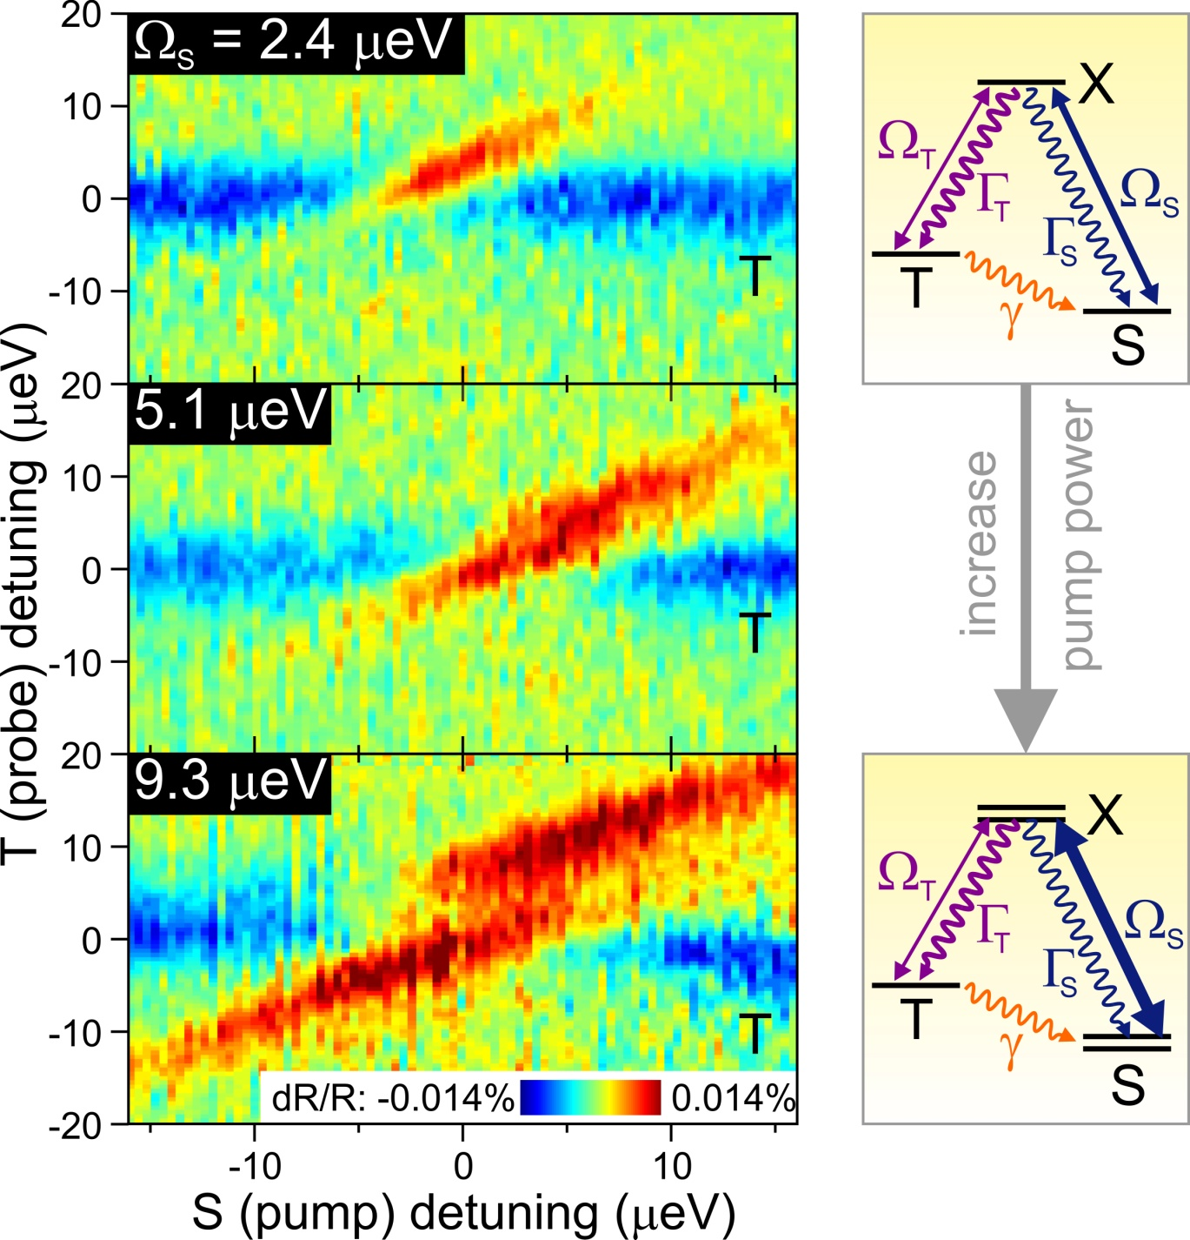
Pump S and probe T transition
Pump off-resonant: scattering reduces probe intensity (blue)
Pump on resonance: CQD increases probe (red) ⇒ optical gain!
Detuning > pump Ω_{S}: gain due to stimulated Raman process
Pump Ω_{S} > detuning: gain from dressed states (Autler-Townes splitting)
Maximum gain ~0.014%

Slide 20
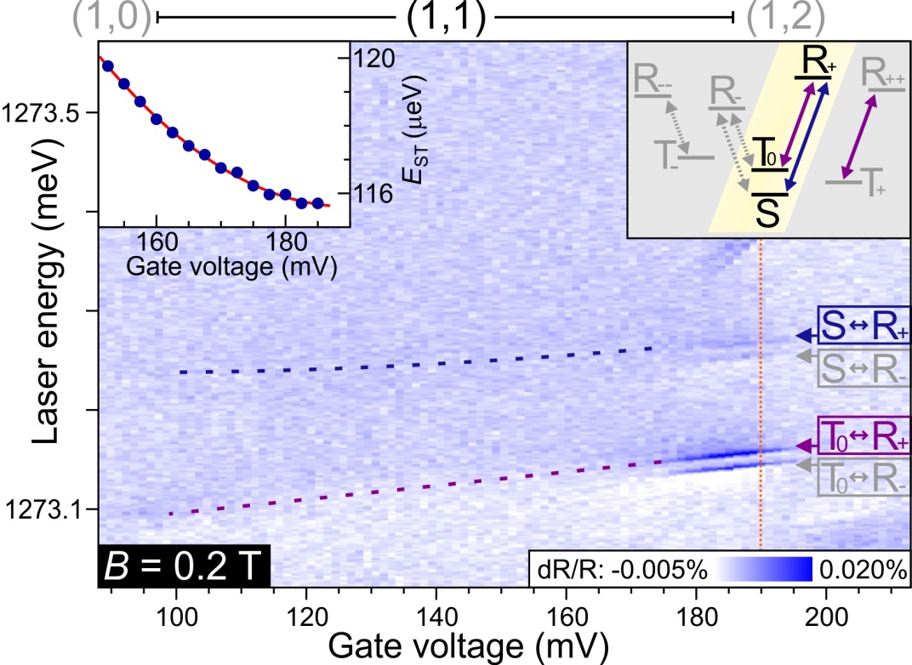
Device B shows spin pumping
B = 0.2 T ⇒ T₊ & T₋ split off from T₀
dR signal vanishes away from edge of (1,1) plateau (spin pumping)
dR signal restored by adding 2nd
“re-pump” laser on other transition
“Sweet spot”:
V₀ ~ 190 mV just outside (1,1)…
Distance to back contact was effectively (much) smaller than designed (50 nm) ⇒ spin-flip cotunneling leads to fast effective spin relaxation (~5 ns)
Grow better sample!
Notes:
% CQDEnergiesFinal
% Author : Jeroen Elzerman
% Date : 2009.07.31
% Version : 0.1
% Plots the transition energies for a set of inital and a set of final
% states in a double dot. Includes B-field dependence. Hole can sit in either blue
% or red QD.
addpath('D:\Scripts\ScriptsNew3\Functions');
clc;
close all;
%%%%%%%%%%%%%%%%%%%%%%%%%%%%%%%%%%%%%%%%%%%%%%%%%%%%%%%%%%
n = 1000; % number of points on gate voltage-axis
nE = 5000; % number of points on energy-axis
Vg1 = -580; % transition from X0 to X-1 in gate voltage [mVg]
Vg2 = -220; % transition from X-1 to X-2 in gate voltage [mVg]
Vg3 = -180; % transition from X-2 to X-3 in gate voltage [mVg]
s_id = 0.05; % indirect transition strength (compared to direct)
s_d = 0.05; % dark transition strength (compared to bright)
s_b = 0.5; % blue transition strenght (compared to red)
leverarm = 9/175; % leverarm determining detuning between two dots
Vgate = linspace(-600,600,n); % gate voltage [mV]
Ed = -Vgate*leverarm; % energy detuning [meV] between dots (Eright - Eleft, with E-right = 0)
index1 = min(find(Vgate>Vg1)); % index of Vgate-array corresponding to Vg1
index2 = min(find(Vgate>Vg2)); % index of Vgate-array corresponding to Vg2
index3 = min(find(Vgate>Vg3)); % index of Vgate-array corresponding to Vg3
B = linspace(0,4,n)'; % B-field [T]
%Ze1 = 0.6*B*0.5*56.8E-3; % half the Zeeman splitting [meV] for the electron (g-factor ~ 0.6)
%Zh2 = 1.3*B*0.5*56.8E-3; % half the Zeeman splitting [meV] for the hole (g-factor ~ 1.2)
Ze1 = 0.0; % half the Zeeman splitting [meV at 1T] for an electron in dot 1
Ze2 = 0.0; % half the Zeeman splitting [meV at 1T] for an electron in dot 2
Zh1 = 0.0; % half the Zeeman splitting [meV at 1T] for a hole in dot 1
Zh2 = 0.0; % half the Zeeman splitting [meV at 1T] for a hole in dot 2
X0R = 1290; % X0R energy [meV]
X0B = 1310; % X0B energy [meV]
HWHM = 0.05; % transition energy width [meV]
E = linspace(X0R-10,X0B-15,nE); % range for plotting transition energies [meV]
%%%%%%%%%%%%%%%%%%%%%%%%%%%%%%%%%%%%%%%%%%%%%%%%%%%%%%%%%%
th_1h = 0.1; % 1h
te_1e = 0.5; % 1e
Ed1_1e = 0; % 1e
ER_1e = 0; % 1e
EB_1e = 0; % 1e
VRR_ee = 20; % 2e
VBB_ee = 22; % 2e
VBR_ee = 10; % 2e
J_ee = 0.0; % 2e (= VBRBR)
VBBBR_ee = 0; % 2e
t_ee = sqrt(2)*(te_1e+VBBBR_ee);% 2e
Ed1_ee = VBB_ee - VBR_ee; % 2e
Ed2_ee = -VRR_ee + VBR_ee; % 2e
ER_ee = VBR_ee; % 2e
te_3e = te_1e; % 3e
Ed1_3e = VBB_ee - VRR_ee; % 3e
ER_3e = VBB_ee + 2*VBR_ee; % 3e
VBRRR_eh = 0; % 1e1h
VBR_eh = 10; % 1e1h
VRR_eh = 24; % 1e1h
VBB_eh = 26; % 1e1h
d0RR = 0.2; % 1e1h
d0BB = 0.2; % 1e1h
d0BR = d0RR/1000; % 1e1h
d1RR = 0.01; % 1e1h
d1BB = 0.01; % 1e1h
d1BR = d1RR/1000; % 1e1h
d2RR = 0.02; % 1e1h
d2BB = 0.02; % 1e1h
d2BR = d2RR/1000; % 1e1h
te_eh = te_1e - VBRRR_eh; % 1e1h
th_eh = th_1h - VBRRR_eh; % 1e1h
Ed1_eh = VRR_eh - VBR_eh; % 1e1h
Ed2_eh = -VBB_eh + VBR_eh; % 1e1h
ER_eh = X0R; % 1e1h
EB_eh = X0B; % 1e1h
te_2e1h = te_1e - VBBBR_ee - VBRRR_eh; % 2e1h
th_2e1h = th_1h - VBBBR_ee - VBRRR_eh; % 2e1h
Ed1_2e1h = VBB_ee - VBR_ee + VRR_eh - VBR_eh; % 2e1h
Ed2_2e1h = -VRR_ee + VBR_ee + VRR_eh - VBR_eh; % 2e1h
Ed3_2e1h = VBB_ee - VBR_ee - VBB_eh + VBR_eh; % 2e1h
Ed4_2e1h = -VRR_ee + VBR_ee - VBB_eh + VBR_eh; % 2e1h
ER_2e1h = X0R + EB_1e; % 2e1h
XmR = X0R + VRR_ee - VRR_eh; % 2e1h
XmB = X0B + VBB_ee - VBB_eh; % 2e1h
EB_2e1h = XmB + ER_1e; % 2e1h
te_3e1h = te_eh; % 3e1h
th_3e1h = th_eh; % 3e1h
Ed1_3e1h = VBB_ee - VRR_ee + VRR_eh - VBR_eh; % 3e1h
Ed2_3e1h = VBB_ee - VRR_ee - VBB_eh + VBR_eh; % 3e1h
ER_3e1h = XmR + ER_ee; % 3e1h VRR_ee-VRR_eh
EB_3e1h = XmB + ER_ee; % 3e1h VBB_ee-VBB_eh
th_4e1h = th_1h; % 4e1h
Ed1_4e1h = VBB_eh - VRR_eh - X0B + X0R; % 4e1h
ER_4e1h = XmR + ER_3e; % 4e1h
EB_4e1h = XmB + ER_3e; % 4e1h
% 0 %%%%%%%%%%%%%%%%%%%%%%%%%%%%%%%%%%%%%%%%%%%%%%%%%%%%%%%%%
E_0 = zeros(n,1);
Vec_0 = mat2cell(ones(1,n),1,linspace(1,1,n));
figure;
plot(Vgate,E_0,'b'); title('0','Fontsize',24);xlabel('Gate voltage (mV)','Fontsize',24);ylabel('Energy (meV)','Fontsize',24);set(gca,'Fontsize',18);
ylim([-15 15]);pbaspect([1.4 1 1]);
% 1e %%%%%%%%%%%%%%%%%%%%%%%%%%%%%%%%%%%%%%%%%%%%%%%%%%%%%%%%%
E_1e = cell(1,n);
Vec_1e = cell(1,n);
for i = 1:n
[E_temp,Vec_temp] = SolveH_1e(te_1e,Ze1,Ze2,ER_1e,Ed1_1e,Ed(i));
E_1e{i} = E_temp;
Vec_1e{i} = Vec_temp; % eigenvectors are columns in each cell (for calculating "gate sweeps" later)
end
E_1e = cell2mat(E_1e)';
figure;
plot(Vgate,E_1e,'b'); title('1e','Fontsize',24);xlabel('Gate voltage (mV)','Fontsize',24);ylabel('Energy (meV)','Fontsize',24);set(gca,'Fontsize',18);
ylim([ER_1e-15 ER_1e+15]);pbaspect([1.4 1 1]);
% 2e %%%%%%%%%%%%%%%%%%%%%%%%%%%%%%%%%%%%%%%%%%%%%%%%%%%%%%%%%
E_2e = cell(1,n);
Vec_2e = cell(1,n);
for i = 1:n
[E_temp,Vec_temp] = SolveH_2e(J_ee,t_ee,Ze1,Ze2,ER_ee,Ed1_ee,Ed2_ee,Ed(i));
E_2e{i} = E_temp;
Vec_2e{i} = Vec_temp; % eigenvectors are columns in each cell (for calculating "gate sweeps" later)
end
E_2e = cell2mat(E_2e)';
figure;
plot(Vgate,E_2e,'b'); title('2e','Fontsize',24);xlabel('Gate voltage (mV)','Fontsize',24);ylabel('Energy (meV)','Fontsize',24);set(gca,'Fontsize',18);
ylim([ER_ee-15 ER_ee+15]);pbaspect([1.4 1 1]);
% 3e %%%%%%%%%%%%%%%%%%%%%%%%%%%%%%%%%%%%%%%%%%%%%%%%%%%%%%%%%
E_3e = cell(1,n);
Vec_3e = cell(1,n);
for i = 1:n
[E_temp,Vec_temp] = SolveH_3e(te_3e,Ze1,Ze2,ER_3e,Ed1_3e,Ed(i));
E_3e{i} = E_temp;
Vec_3e{i} = Vec_temp; % eigenvectors are columns in each cell (for calculating "gate sweeps" later)
end
E_3e = cell2mat(E_3e)';
figure;
plot(Vgate,E_3e,'b'); title('3e','Fontsize',24);xlabel('Gate voltage (mV)','Fontsize',24);ylabel('Energy (meV)','Fontsize',24);set(gca,'Fontsize',18);
ylim([ER_3e-15 ER_3e+15]);pbaspect([1.4 1 1]);
% 1e1h %%%%%%%%%%%%%%%%%%%%%%%%%%%%%%%%%%%%%%%%%%%%%%%%%%%%%%%%
E_eh = cell(1,n);
Vec_eh = cell(1,n);
for i = 1:n
[E_temp,Vec_temp] = SolveH_1e1h(d0RR,d0BB,d0BR,d1RR,d1BB,d1BR,d2RR,d2BB,d2BR,te_eh,th_eh,Ze1,Ze2,Zh1,Zh2,ER_eh,EB_eh,Ed1_eh,Ed2_eh,Ed(i));
E_eh{i} = E_temp;
Vec_eh{i} = Vec_temp; % eigenvectors are columns in each cell (for calculating "gate sweeps" later)
end
E_eh = cell2mat(E_eh)';
figure;
plot(Vgate,E_eh,'b'); title('1e1h','Fontsize',24);xlabel('Gate voltage (mV)','Fontsize',24);ylabel('Energy (meV)','Fontsize',24);set(gca,'Fontsize',18);
ylim([ER_eh-5 ER_eh+25]);pbaspect([1.4 1 1]);
% 2e1h %%%%%%%%%%%%%%%%%%%%%%%%%%%%%%%%%%%%%%%%%%%%%%%%%%%%%%%%%
E_2e1h = cell(1,n);
Vec_2e1h = cell(1,n);
for i = 1:n
[E_temp,Vec_temp] = SolveH_2e1h(J_ee,te_2e1h,th_2e1h,d0RR,d0BB,d1RR,d1BB,d2RR,d2BB,Ze1,Ze2,Zh1,Zh2,ER_2e1h,EB_2e1h,Ed1_2e1h,Ed2_2e1h,Ed3_2e1h,Ed4_2e1h,Ed(i));
E_2e1h{i} = E_temp;
Vec_2e1h{i} = Vec_temp; % eigenvectors are columns in each cell (for calculating "gate sweeps" later)
end
E_2e1h = cell2mat(E_2e1h)';
figure;
plot(Vgate,E_2e1h,'b'); title('2e1h','Fontsize',24);xlabel('Gate voltage (mV)','Fontsize',24);ylabel('Energy (meV)','Fontsize',24);set(gca,'Fontsize',18);
ylim([ER_2e1h-10 ER_2e1h+20]);pbaspect([1.4 1 1]);
% 3e1h %%%%%%%%%%%%%%%%%%%%%%%%%%%%%%%%%%%%%%%%%%%%%%%%%%%%%%%%%
E_3e1h = cell(1,n);
Vec_3e1h = cell(1,n);
for i = 1:n
[E_temp,Vec_temp] = SolveH_3e1h(d0RR,d0BB,d0BR,d1RR,d1BB,d1BR,d2RR,d2BB,d2BR,te_3e1h,th_3e1h,Ze1,Ze2,Zh1,Zh2,ER_3e1h,EB_3e1h,Ed1_3e1h,Ed2_3e1h,Ed(i));
E_3e1h{i} = E_temp;
Vec_3e1h{i} = Vec_temp; % eigenvectors are columns in each cell (for calculating "gate sweeps" later)
end
E_3e1h = cell2mat(E_3e1h)';
figure;
plot(Vgate,E_3e1h,'b'); title('3e1h','Fontsize',24);xlabel('Gate voltage (mV)','Fontsize',24);ylabel('Energy (meV)','Fontsize',24);set(gca,'Fontsize',18);
ylim([ER_3e1h-5 ER_3e1h+25]);pbaspect([1.4 1 1]);
% 4e1h %%%%%%%%%%%%%%%%%%%%%%%%%%%%%%%%%%%%%%%%%%%%%%%%%%%%%%%%%
E_4e1h = cell(1,n);
Vec_4e1h = cell(1,n);
for i = 1:n
[E_temp,Vec_temp] = SolveH_4e1h(th_4e1h,Zh1,Zh2,ER_4e1h,Ed1_4e1h,Ed(i));
E_4e1h{i} = E_temp;
Vec_4e1h{i} = Vec_temp; % eigenvectors are columns in each cell (for calculating "gate sweeps" later)
end
E_4e1h = cell2mat(E_4e1h)';
figure;
plot(Vgate,E_4e1h,'b'); title('4e1h','Fontsize',24);xlabel('Gate voltage (mV)','Fontsize',24);ylabel('Energy (meV)','Fontsize',24);set(gca,'Fontsize',18);
ylim([ER_4e1h-20 ER_4e1h+10]);pbaspect([1.4 1 1]);
% 1e1h - 0 %%%%%%%%%%%%%%%%%%%%%%%%%%%%%%%%%%%%%%%%%%%%%%%%%%%%%%%%%
M_eh = [s_id 1 s_id 1 s_id*s_d s_d s_id*s_d s_d s_id*s_b s_b s_id*s_b s_b s_id*s_d*s_b s_d*s_b s_id*s_d*s_b s_d*s_b];
E_0 = TransitionEnergy(E_eh,zeros(n,1));
matrix0 = TransitionStrength(E_0,Vec_eh,Vec_0,M_eh,E,HWHM);
figure;plot(Vgate,E_0,'b'); title('X0','Fontsize',24);xlabel('Gate voltage (mV)','Fontsize',24);ylabel('Energy (meV)','Fontsize',24);set(gca,'Fontsize',18);
ylim([X0R-10 X0B+5]);pbaspect([1.4 1 1]);
PlotMatrix(matrix0,Vgate,E(1,:),'Gate voltage (mV)','Transition energy (meV)','X0',[-3E10 3E10]);pbaspect([1.4 1 1]);
PlotMatrix(log(abs(matrix0)),Vgate,E(1,:),'Gate voltage (mV)','Transition energy (meV)','X0',[-3E10 3E10]);pbaspect([1.4 1 1]);
% 2e1h - 1e %%%%%%%%%%%%%%%%%%%%%%%%%%%%%%%%%%%%%%%%%%%%%%%%%%%%%%%%%
M_2e1h = [ s_id 0 1 0 s_d 0 s_d*s_id 0 s_d 0 1 0 s_b 0 s_id*s_b 0 s_d*s_id 0 s_b*s_d 0 s_b*s_d*s_id 0 s_b*s_id 0;
0 1 0 s_id s_d*s_id 0 0 s_d 0 s_d*s_id s_id 0 s_b*0 s_b*s_id 0 s_b s_b*s_d 0 0 s_b*s_d*s_id 0 s_b*s_d s_b 0;
s_d*s_id 0 0 s_d 0 1 s_id 0 0 1 0 s_d s_b*s_d 0 0 s_b*s_d*s_id 0 s_b*s_id s_b 0 0 s_b*s_id 0 s_b*s_d*s_id;
0 s_d s_d*s_id 0 0 s_id 0 1 s_id 0 0 s_d*s_id 0 s_b*s_d*s_id s_b*s_d 0 0 s_b 0 s_b*s_id s_b 0 0 s_b*s_d ];
E_1 = TransitionEnergy(E_2e1h,E_1e);
matrix1 = TransitionStrength(E_1,Vec_2e1h,Vec_1e,M_2e1h,E,HWHM);
figure;
plot(Vgate,E_1,'b'); title('X1-','Fontsize',24);xlabel('Gate voltage (mV)','Fontsize',24);ylabel('Energy (meV)','Fontsize',24);set(gca,'Fontsize',18);
ylim([X0R-10 X0B+5]);pbaspect([1.4 1 1]);
PlotMatrix(matrix1,Vgate,E(1,:),'Gate voltage (mV)','Transition energy (meV)','X1-',[-3E10 3E10]);pbaspect([1.4 1 1]);
PlotMatrix(log(abs(matrix1)),Vgate,E(1,:),'Gate voltage (mV)','Transition energy (meV)','X1-',[-3E10 3E10]);pbaspect([1.4 1 1]);
% 3e1h - 2e %%%%%%%%%%%%%%%%%%%%%%%%%%%%%%%%%%%%%%%%%%%%%%%%%%%%%%%%%
M_3e1h = ones(6,16);
M_3e1h = [ 0 1 0 1 0 s_d 0 s_d s_b*s_id 0 s_b*s_id 0 s_b*s_d*s_id 0 s_b*s_d*s_id 0;
s_id 0 s_id 0 s_d*s_id 0 s_d*s_id 0 0 s_b 0 s_b 0 s_b*s_d 0 s_b*s_d;
0 s_id 1 0 s_d 0 0 s_d*s_id s_b 0 s_b*s_d s_b*s_id 0 s_b*s_d*s_id s_b*s_d 0;
1 0 0 s_id 0 s_d*s_id s_d 0 0 s_b*s_id s_b 0 s_b*s_d 0 0 s_b*s_d*s_id;
0 0 s_d s_d*s_id 1 s_id 0 0 0 0 s_b*s_d s_b*s_d*s_id s_b s_b*s_id 0 0;
s_d s_d*s_id 0 0 0 0 1 s_id s_b*s_d s_b*s_d*s_id 0 0 0 0 s_b s_b*s_id];
E_2 = TransitionEnergy(E_3e1h,E_2e);
matrix2 = TransitionStrength(E_2,Vec_3e1h,Vec_2e,M_3e1h,E,HWHM);
figure;
plot(Vgate,E_2,'b'); title('X2-','Fontsize',24);xlabel('Gate voltage (mV)','Fontsize',24);ylabel('Energy (meV)','Fontsize',24);set(gca,'Fontsize',18);
ylim([X0R-10 X0B+5]);pbaspect([1.4 1 1]);
PlotMatrix(matrix2,Vgate,E(1,:),'Gate voltage (mV)','Transition energy (meV)','X2-',[-3E10 3E10]);pbaspect([1.4 1 1]);
PlotMatrix(log(abs(matrix2)),Vgate,E(1,:),'Gate voltage (mV)','Transition energy (meV)','X2-',[-3E10 3E10]);pbaspect([1.4 1 1]);
% 4e1h - 3e %%%%%%%%%%%%%%%%%%%%%%%%%%%%%%%%%%%%%%%%%%%%%%%%%%%%%%%%%
M_4e1h = ones(4,4);
M_4e1h = [ s_b s_id s_b*s_d s_d*s_id;
s_b*s_id 1 s_b*s_d*s_id s_d;
s_b*s_d s_d*s_id s_b s_id;
s_b*s_d*s_id s_d s_b*s_id 1];
E_3 = TransitionEnergy(E_4e1h,E_3e);
matrix3 = TransitionStrength(E_3,Vec_4e1h,Vec_3e,M_4e1h,E,HWHM);
figure;
plot(Vgate,E_3,'b'); title('X3-','Fontsize',24);xlabel('Gate voltage (mV)','Fontsize',24);ylabel('Energy (meV)','Fontsize',24);set(gca,'Fontsize',18);
ylim([X0R-10 X0B+5]);pbaspect([1.4 1 1]);
PlotMatrix(matrix3,Vgate,E(1,:),'Gate voltage (mV)','Transition energy (meV)','X3-',[-3E10 3E10]);pbaspect([1.4 1 1]);
PlotMatrix(log(abs(matrix3)),Vgate,E(1,:),'Gate voltage (mV)','Transition energy (meV)','X3-',[-3E10 3E10]);pbaspect([1.4 1 1]);
% combined %%%%%%%%%%%%%%%%%%%%%%%%%%%%%%%%%%%%%%%%%%%%%%%%%%%%%%%%%
figure; title(['All transitions: Vg1 = ',num2str(Vg1),' mV; Vg2 = ',num2str(Vg2),' mV'],'Fontsize',24);
hold on;
plot(Vgate(1:index1),E_0(1:index1,:),'b');
plot(Vgate(index1+1:index2),E_1(index1+1:index2,:),'b');
plot(Vgate(index2+1:index3),E_2(index2+1:index3,:),'b');
plot(Vgate(index3+1:n),E_3(index3+1:n,:),'b');
ylim([X0R-10 X0B+5]);pbaspect([1.4 1 1]);
xlabel('Gate voltage (mV)','Fontsize',24);ylabel('Energy (meV)','Fontsize',24);set(gca,'Fontsize',18);
hold off;
matrix = [matrix0(1:index1,:);matrix1(index1+1:index2,:);matrix2(index2+1:index3,:);matrix3(index3+1:n,:)];
PlotMatrix(matrix,Vgate,E(1,:),'Gate voltage (mV)','Transition energy (meV)',['All transitions: Vg1 = ',num2str(Vg1),' mV; Vg2 = ',num2str(Vg2),' mV'],[-3E10 3E10]);pbaspect([1.4 1 1]);
PlotMatrix(log(abs(matrix)),Vgate,E(1,:),'Gate voltage (mV)','Transition energy (meV)',['All transitions: Vg1 = ',num2str(Vg1),' mV; Vg2 = ',num2str(Vg2),' mV'],[-3E10 3E10]);pbaspect([1.4 1 1]);
matrix = (matrix0+matrix1+matrix2+matrix3)/4;
PlotMatrix(matrix,Vgate,E(1,:),'Gate voltage (mV)','Transition energy (meV)','All transitions together:',[-3E10 3E10]);pbaspect([1.4 1 1]);
PlotMatrix(log(abs(matrix)),Vgate,E(1,:),'Gate voltage (mV)','Transition energy (meV)','All transitions together:',[-3E10 3E10]);pbaspect([1.4 1 1]);
% SAVE %%%%%%%%%%%%%%%%%%%%%%%%%%%%%%%%%%%%%%%%%%%%%%%%%%%%%%%%
% eval(['save ', 'D:\Temp\temp.dat', ' PLE -ascii']);

Slide 21
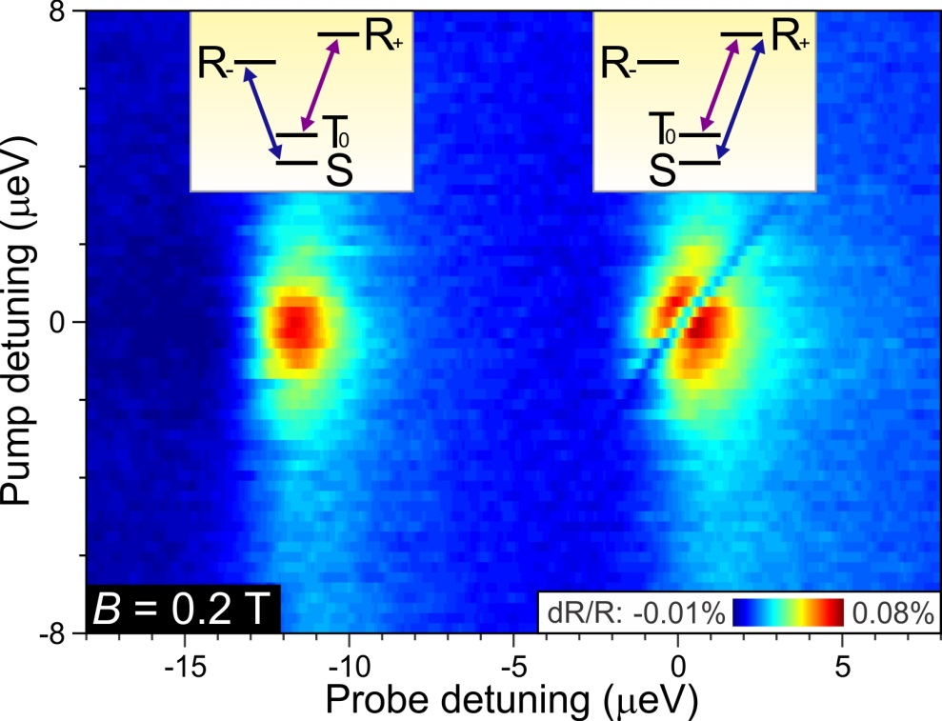
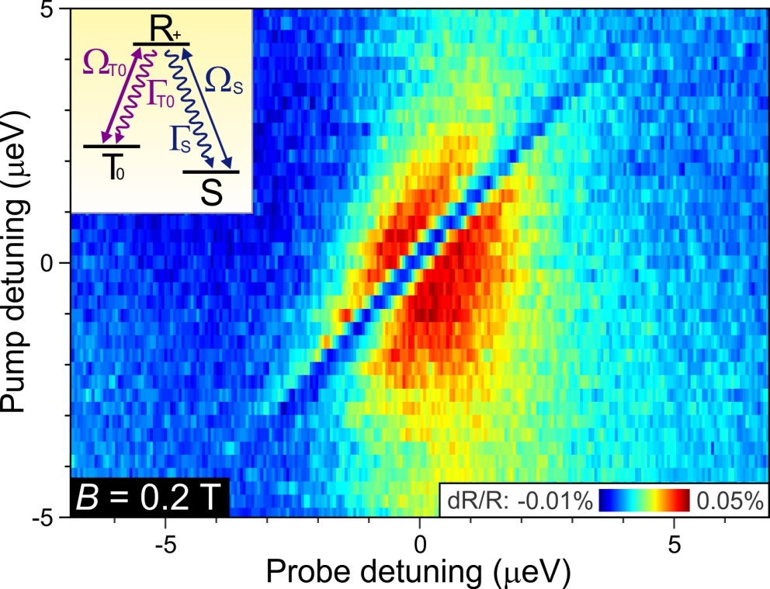
Coherent population trapping with 2 spins
Pump and probe orthogonal linear polarization ⇒ suppress reflected pump laser before detector
Pump T₀ – R+ and probe S transition
CPT dip when probe hits S – R+ due to antisymmetric superposition of S and T0
Pump T₀ – R+ and probe S – R+ transition ⇒ clear CPT-dip at 2-photon resonance
Large pump: dR signal vanishes completely, CQD fully transparent
Weaker pump: depth of dip sensitive to dephasing between S and T₀

Slide 22
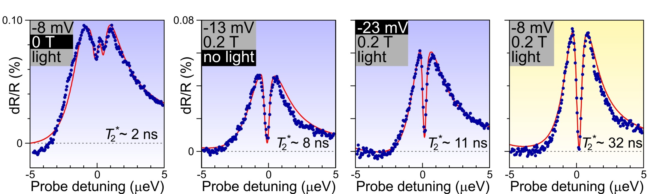
CPT dip as probe of S- T0 dephasing
At B = 0: in-plane component of nuclear field mixes T states ⇒ three CPT dips (one obscured by asymmetry)
Without non-resonant (850 nm) laser: more charge fluctuations
Tune closer to sweet spot: CPT dip becomes deeper
Due to proximity of sweet spot to plateau edge: spin-flip tunneling limits spin coherence
Find better CQD pair!

Slide 23
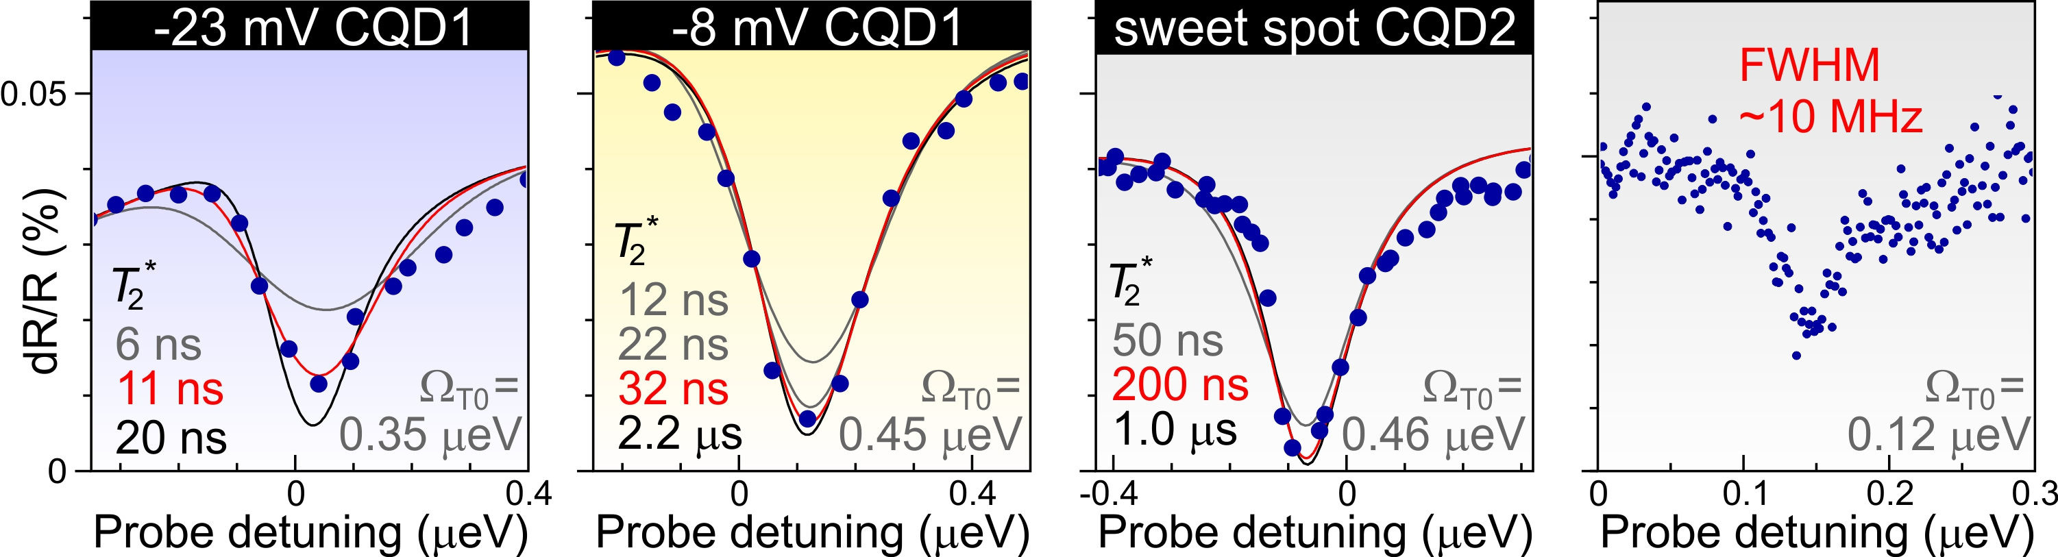
Enhancement of T2* close to sweet spot
Measure CPT dip for various pump powers
Fit dip with full 8-level master equation in steady state, including two decoherence mechanisms: slow charge fluctuations (give Gaussian dip) plus fast spin-flip tunneling with back contact (Lorentzian dip)
T₂* ~200 ns close to sweet spot:
~100 times better than for single electron spin
FWHM of CPT dip ~10 MHz for weakest pump power used
⇒
High-resolution spectroscopy in solid state

Slide 24
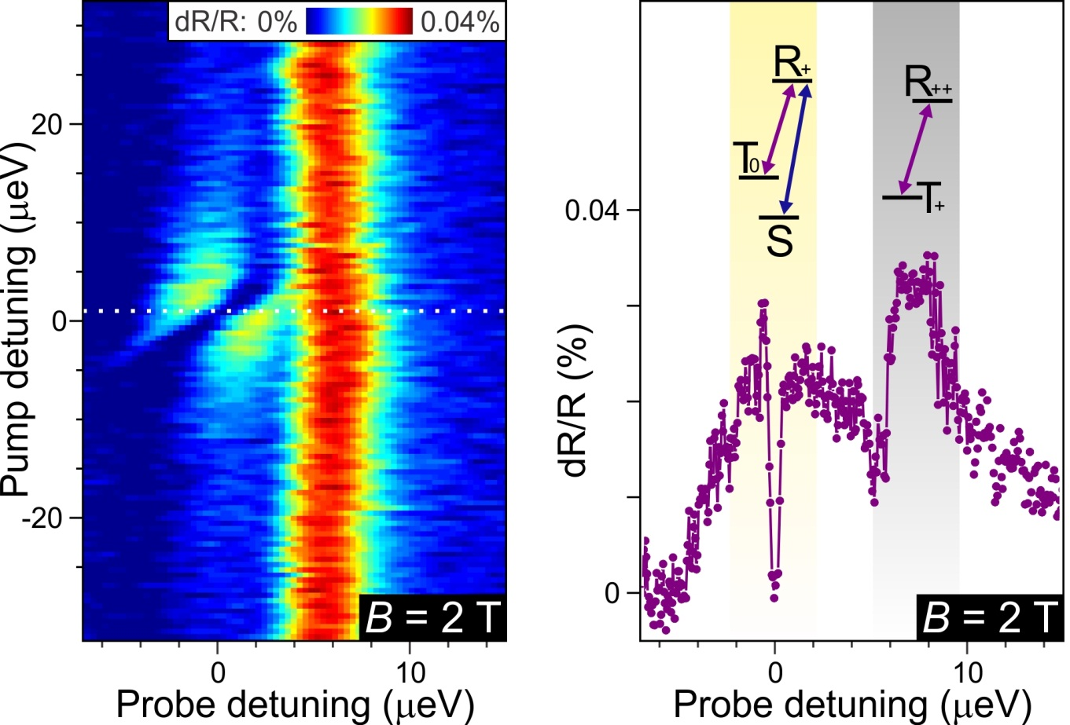
Large B-field splits degenerate transitions
Electronic g-factors for two dots ~10% different ⇒ two σ+ transitions slightly detuned at B = 2 T
One transition is part of lambda system ⇒ very efficient spin pumping
Other transition is quasi-recycling ⇒ maintains dR contrast even away from pump resonance
Could be useful for spin read-out or nuclear spin preparation

Slide 25
Conclusions
CPT is very useful tool to study dephasing processes
When T₂* is long, method is limited by difficulty of laser stabilisation: in that case time-resolved measurement may be easier
Two-electron S and T₀ qubit states can be robust against charge and nuclear spin fluctuations
At sweet spot and away from edge of charging plateau,
T₂* could be ~1 μs without spin echo!

Slide 26
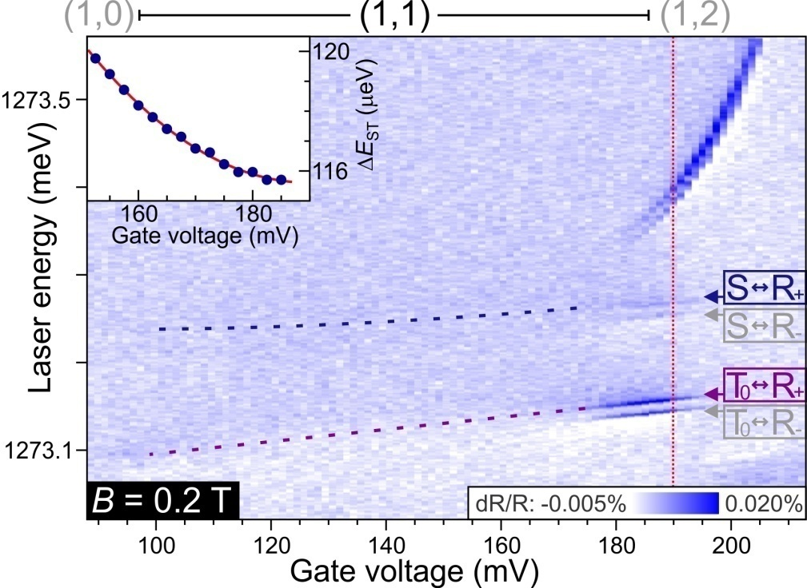
Device B shows spin pumping
B = 0.2 T ⇒ T₊ & T₋ split off from T₀
dR signal vanishes away from edge of (1,1) plateau (spin pumping)
dR signal restored by adding 2nd “re-pump” laser on other transition
“Sweet spot” (S-T₀ energy splitting insensitive to charge fluctuations): V₀ ~ 190 mV just outside (1,1)…
Distance to back contact was effectively (much) smaller than designed (50 nm) ⇒ spin-flip cotunneling leads to fast effective spin relaxation (~5 ns)
Grow better sample!
Notes:
% CQDEnergiesFinal
% Author : Jeroen Elzerman
% Date : 2009.07.31
% Version : 0.1
% Plots the transition energies for a set of inital and a set of final
% states in a double dot. Includes B-field dependence. Hole can sit in either blue
% or red QD.
addpath('D:\Scripts\ScriptsNew3\Functions');
clc;
close all;
%%%%%%%%%%%%%%%%%%%%%%%%%%%%%%%%%%%%%%%%%%%%%%%%%%%%%%%%%%
n = 1000; % number of points on gate voltage-axis
nE = 5000; % number of points on energy-axis
Vg1 = -580; % transition from X0 to X-1 in gate voltage [mVg]
Vg2 = -220; % transition from X-1 to X-2 in gate voltage [mVg]
Vg3 = -180; % transition from X-2 to X-3 in gate voltage [mVg]
s_id = 0.05; % indirect transition strength (compared to direct)
s_d = 0.05; % dark transition strength (compared to bright)
s_b = 0.5; % blue transition strenght (compared to red)
leverarm = 9/175; % leverarm determining detuning between two dots
Vgate = linspace(-600,600,n); % gate voltage [mV]
Ed = -Vgate*leverarm; % energy detuning [meV] between dots (Eright - Eleft, with E-right = 0)
index1 = min(find(Vgate>Vg1)); % index of Vgate-array corresponding to Vg1
index2 = min(find(Vgate>Vg2)); % index of Vgate-array corresponding to Vg2
index3 = min(find(Vgate>Vg3)); % index of Vgate-array corresponding to Vg3
B = linspace(0,4,n)'; % B-field [T]
%Ze1 = 0.6*B*0.5*56.8E-3; % half the Zeeman splitting [meV] for the electron (g-factor ~ 0.6)
%Zh2 = 1.3*B*0.5*56.8E-3; % half the Zeeman splitting [meV] for the hole (g-factor ~ 1.2)
Ze1 = 0.0; % half the Zeeman splitting [meV at 1T] for an electron in dot 1
Ze2 = 0.0; % half the Zeeman splitting [meV at 1T] for an electron in dot 2
Zh1 = 0.0; % half the Zeeman splitting [meV at 1T] for a hole in dot 1
Zh2 = 0.0; % half the Zeeman splitting [meV at 1T] for a hole in dot 2
X0R = 1290; % X0R energy [meV]
X0B = 1310; % X0B energy [meV]
HWHM = 0.05; % transition energy width [meV]
E = linspace(X0R-10,X0B-15,nE); % range for plotting transition energies [meV]
%%%%%%%%%%%%%%%%%%%%%%%%%%%%%%%%%%%%%%%%%%%%%%%%%%%%%%%%%%
th_1h = 0.1; % 1h
te_1e = 0.5; % 1e
Ed1_1e = 0; % 1e
ER_1e = 0; % 1e
EB_1e = 0; % 1e
VRR_ee = 20; % 2e
VBB_ee = 22; % 2e
VBR_ee = 10; % 2e
J_ee = 0.0; % 2e (= VBRBR)
VBBBR_ee = 0; % 2e
t_ee = sqrt(2)*(te_1e+VBBBR_ee);% 2e
Ed1_ee = VBB_ee - VBR_ee; % 2e
Ed2_ee = -VRR_ee + VBR_ee; % 2e
ER_ee = VBR_ee; % 2e
te_3e = te_1e; % 3e
Ed1_3e = VBB_ee - VRR_ee; % 3e
ER_3e = VBB_ee + 2*VBR_ee; % 3e
VBRRR_eh = 0; % 1e1h
VBR_eh = 10; % 1e1h
VRR_eh = 24; % 1e1h
VBB_eh = 26; % 1e1h
d0RR = 0.2; % 1e1h
d0BB = 0.2; % 1e1h
d0BR = d0RR/1000; % 1e1h
d1RR = 0.01; % 1e1h
d1BB = 0.01; % 1e1h
d1BR = d1RR/1000; % 1e1h
d2RR = 0.02; % 1e1h
d2BB = 0.02; % 1e1h
d2BR = d2RR/1000; % 1e1h
te_eh = te_1e - VBRRR_eh; % 1e1h
th_eh = th_1h - VBRRR_eh; % 1e1h
Ed1_eh = VRR_eh - VBR_eh; % 1e1h
Ed2_eh = -VBB_eh + VBR_eh; % 1e1h
ER_eh = X0R; % 1e1h
EB_eh = X0B; % 1e1h
te_2e1h = te_1e - VBBBR_ee - VBRRR_eh; % 2e1h
th_2e1h = th_1h - VBBBR_ee - VBRRR_eh; % 2e1h
Ed1_2e1h = VBB_ee - VBR_ee + VRR_eh - VBR_eh; % 2e1h
Ed2_2e1h = -VRR_ee + VBR_ee + VRR_eh - VBR_eh; % 2e1h
Ed3_2e1h = VBB_ee - VBR_ee - VBB_eh + VBR_eh; % 2e1h
Ed4_2e1h = -VRR_ee + VBR_ee - VBB_eh + VBR_eh; % 2e1h
ER_2e1h = X0R + EB_1e; % 2e1h
XmR = X0R + VRR_ee - VRR_eh; % 2e1h
XmB = X0B + VBB_ee - VBB_eh; % 2e1h
EB_2e1h = XmB + ER_1e; % 2e1h
te_3e1h = te_eh; % 3e1h
th_3e1h = th_eh; % 3e1h
Ed1_3e1h = VBB_ee - VRR_ee + VRR_eh - VBR_eh; % 3e1h
Ed2_3e1h = VBB_ee - VRR_ee - VBB_eh + VBR_eh; % 3e1h
ER_3e1h = XmR + ER_ee; % 3e1h VRR_ee-VRR_eh
EB_3e1h = XmB + ER_ee; % 3e1h VBB_ee-VBB_eh
th_4e1h = th_1h; % 4e1h
Ed1_4e1h = VBB_eh - VRR_eh - X0B + X0R; % 4e1h
ER_4e1h = XmR + ER_3e; % 4e1h
EB_4e1h = XmB + ER_3e; % 4e1h
% 0 %%%%%%%%%%%%%%%%%%%%%%%%%%%%%%%%%%%%%%%%%%%%%%%%%%%%%%%%%
E_0 = zeros(n,1);
Vec_0 = mat2cell(ones(1,n),1,linspace(1,1,n));
figure;
plot(Vgate,E_0,'b'); title('0','Fontsize',24);xlabel('Gate voltage (mV)','Fontsize',24);ylabel('Energy (meV)','Fontsize',24);set(gca,'Fontsize',18);
ylim([-15 15]);pbaspect([1.4 1 1]);
% 1e %%%%%%%%%%%%%%%%%%%%%%%%%%%%%%%%%%%%%%%%%%%%%%%%%%%%%%%%%
E_1e = cell(1,n);
Vec_1e = cell(1,n);
for i = 1:n
[E_temp,Vec_temp] = SolveH_1e(te_1e,Ze1,Ze2,ER_1e,Ed1_1e,Ed(i));
E_1e{i} = E_temp;
Vec_1e{i} = Vec_temp; % eigenvectors are columns in each cell (for calculating "gate sweeps" later)
end
E_1e = cell2mat(E_1e)';
figure;
plot(Vgate,E_1e,'b'); title('1e','Fontsize',24);xlabel('Gate voltage (mV)','Fontsize',24);ylabel('Energy (meV)','Fontsize',24);set(gca,'Fontsize',18);
ylim([ER_1e-15 ER_1e+15]);pbaspect([1.4 1 1]);
% 2e %%%%%%%%%%%%%%%%%%%%%%%%%%%%%%%%%%%%%%%%%%%%%%%%%%%%%%%%%
E_2e = cell(1,n);
Vec_2e = cell(1,n);
for i = 1:n
[E_temp,Vec_temp] = SolveH_2e(J_ee,t_ee,Ze1,Ze2,ER_ee,Ed1_ee,Ed2_ee,Ed(i));
E_2e{i} = E_temp;
Vec_2e{i} = Vec_temp; % eigenvectors are columns in each cell (for calculating "gate sweeps" later)
end
E_2e = cell2mat(E_2e)';
figure;
plot(Vgate,E_2e,'b'); title('2e','Fontsize',24);xlabel('Gate voltage (mV)','Fontsize',24);ylabel('Energy (meV)','Fontsize',24);set(gca,'Fontsize',18);
ylim([ER_ee-15 ER_ee+15]);pbaspect([1.4 1 1]);
% 3e %%%%%%%%%%%%%%%%%%%%%%%%%%%%%%%%%%%%%%%%%%%%%%%%%%%%%%%%%
E_3e = cell(1,n);
Vec_3e = cell(1,n);
for i = 1:n
[E_temp,Vec_temp] = SolveH_3e(te_3e,Ze1,Ze2,ER_3e,Ed1_3e,Ed(i));
E_3e{i} = E_temp;
Vec_3e{i} = Vec_temp; % eigenvectors are columns in each cell (for calculating "gate sweeps" later)
end
E_3e = cell2mat(E_3e)';
figure;
plot(Vgate,E_3e,'b'); title('3e','Fontsize',24);xlabel('Gate voltage (mV)','Fontsize',24);ylabel('Energy (meV)','Fontsize',24);set(gca,'Fontsize',18);
ylim([ER_3e-15 ER_3e+15]);pbaspect([1.4 1 1]);
% 1e1h %%%%%%%%%%%%%%%%%%%%%%%%%%%%%%%%%%%%%%%%%%%%%%%%%%%%%%%%
E_eh = cell(1,n);
Vec_eh = cell(1,n);
for i = 1:n
[E_temp,Vec_temp] = SolveH_1e1h(d0RR,d0BB,d0BR,d1RR,d1BB,d1BR,d2RR,d2BB,d2BR,te_eh,th_eh,Ze1,Ze2,Zh1,Zh2,ER_eh,EB_eh,Ed1_eh,Ed2_eh,Ed(i));
E_eh{i} = E_temp;
Vec_eh{i} = Vec_temp; % eigenvectors are columns in each cell (for calculating "gate sweeps" later)
end
E_eh = cell2mat(E_eh)';
figure;
plot(Vgate,E_eh,'b'); title('1e1h','Fontsize',24);xlabel('Gate voltage (mV)','Fontsize',24);ylabel('Energy (meV)','Fontsize',24);set(gca,'Fontsize',18);
ylim([ER_eh-5 ER_eh+25]);pbaspect([1.4 1 1]);
% 2e1h %%%%%%%%%%%%%%%%%%%%%%%%%%%%%%%%%%%%%%%%%%%%%%%%%%%%%%%%%
E_2e1h = cell(1,n);
Vec_2e1h = cell(1,n);
for i = 1:n
[E_temp,Vec_temp] = SolveH_2e1h(J_ee,te_2e1h,th_2e1h,d0RR,d0BB,d1RR,d1BB,d2RR,d2BB,Ze1,Ze2,Zh1,Zh2,ER_2e1h,EB_2e1h,Ed1_2e1h,Ed2_2e1h,Ed3_2e1h,Ed4_2e1h,Ed(i));
E_2e1h{i} = E_temp;
Vec_2e1h{i} = Vec_temp; % eigenvectors are columns in each cell (for calculating "gate sweeps" later)
end
E_2e1h = cell2mat(E_2e1h)';
figure;
plot(Vgate,E_2e1h,'b'); title('2e1h','Fontsize',24);xlabel('Gate voltage (mV)','Fontsize',24);ylabel('Energy (meV)','Fontsize',24);set(gca,'Fontsize',18);
ylim([ER_2e1h-10 ER_2e1h+20]);pbaspect([1.4 1 1]);
% 3e1h %%%%%%%%%%%%%%%%%%%%%%%%%%%%%%%%%%%%%%%%%%%%%%%%%%%%%%%%%
E_3e1h = cell(1,n);
Vec_3e1h = cell(1,n);
for i = 1:n
[E_temp,Vec_temp] = SolveH_3e1h(d0RR,d0BB,d0BR,d1RR,d1BB,d1BR,d2RR,d2BB,d2BR,te_3e1h,th_3e1h,Ze1,Ze2,Zh1,Zh2,ER_3e1h,EB_3e1h,Ed1_3e1h,Ed2_3e1h,Ed(i));
E_3e1h{i} = E_temp;
Vec_3e1h{i} = Vec_temp; % eigenvectors are columns in each cell (for calculating "gate sweeps" later)
end
E_3e1h = cell2mat(E_3e1h)';
figure;
plot(Vgate,E_3e1h,'b'); title('3e1h','Fontsize',24);xlabel('Gate voltage (mV)','Fontsize',24);ylabel('Energy (meV)','Fontsize',24);set(gca,'Fontsize',18);
ylim([ER_3e1h-5 ER_3e1h+25]);pbaspect([1.4 1 1]);
% 4e1h %%%%%%%%%%%%%%%%%%%%%%%%%%%%%%%%%%%%%%%%%%%%%%%%%%%%%%%%%
E_4e1h = cell(1,n);
Vec_4e1h = cell(1,n);
for i = 1:n
[E_temp,Vec_temp] = SolveH_4e1h(th_4e1h,Zh1,Zh2,ER_4e1h,Ed1_4e1h,Ed(i));
E_4e1h{i} = E_temp;
Vec_4e1h{i} = Vec_temp; % eigenvectors are columns in each cell (for calculating "gate sweeps" later)
end
E_4e1h = cell2mat(E_4e1h)';
figure;
plot(Vgate,E_4e1h,'b'); title('4e1h','Fontsize',24);xlabel('Gate voltage (mV)','Fontsize',24);ylabel('Energy (meV)','Fontsize',24);set(gca,'Fontsize',18);
ylim([ER_4e1h-20 ER_4e1h+10]);pbaspect([1.4 1 1]);
% 1e1h - 0 %%%%%%%%%%%%%%%%%%%%%%%%%%%%%%%%%%%%%%%%%%%%%%%%%%%%%%%%%
M_eh = [s_id 1 s_id 1 s_id*s_d s_d s_id*s_d s_d s_id*s_b s_b s_id*s_b s_b s_id*s_d*s_b s_d*s_b s_id*s_d*s_b s_d*s_b];
E_0 = TransitionEnergy(E_eh,zeros(n,1));
matrix0 = TransitionStrength(E_0,Vec_eh,Vec_0,M_eh,E,HWHM);
figure;plot(Vgate,E_0,'b'); title('X0','Fontsize',24);xlabel('Gate voltage (mV)','Fontsize',24);ylabel('Energy (meV)','Fontsize',24);set(gca,'Fontsize',18);
ylim([X0R-10 X0B+5]);pbaspect([1.4 1 1]);
PlotMatrix(matrix0,Vgate,E(1,:),'Gate voltage (mV)','Transition energy (meV)','X0',[-3E10 3E10]);pbaspect([1.4 1 1]);
PlotMatrix(log(abs(matrix0)),Vgate,E(1,:),'Gate voltage (mV)','Transition energy (meV)','X0',[-3E10 3E10]);pbaspect([1.4 1 1]);
% 2e1h - 1e %%%%%%%%%%%%%%%%%%%%%%%%%%%%%%%%%%%%%%%%%%%%%%%%%%%%%%%%%
M_2e1h = [ s_id 0 1 0 s_d 0 s_d*s_id 0 s_d 0 1 0 s_b 0 s_id*s_b 0 s_d*s_id 0 s_b*s_d 0 s_b*s_d*s_id 0 s_b*s_id 0;
0 1 0 s_id s_d*s_id 0 0 s_d 0 s_d*s_id s_id 0 s_b*0 s_b*s_id 0 s_b s_b*s_d 0 0 s_b*s_d*s_id 0 s_b*s_d s_b 0;
s_d*s_id 0 0 s_d 0 1 s_id 0 0 1 0 s_d s_b*s_d 0 0 s_b*s_d*s_id 0 s_b*s_id s_b 0 0 s_b*s_id 0 s_b*s_d*s_id;
0 s_d s_d*s_id 0 0 s_id 0 1 s_id 0 0 s_d*s_id 0 s_b*s_d*s_id s_b*s_d 0 0 s_b 0 s_b*s_id s_b 0 0 s_b*s_d ];
E_1 = TransitionEnergy(E_2e1h,E_1e);
matrix1 = TransitionStrength(E_1,Vec_2e1h,Vec_1e,M_2e1h,E,HWHM);
figure;
plot(Vgate,E_1,'b'); title('X1-','Fontsize',24);xlabel('Gate voltage (mV)','Fontsize',24);ylabel('Energy (meV)','Fontsize',24);set(gca,'Fontsize',18);
ylim([X0R-10 X0B+5]);pbaspect([1.4 1 1]);
PlotMatrix(matrix1,Vgate,E(1,:),'Gate voltage (mV)','Transition energy (meV)','X1-',[-3E10 3E10]);pbaspect([1.4 1 1]);
PlotMatrix(log(abs(matrix1)),Vgate,E(1,:),'Gate voltage (mV)','Transition energy (meV)','X1-',[-3E10 3E10]);pbaspect([1.4 1 1]);
% 3e1h - 2e %%%%%%%%%%%%%%%%%%%%%%%%%%%%%%%%%%%%%%%%%%%%%%%%%%%%%%%%%
M_3e1h = ones(6,16);
M_3e1h = [ 0 1 0 1 0 s_d 0 s_d s_b*s_id 0 s_b*s_id 0 s_b*s_d*s_id 0 s_b*s_d*s_id 0;
s_id 0 s_id 0 s_d*s_id 0 s_d*s_id 0 0 s_b 0 s_b 0 s_b*s_d 0 s_b*s_d;
0 s_id 1 0 s_d 0 0 s_d*s_id s_b 0 s_b*s_d s_b*s_id 0 s_b*s_d*s_id s_b*s_d 0;
1 0 0 s_id 0 s_d*s_id s_d 0 0 s_b*s_id s_b 0 s_b*s_d 0 0 s_b*s_d*s_id;
0 0 s_d s_d*s_id 1 s_id 0 0 0 0 s_b*s_d s_b*s_d*s_id s_b s_b*s_id 0 0;
s_d s_d*s_id 0 0 0 0 1 s_id s_b*s_d s_b*s_d*s_id 0 0 0 0 s_b s_b*s_id];
E_2 = TransitionEnergy(E_3e1h,E_2e);
matrix2 = TransitionStrength(E_2,Vec_3e1h,Vec_2e,M_3e1h,E,HWHM);
figure;
plot(Vgate,E_2,'b'); title('X2-','Fontsize',24);xlabel('Gate voltage (mV)','Fontsize',24);ylabel('Energy (meV)','Fontsize',24);set(gca,'Fontsize',18);
ylim([X0R-10 X0B+5]);pbaspect([1.4 1 1]);
PlotMatrix(matrix2,Vgate,E(1,:),'Gate voltage (mV)','Transition energy (meV)','X2-',[-3E10 3E10]);pbaspect([1.4 1 1]);
PlotMatrix(log(abs(matrix2)),Vgate,E(1,:),'Gate voltage (mV)','Transition energy (meV)','X2-',[-3E10 3E10]);pbaspect([1.4 1 1]);
% 4e1h - 3e %%%%%%%%%%%%%%%%%%%%%%%%%%%%%%%%%%%%%%%%%%%%%%%%%%%%%%%%%
M_4e1h = ones(4,4);
M_4e1h = [ s_b s_id s_b*s_d s_d*s_id;
s_b*s_id 1 s_b*s_d*s_id s_d;
s_b*s_d s_d*s_id s_b s_id;
s_b*s_d*s_id s_d s_b*s_id 1];
E_3 = TransitionEnergy(E_4e1h,E_3e);
matrix3 = TransitionStrength(E_3,Vec_4e1h,Vec_3e,M_4e1h,E,HWHM);
figure;
plot(Vgate,E_3,'b'); title('X3-','Fontsize',24);xlabel('Gate voltage (mV)','Fontsize',24);ylabel('Energy (meV)','Fontsize',24);set(gca,'Fontsize',18);
ylim([X0R-10 X0B+5]);pbaspect([1.4 1 1]);
PlotMatrix(matrix3,Vgate,E(1,:),'Gate voltage (mV)','Transition energy (meV)','X3-',[-3E10 3E10]);pbaspect([1.4 1 1]);
PlotMatrix(log(abs(matrix3)),Vgate,E(1,:),'Gate voltage (mV)','Transition energy (meV)','X3-',[-3E10 3E10]);pbaspect([1.4 1 1]);
% combined %%%%%%%%%%%%%%%%%%%%%%%%%%%%%%%%%%%%%%%%%%%%%%%%%%%%%%%%%
figure; title(['All transitions: Vg1 = ',num2str(Vg1),' mV; Vg2 = ',num2str(Vg2),' mV'],'Fontsize',24);
hold on;
plot(Vgate(1:index1),E_0(1:index1,:),'b');
plot(Vgate(index1+1:index2),E_1(index1+1:index2,:),'b');
plot(Vgate(index2+1:index3),E_2(index2+1:index3,:),'b');
plot(Vgate(index3+1:n),E_3(index3+1:n,:),'b');
ylim([X0R-10 X0B+5]);pbaspect([1.4 1 1]);
xlabel('Gate voltage (mV)','Fontsize',24);ylabel('Energy (meV)','Fontsize',24);set(gca,'Fontsize',18);
hold off;
matrix = [matrix0(1:index1,:);matrix1(index1+1:index2,:);matrix2(index2+1:index3,:);matrix3(index3+1:n,:)];
PlotMatrix(matrix,Vgate,E(1,:),'Gate voltage (mV)','Transition energy (meV)',['All transitions: Vg1 = ',num2str(Vg1),' mV; Vg2 = ',num2str(Vg2),' mV'],[-3E10 3E10]);pbaspect([1.4 1 1]);
PlotMatrix(log(abs(matrix)),Vgate,E(1,:),'Gate voltage (mV)','Transition energy (meV)',['All transitions: Vg1 = ',num2str(Vg1),' mV; Vg2 = ',num2str(Vg2),' mV'],[-3E10 3E10]);pbaspect([1.4 1 1]);
matrix = (matrix0+matrix1+matrix2+matrix3)/4;
PlotMatrix(matrix,Vgate,E(1,:),'Gate voltage (mV)','Transition energy (meV)','All transitions together:',[-3E10 3E10]);pbaspect([1.4 1 1]);
PlotMatrix(log(abs(matrix)),Vgate,E(1,:),'Gate voltage (mV)','Transition energy (meV)','All transitions together:',[-3E10 3E10]);pbaspect([1.4 1 1]);
% SAVE %%%%%%%%%%%%%%%%%%%%%%%%%%%%%%%%%%%%%%%%%%%%%%%%%%%%%%%%
% eval(['save ', 'D:\Temp\temp.dat', ' PLE -ascii']);

Slide 27
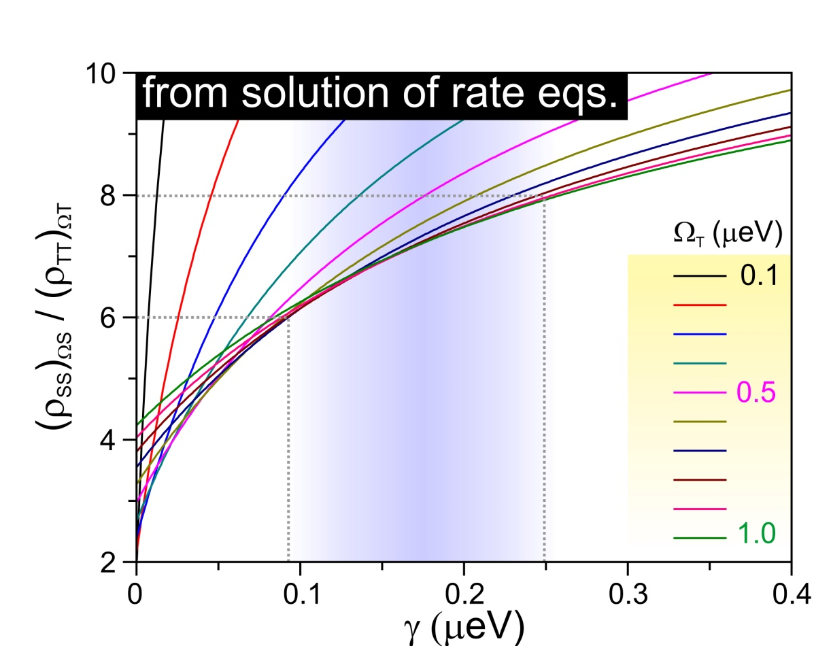
Determining relaxation rate γ
Steady-state solution of rate eqs. describing populations in S, T & X:
γ/Γ ~ 0.1 – 0.25 ⇒ 1/γ ~ few ns
Mechanism: spin-flip cotunneling due to strong coupling to nearby electron reservoir (dopant segregation)

Slide 28
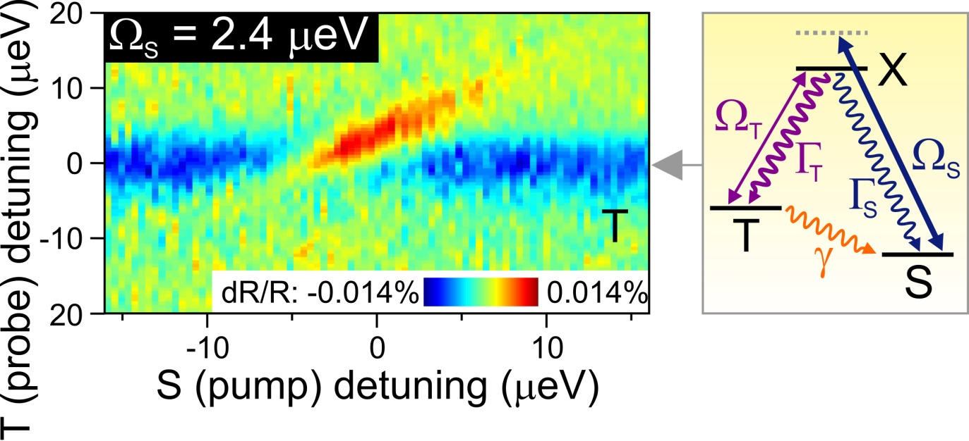
Pump S and probe T transition
Pump off-resonant: scattering reduces probe intensity (blue)

Slide 29
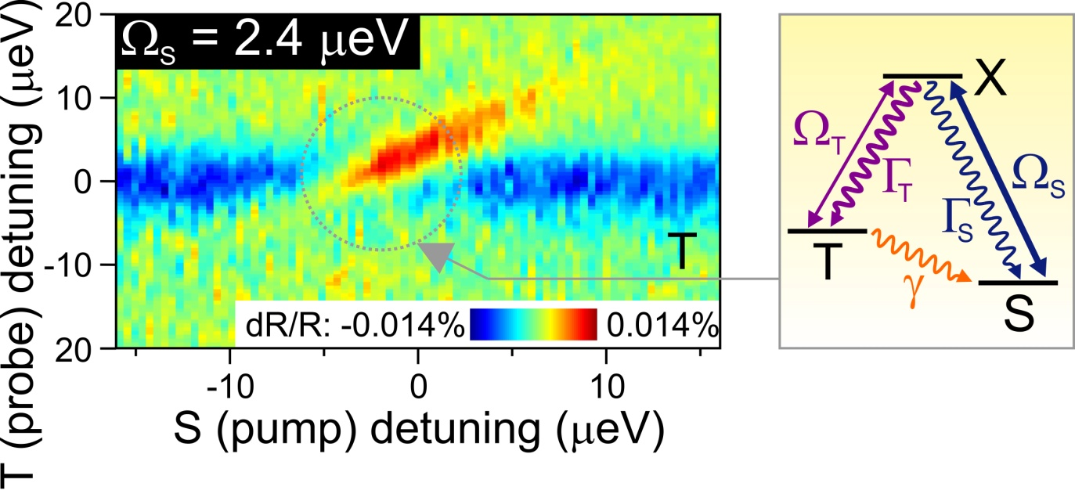
Pump S and probe T transition
Pump off-resonant: scattering reduces probe intensity (blue)
Pump on resonance: CQD increases probe (red) ⇒ optical gain!

Slide 30

Pump S and probe T transition
Pump off-resonant: scattering reduces probe intensity (blue)
Pump on resonance: CQD increases probe (red) ⇒ optical gain!
Detuning > pump Ω_{S}: gain due to stimulated Raman process

Slide 31
Pump S and probe T transition
Pump off-resonant: scattering reduces probe intensity (blue)
Pump on resonance: CQD increases probe (red) ⇒ optical gain!
Detuning > pump Ω_{S}: gain due to stimulated Raman process
Pump Ω_{S} > detuning: gain from dressed states (Autler-Townes splitting)
Maximum gain ~0.014%

Slide 32
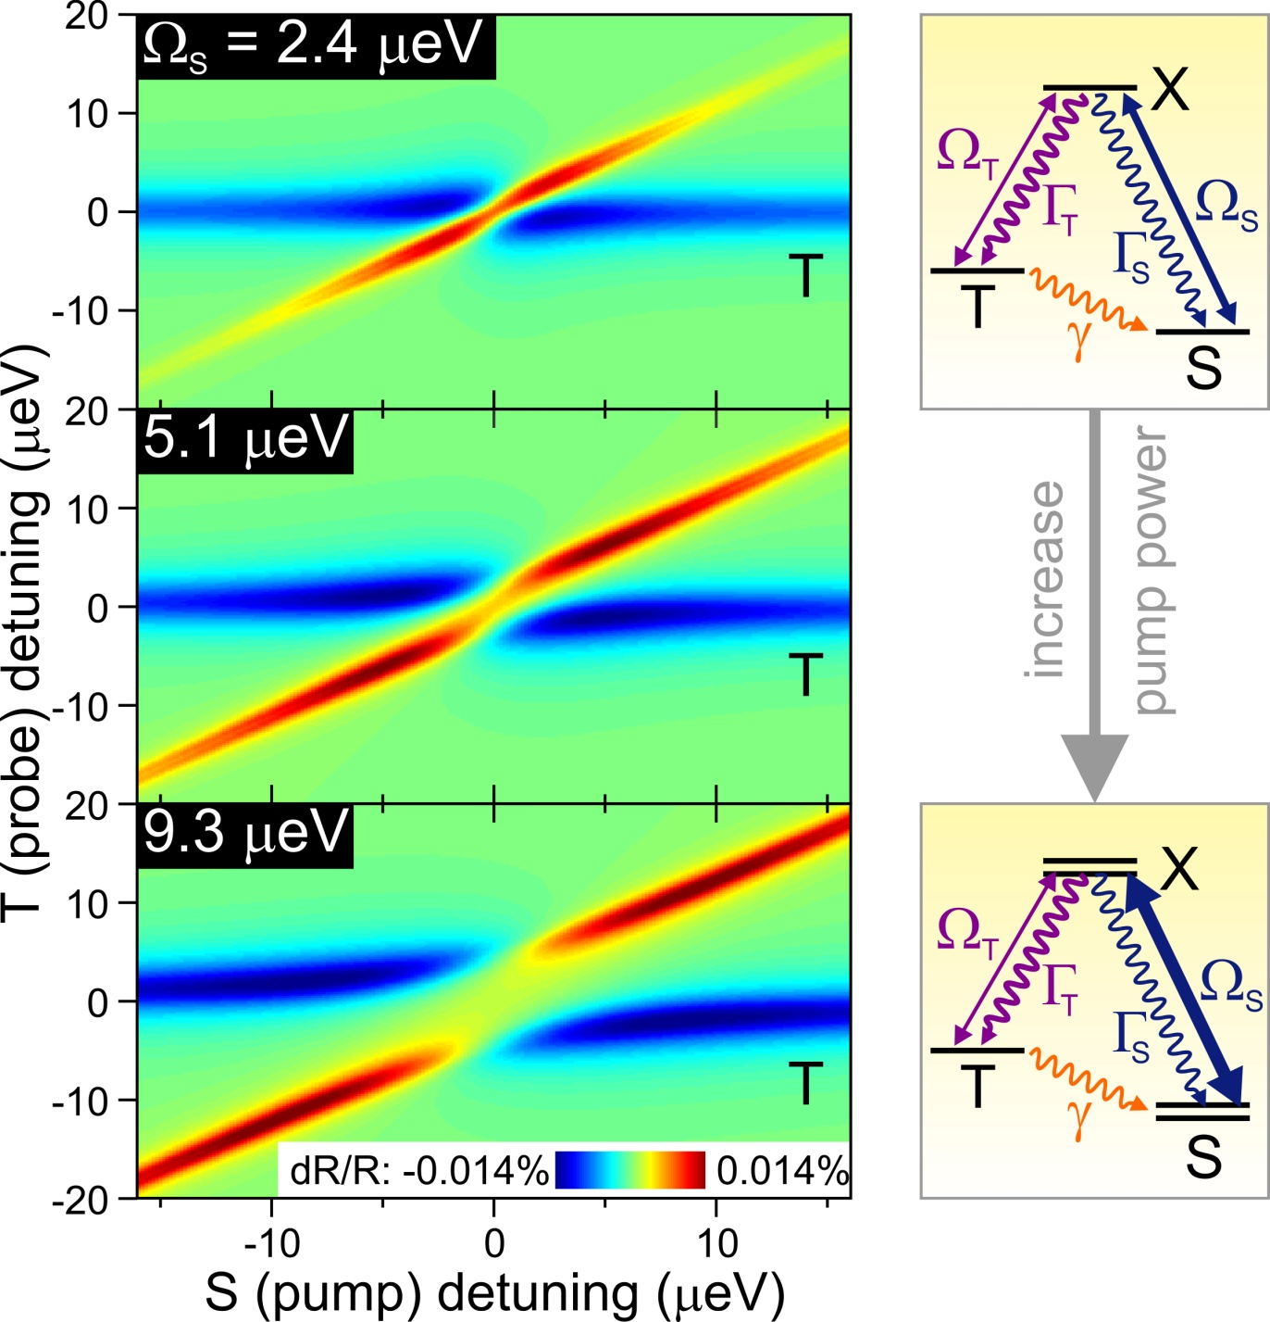
Numerical simulations

Slide 33
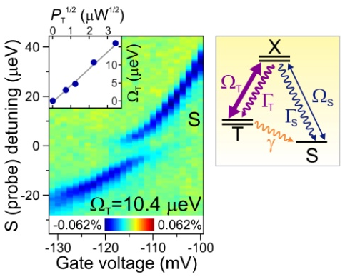
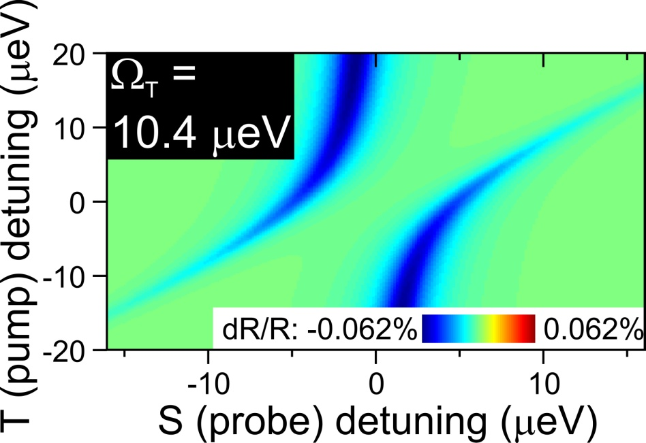
Control experiment and simulation
Pump T, probe S: no gain for any gate voltage!
⇒ unidirectional TS relaxation responsible for gain
Standard (absorbtive) Autler-Townes anticrossing

