Slide 1


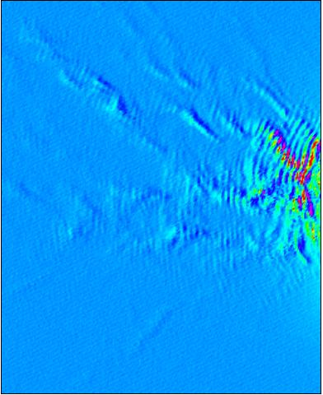
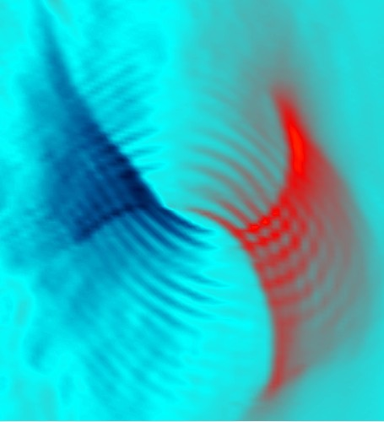
Imaging transmission of nanostructures in a high-mobility heterostructure
Clemens Rössler
Thomas Ihn
Klaus Ensslin
C. Reichl
W. Wegscheider
Aleksey Kozikov
Local electron transport
Classical/quantum
phenomena
Diffusive/ballistic
transport

Slide 2
Motivation
Ultra high-mobility:
l_{p} >> L → Ballistic transport:
electron trajectories are straight lines
Modulation doping technique → Small-angle scattering:
electron trajectories are wavy lines
How does small-angle scattering affect transport?

Slide 3
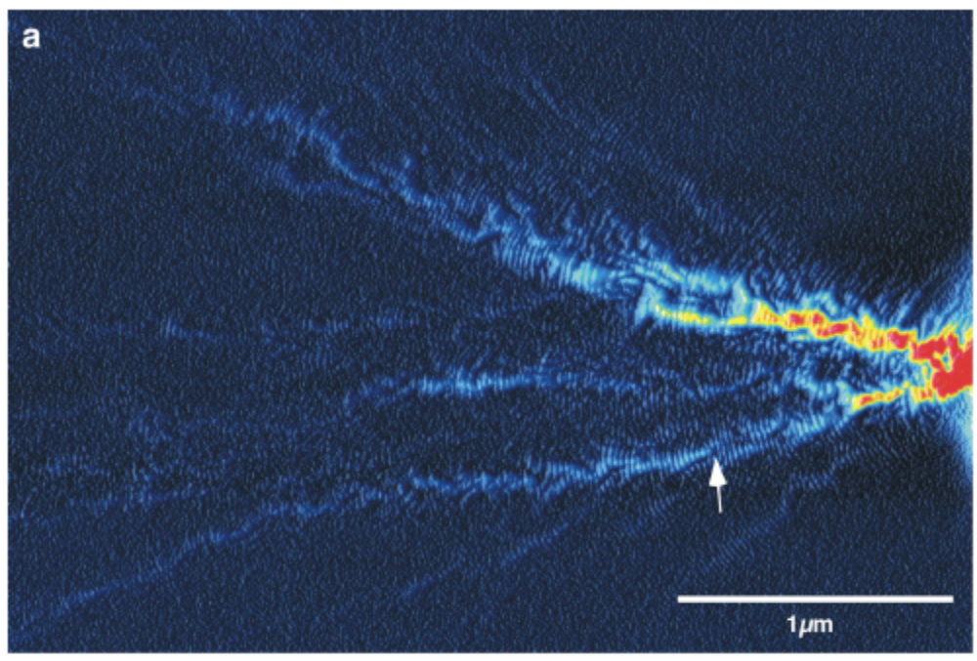
Motivation
Conductance, G
2DEG
QPC
y
x
M. Topinka et al. Nature 410, 183-186 (2001)

Slide 4
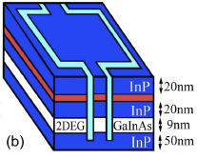
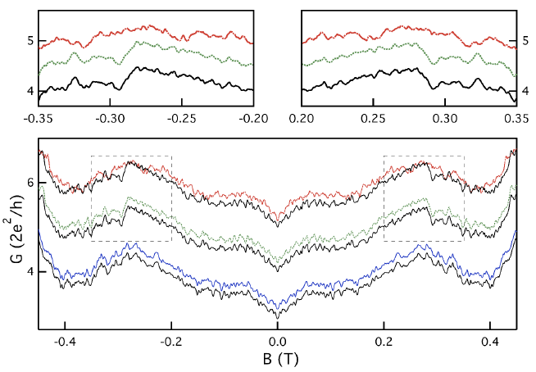
Motivation
Scannell et al. PRB 85, 195319 (2012)
K
115 K
0.24 K
Local relocation of charge between donor sites

Slide 5
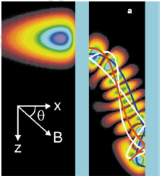
Motivation
Conductance through
a tunneling diode
Wilkinson et al. Nature 380,
608 (1996)

Slide 6
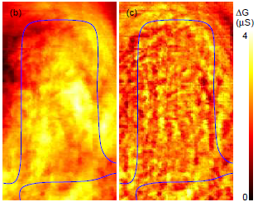
Motivation
Experimental data
Filtered data
Crook et al. PRL 91,
246803 (2003)

Slide 7
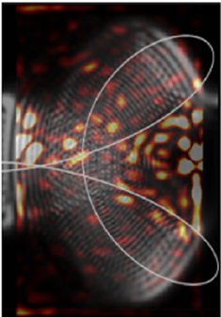
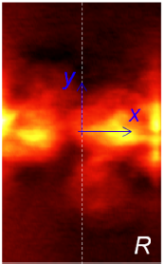
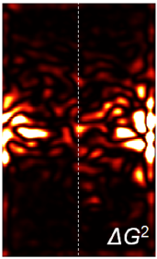
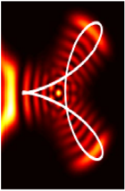
Motivation
Experimental data
Filtered data
Theory
Aoki et al. PRL 108, 136804 (2012)
No one-to-one correspondence

Slide 8
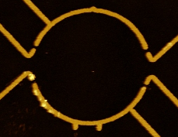
Sample
Golden top gates
n = 1.2 × 10¹⁵ m⁻²
E_{F} = 4 meV
λ_{F} = 72 nm
µ = 850 m²/Vs
l_{p} = 49 µm
D_{Stadium} = 3 µm
1 µm
2DEG
QPC
Ballistic
stadium
Excellent wafers:
C. Reichl
W. Wegscheider
ETH Zurich

Slide 9
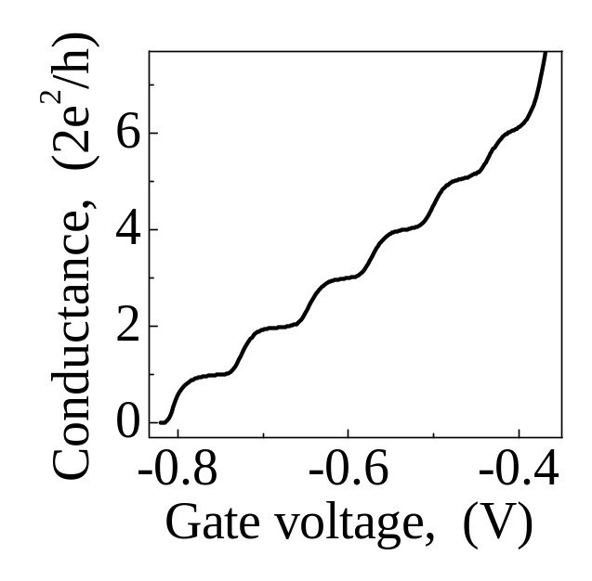
Quantum point contact
Top gates
Electron flow
D. A. Wharam et al., 1988
B. J. van Wees et al., 1988
2DEG

Slide 10
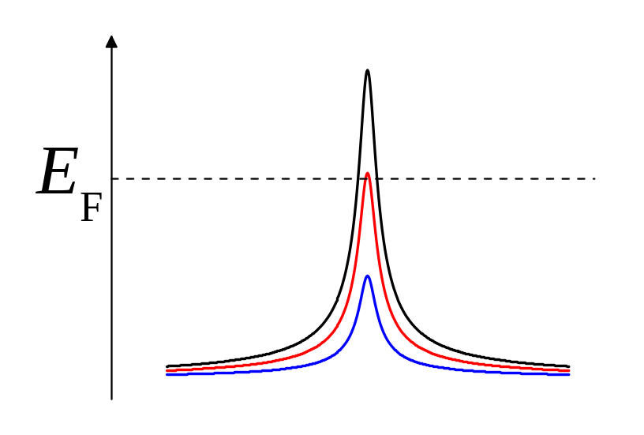
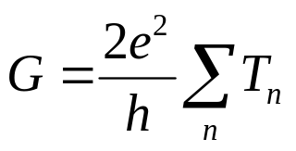
SGM technique
Energy
Tip
Top gates
d
D. A. Wharam et al., 1988
B. J. van Wees et al., 1988
Landauer-Büttiker theory
of transport
2DEG
Backscattering effect

Slide 11
Electron backscattering through the QPC
x
Differential conductance, dG/dx
y
3rd plateau
V_{tip}= -6.0 V
d = 70 nm
arXiv:1206.1371
1 µm
Notes:
11

Slide 12
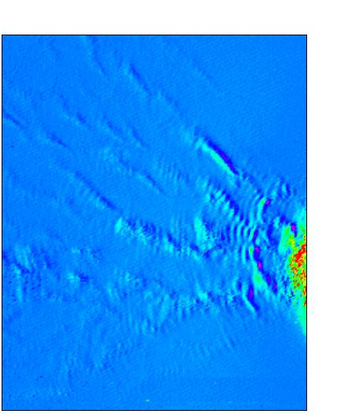
Scanning gate microscopy on a QPC
0.5 µm
y (µm)
Gate voltage dependence
Tip voltage dependence
Tip-surface distance dependence
Temperature dependence
Source-drain bias dependence
QPC asymmetry dependence
Magnetic field dependence: backscattering is essential
Strongly varying interference fringe spacing (50%)
X (µm)
Small-angle scattering
arXiv:1206.1371

Slide 13
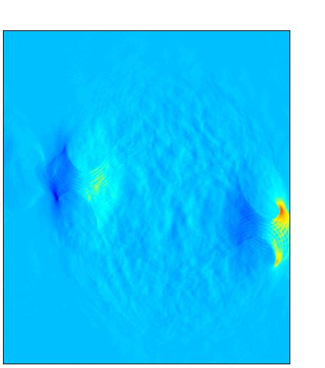
Scanning gate microscopy on a stadium
dG/dx
1 µm
y (µm)
V_{tip}= -8.0 V
V_{stadium}= -0.5 V
X (µm)
Notes:
13

Slide 14
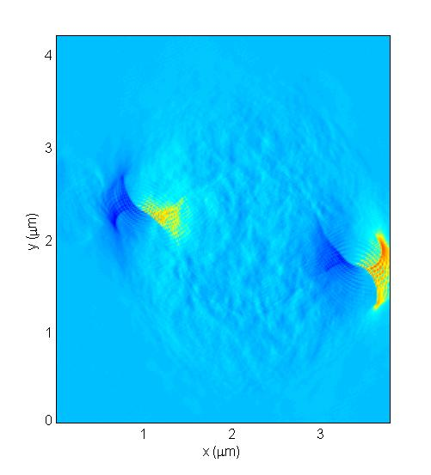
Scanning gate microscopy on a stadium
dG/dx
1 µm
y (µm)
V_{tip}= -8.0 V
V_{stadium}= -0.8 V
X (µm)
Notes:
14

Slide 15
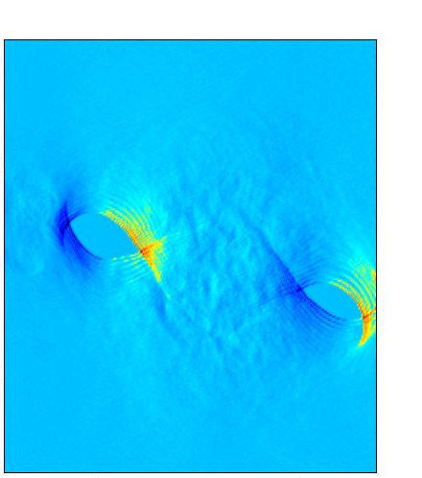
Scanning gate microscopy on a stadium
dG/dx
1 µm
y (µm)
V_{tip}= -8.0 V
V_{stadium}= -2.0 V
X (µm)
Notes:
15

Slide 16
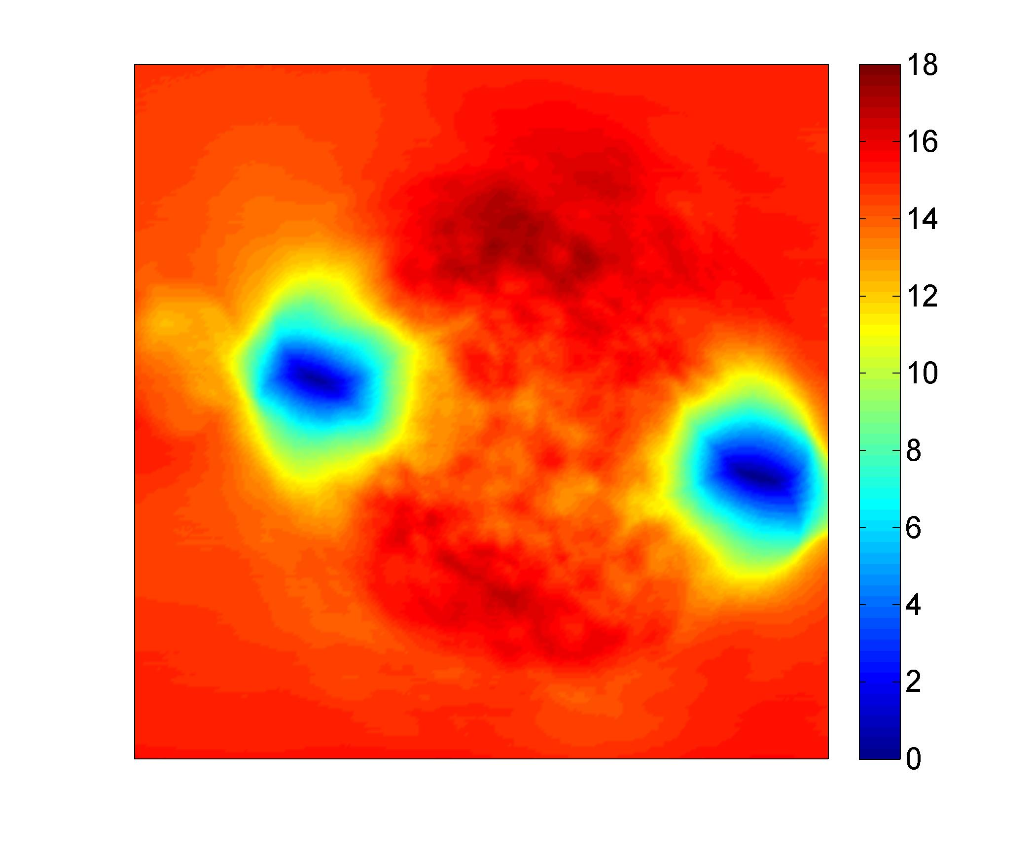
Scanning gate microscopy on a stadium
dG/dx
G (2e²/h)
1 µm
1 µm
V_{tip}= -8.0 V
V_{stadium}= -0.8 V
Notes:
16

Slide 17
Scanning gate microscopy on a stadium
dG/dx
500 nm

Slide 18
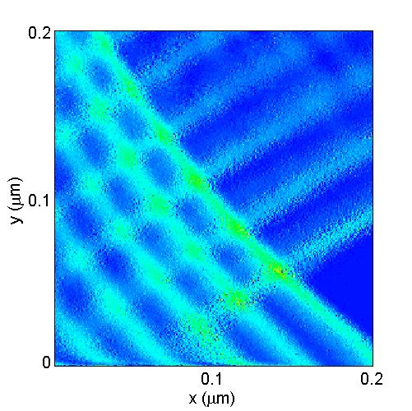
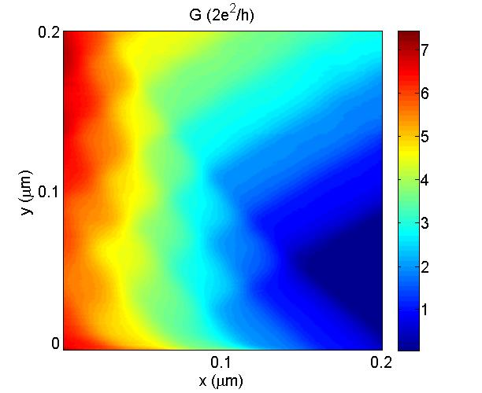
Scanning gate microscopy on a stadium
dG/dx
G (2e²/h)
dG/dx

Slide 19
Qualitative model
d
a
c
b

Slide 20

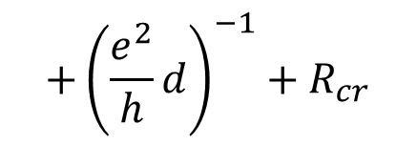
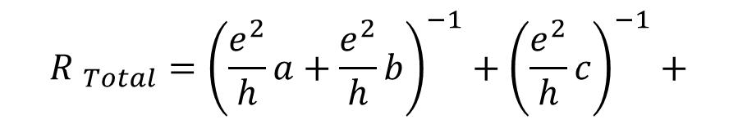
Qualitative model
$${R }_{Total}={R }_{a}||{R }_{b}+{R }_{c}+{R }_{d}+{R }_{cr}$$
$${R }_{Total}={\left(\frac{e^{2}}{h}a+\frac{e^{2}}{h}b\right)}^{−1}+{\left(\frac{e^{2}}{h}c\right)}^{−1}+$$
d
a
$${+\left(\frac{e^{2}}{h}d\right)}^{−1}+R_{cr}$$
c
R_{cr}
contact
resistance
b
$$G_{Total}=1/R_{Total}$$

Slide 21
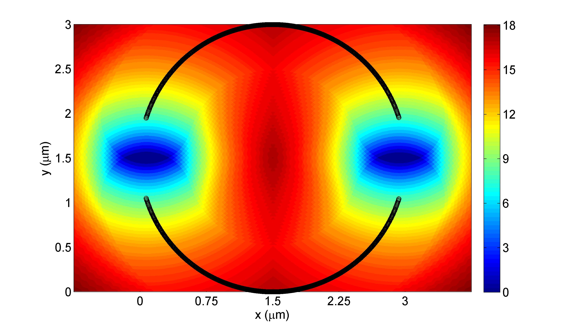
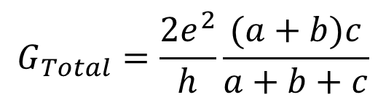
Qualitative model
G (2e²/h)
Assumptions: R_{cr}= 0, d = ∞
c = 25, W = 0.9 µm, R_{Tip}=0.5 µm
$$G_{Total}=\frac{2e^{2}}{h}\frac{(a+b)c}{a+b+c}$$

Slide 22
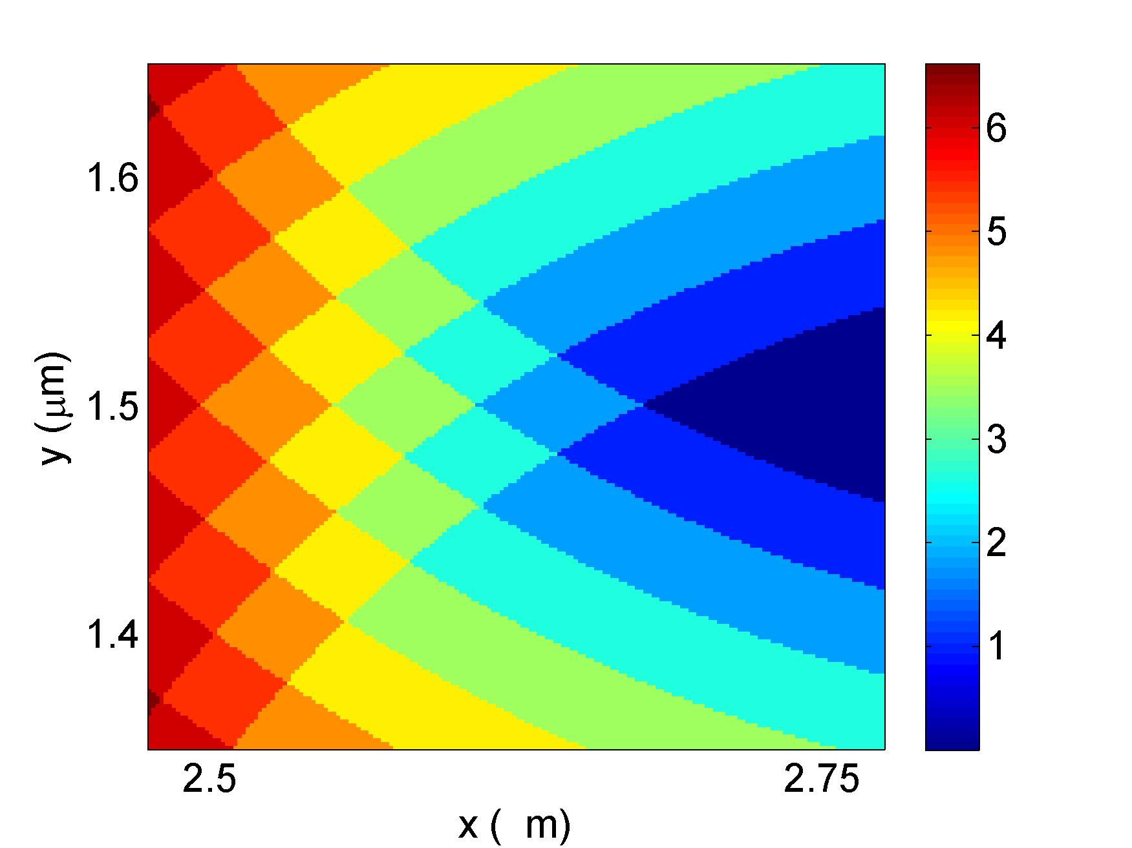
Model vs. experiment
Model
G (2e²/h)
Experiment
G (2e²/h)
µ
Dashed lines are guides to the eye

Slide 23
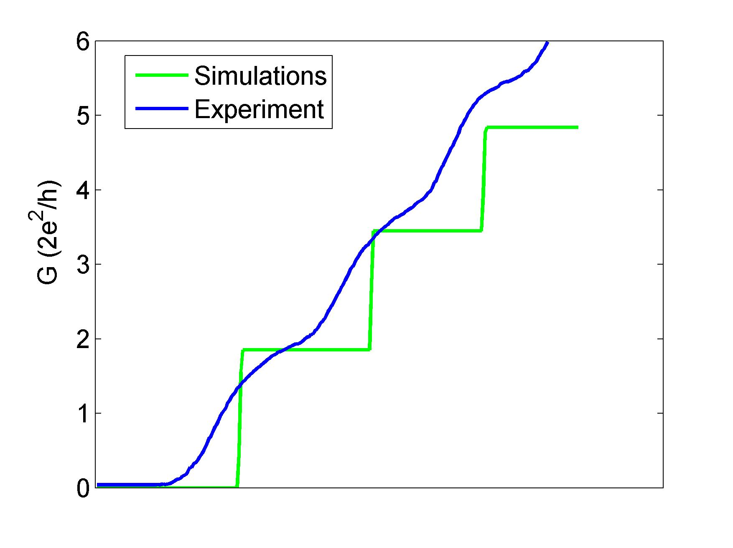
Model vs. experiment
1D profiles along red lines shown in the previous slide

Slide 24
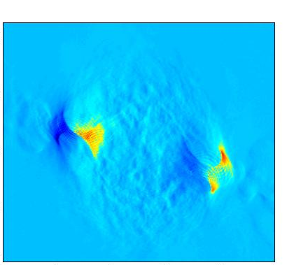
Magnetic field dependence
dG/dx
1 µm
y (µm)
V_{tip}= -8.0 V
V_{cgate}= -1.0 V
B = 0 mT
X (µm)
Notes:
24

Slide 25
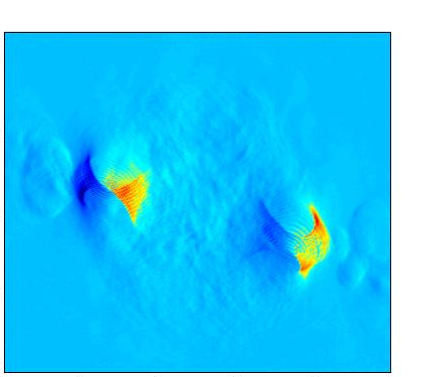
Magnetic field dependence
dG/dx
1 µm
y (µm)
V_{tip}= -8.0 V
V_{cgate}= -1.0 V
B = 50 mT
X (µm)
Notes:
25

Slide 26
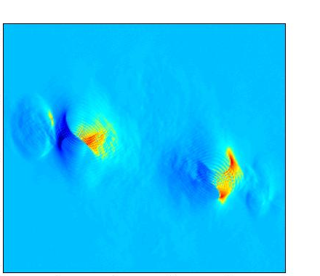
Magnetic field dependence
dG/dx
1 µm
y (µm)
V_{tip}= -8.0 V
V_{cgate}= -1.0 V
B = 100 mT
X (µm)
Notes:
26

Slide 27
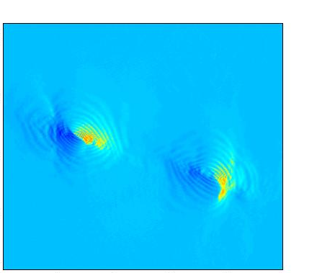
Magnetic field dependence
dG/dx
1 µm
y (µm)
V_{tip}= -8.0 V
V_{cgate}= -1.0 V
B = 200 mT
X (µm)
Notes:
27

Slide 28
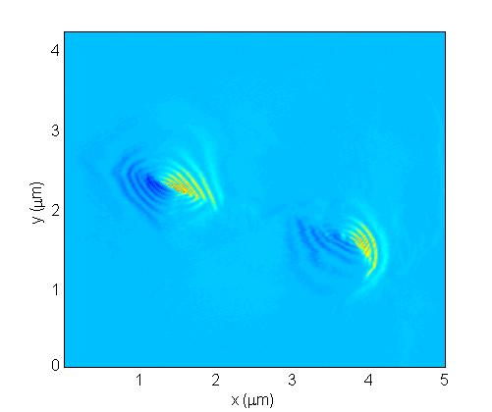
Magnetic field dependence
dG/dx
1 µm
y (µm)
V_{tip}= -8.0 V
V_{cgate}= -1.0 V
B = 300 mT
X (µm)
Notes:
28

Slide 29
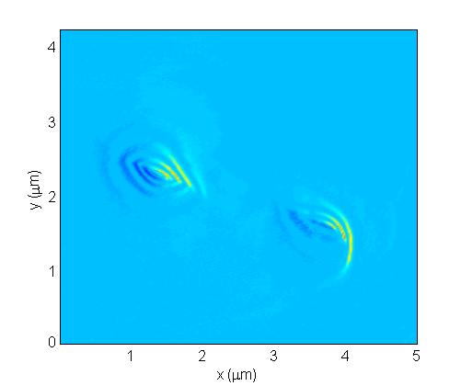
Magnetic field dependence
dG/dx
1 µm
y (µm)
V_{tip}= -8.0 V
V_{cgate}= -1.0 V
B = 500 mT
X (µm)
Notes:
29

Slide 30
Magnetic field dependence
dG/dx
1 µm
y (µm)
V_{tip}= -8.0 V
V_{cgate}= -1.0 V
B = 0 mT
X (µm)
Notes:
30

Slide 31
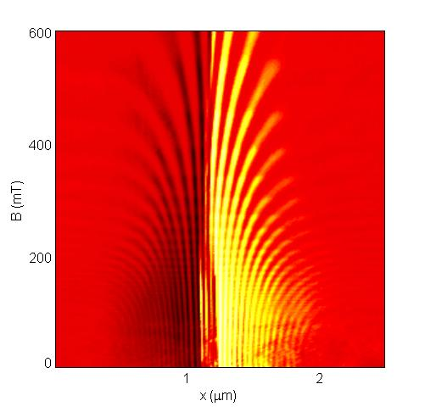
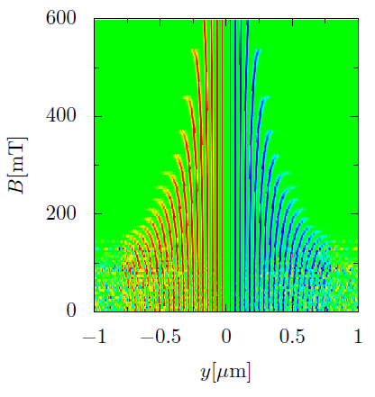
Magnetic field dependence
dG/dx
dG/dx
QPCSGM116
5th cooldown
Dr. Dietmar Weinmann,
Strasbourg, France
Notes:
31

Slide 32
Summary (experimental observations)
QPC:
Backscattering effect
Interference effect
1 µm
1 µm
500 nm
Ballistic stadium:
Two fringe patterns
Conductance fluctuations

Slide 33
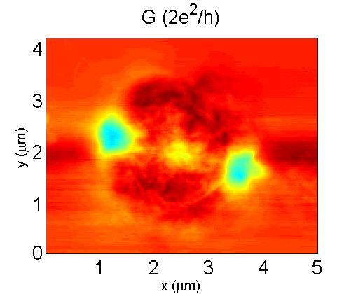
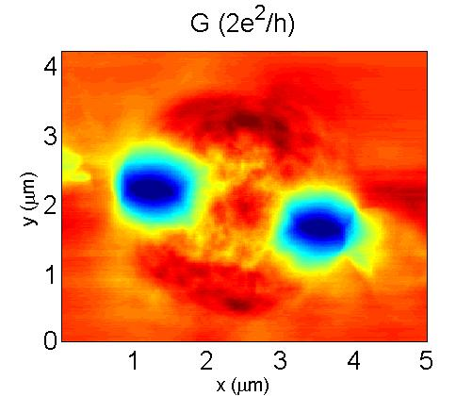

Summary (experimental features not covered by the model)
Center of the stadium
Positions of the lens-shaped regions
Magnetic field
dependence

Slide 34
THANK YOU

Slide 35
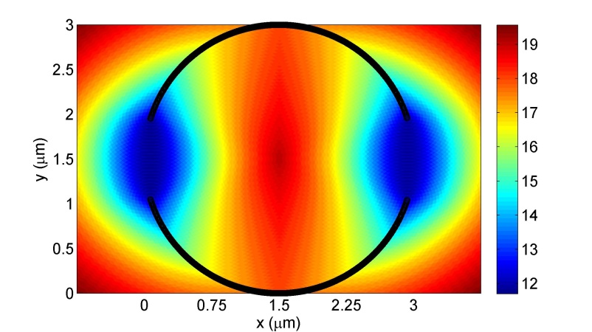

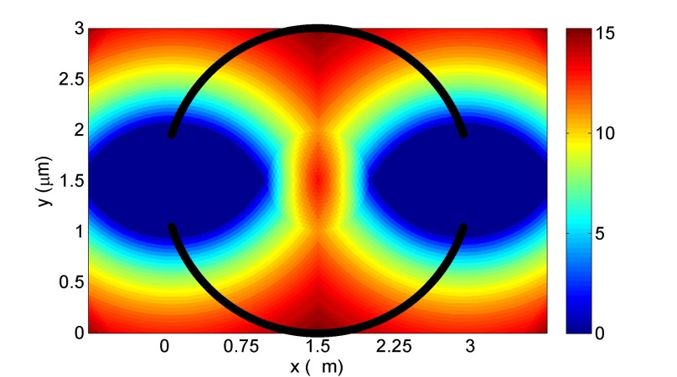
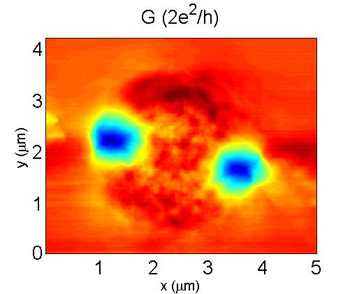
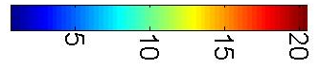
Numerical simulations (top panel) vs. experiment (bottom panel)
R_{Tip}=0.05 µm
R_{Tip}=0.5 µm
R_{Tip}=1 µm
V_{tip} = - 4 V
V_{tip} = - 6 V
V_{tip} = - 8 V
G ≈ 17× 2e²/h without the tip

Slide 36
Features not explained by simulations
A region of reduced conductance in the center of the stadium at low tip biases (experiment)
Positions of the lens-shaped regions:
inside the stadium in the experiment
in the centers of the constrictions in the simulations

Slide 37
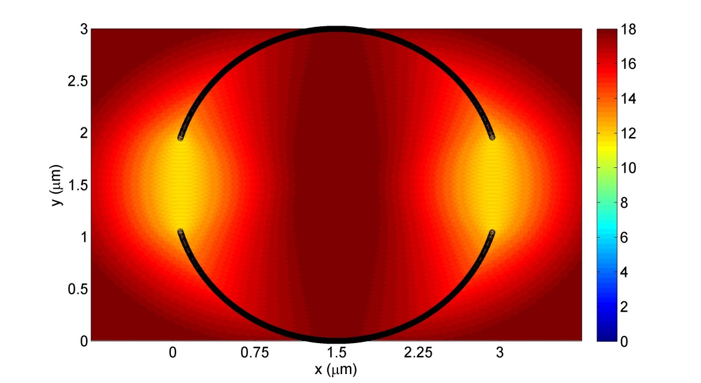

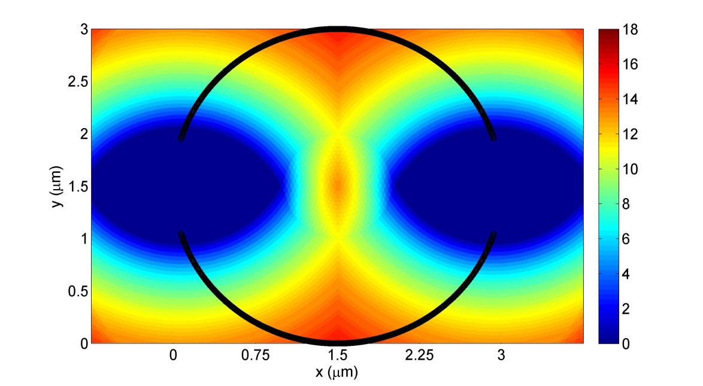
Numerical simulations (B = 0 mT): same as in the previous slide, but the color scales are different
R_{Tip}=0.05 µm
R_{Tip}=0.5 µm
R_{Tip}=1 µm

Slide 38
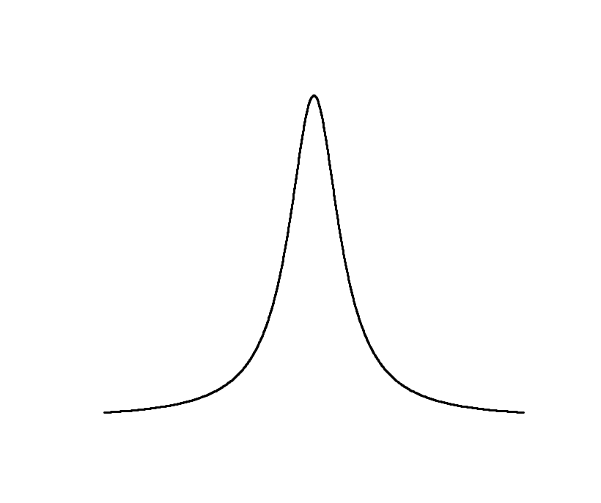
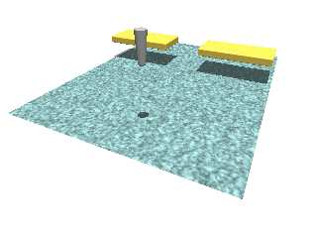
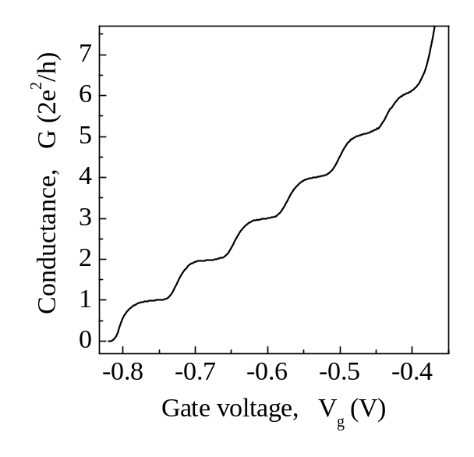
SGM technique
Tip
Tip-induced
potential
Top gates
Energy
μ_{S}
μ_{D}
D. A. Wharam et al., 1988
B. J. van Wees et al., 1988
2DEG
Gating effect

Slide 39
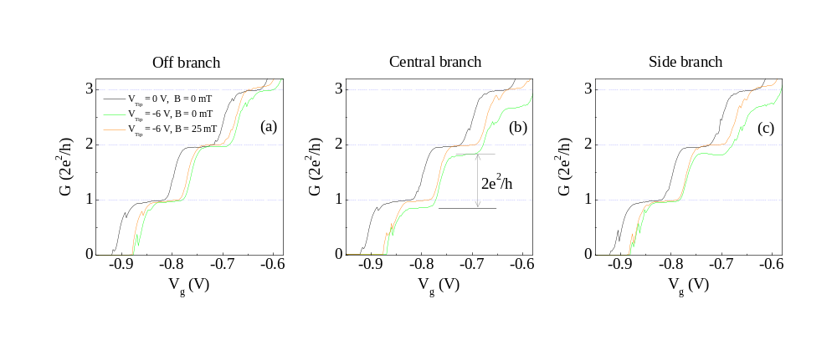
Influence of the tip on the conductance

Slide 40
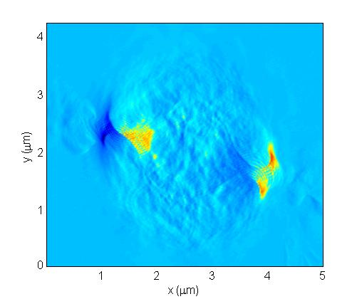
Scanning inside the stadium
V_{tip}=-8.0 V
V_{cgate}=-1.0 V
V_{QPC}=0 V
Notes:
40

Slide 41
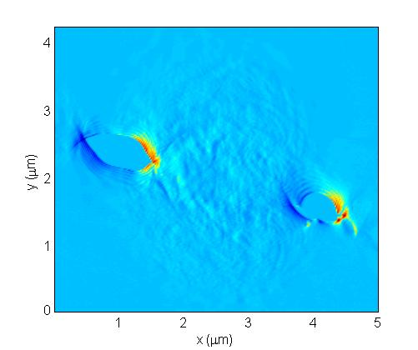
Scanning inside the stadium
V_{tip}=-8.0 V
V_{cgate}=-1.0 V
V_{QPC}=-0.38 V
B=0 mT
Notes:
41

Slide 42


Profiles
A
B
V_{tip}=-8.0 V
V_{cgate}=-1.0 V
B=0 mT
Left QPC is biased,
3 modes. This is the
case only in this slide.
A
B
Notes:
42

Slide 43


Profiles
I (nA)
A
B
V_{tip}=-8.0 V
V_{cgate}=-1.0 V
B=300 mT
A
B
Notes:
43

Slide 44


Profiles
I (nA)
A
B
V_{tip}=-8.0 V
V_{cgate}=-1.0 V
B=500 mT
A
B
Notes:
44

Slide 45

Magnetoresistance measurements
Notes:
45

Slide 46

Magnetoresistance measurements
Stadium
voltage
B (mT) | rc (um)
120 | 0.48
100 | 0.58
80 | 0.72
60 | 0.96
40 | 1.44
10 | 5.75
Notes:
46

Slide 47




Magnetic focusing
80 mT
100 mT
B (mT) | rc (um)
120 | 0.48
100 | 0.58
80 | 0.72
60 | 0.96
40 | 1.44
10 | 5.75
50 mT

Slide 48
Summary (experimental observations)
Scanning gate microscopy on a quantum point contact:
Imaging electron backscattering
Observation of branches and interference fringes
Detailed investigation of the branching behaviour
Strongly varying interference fringe spacing
Scanning gate microscopy on a ballistic stadium:
Two fringe pattern close to the constrictions
Measurements at high magnetic fields
Proposed model explains some of the observed features, but not all of them

