Slide 1





Dynamical response of nanoconductors: the example of the quantum RC circuit
Christophe Mora
Collaboration with Audrey Cottet, Takis Kontos, Michele Filippone, Karyn Le Hur

Slide 2

Outline of the talk
Mesoscopic and nanoscopic physics
Three transverse concepts in mesoscopic physics
Quantum coherence (electrons are also waves)
Interactions (electrons are not social people)
3) Spin degree of freedom

Slide 3
Outline of the talk
Mesoscopic Capacitor (Quantum RC circuit)
Adding Coulomb interactions
Giant peak in the charge relaxation resistance

Slide 4
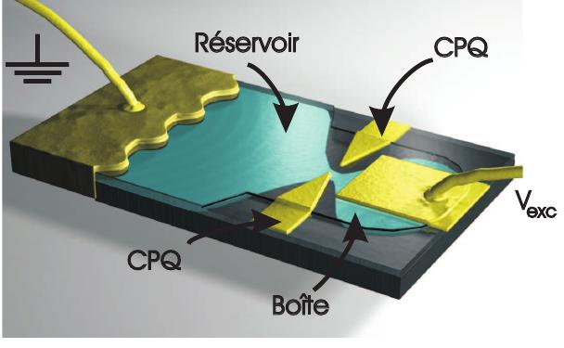
Mesoscopic capacitor or the quantum RC circuit
D. Darson
Gwendal Fève, Thesis (2006)

Slide 5
The Quantum RC circuit
The quantum RC circuit
Dot
QPC
Lead: Single-mode
Spin polarized
Gate
AC excitation
B
Linear response theory
~
Classical circuit
Vg
Low frequency
response
Gabelli et al. (Science, 2006)
Fève et al. (Science, 2007)

Slide 6
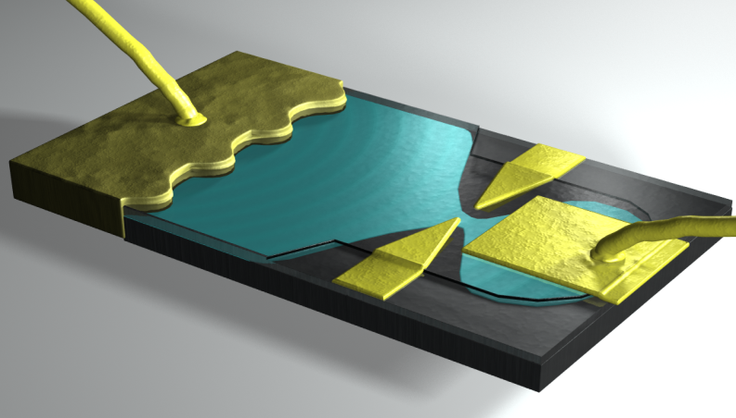
Mesoscopic Capacitor
Mesoscopic capacitor
Gabelli et al. (Science, 2006)
Fève et al. (Science, 2007)
l < μm
Meso, ENS
D. Darson
Quantum dot in a microwave resonator
dispersive shift of the resonance: capacitance
broadening (dissipation): resistance
Delbecq et al. (PRL, 2011)
Chorley et al. (PRL, 2012)
Frey et al. (PRL, 2012)

Slide 7
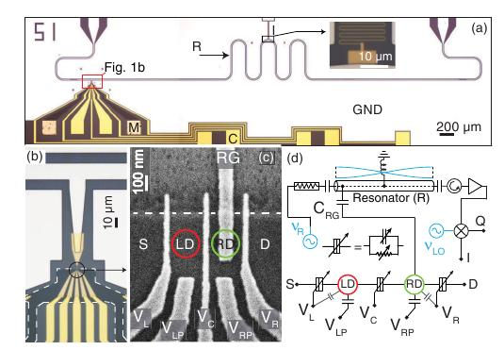
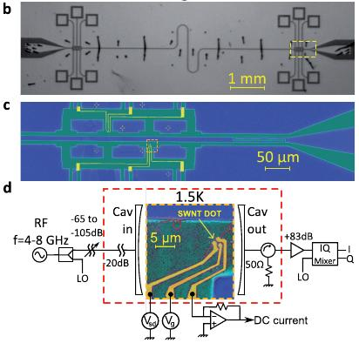
Mesoscopic Capacitor
Microwave Resonator
Quantum dot in a microwave resonator
dispersive shift of the resonance: capacitance
broadening (dissipation): resistance
Frey et al. (PRL, 2012)
Delbecq et al. (PRL, 2011)

Slide 8
Energy scales
Energy scales
Experiment on the
meso. capacitor, LPA ENS
Charging Energy
Level spacing
Dwell time
Excitation frequency

Slide 9
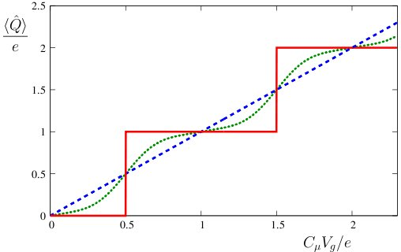
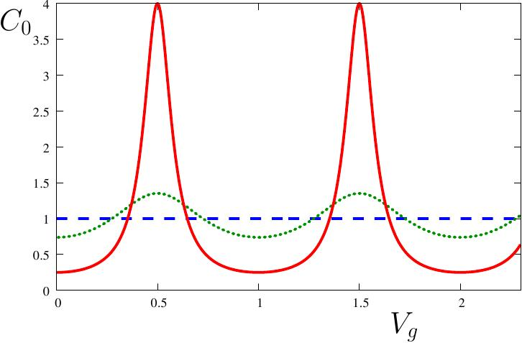
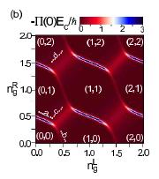
Differential capacitance
Differential capacitance
Opening of the QPC:
from Coulomb staircase
to classical behaviour
Cottet, Mora, Kontos (PRB, 2011)

Slide 10
Electron optics
Electron optics
Buttiker, Prêtre , Thomas (PRL, 1993)
Similar to light propagation in a dispersive medium
Wigner delay time
Ringel, Imry, Entin-Wohlman (PRB, 2008)

Slide 11
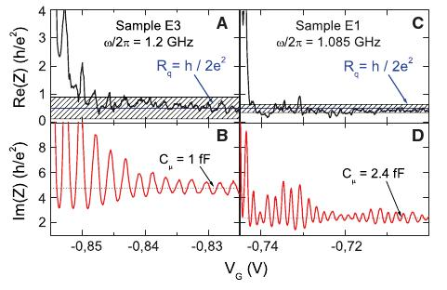
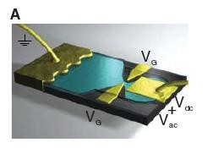
Experimental results
Experimental results
Gabelli et al. (Science, 2006)
Fève et al. (Science, 2007)
Oscillations
Notes:
Ajouter des commentaires sur les courbes experimentales ?

Slide 12
Adding Coulomb interactions

Slide 13
Pertubative approaches
Weak tunneling
B
Strong tunneling (weak backscattering)
Hamamoto, Jonckheere,
Kato, T. Martin (PRB, 2010)
Mora, Le Hur (Nature Phys. 2010)

Slide 14
Universal resistances
Universal resistances
Results for small frequencies
Mora, Le Hur (Nature Phys. 2010)
Small dot
Large dot
Confirms result for finite dot, new result in the large dot case
Hamamoto, Jonckheere,
Kato, T. Martin (PRB, 2010)

Slide 15
Kondo mapping
Matveev (JETP, 1991)
divergence for
0
1
Charge states
Mapping to the Kondo hamiltonian (0 and 1 -> Sz = -1/2,1/2)
Correspondance

Slide 16
Korringa-Shiba relation
Korringa-Shiba relation
Shiba (Prog. Theo. Phys., 1975)
At low frequency
Garst, Wolfle, Borda, von Delft, Glazman (PRB, 2005)
and therefore

Slide 17
Dominant elastic scattering
Even in the presence of strong Coulomb blockade
Energy conservation
at long times (low frequency)
Probability of inelastic scattering process small
Usual Fermi liquid argument
of phase-space restriction
Aleiner, Glazman (PRB,1998)

Slide 18
Weak tunneling regime
Fermi liquid approach
Power dissipated under AC drive
Original model
Linear response theory
Low energy model
related to through Friedel sum rule
Filippone, Mora (PRB 2012)

Slide 19
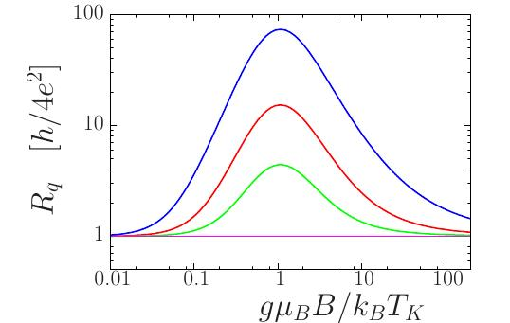
Giant peak in the charge relaxation resistance

Slide 20
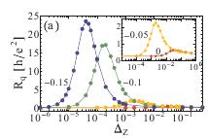

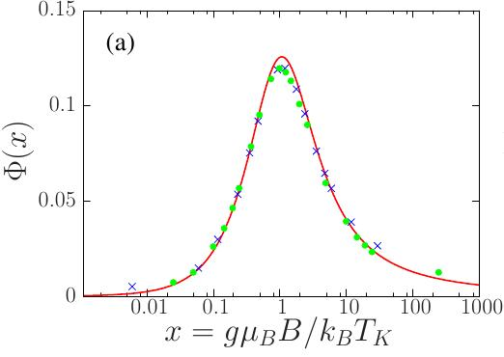
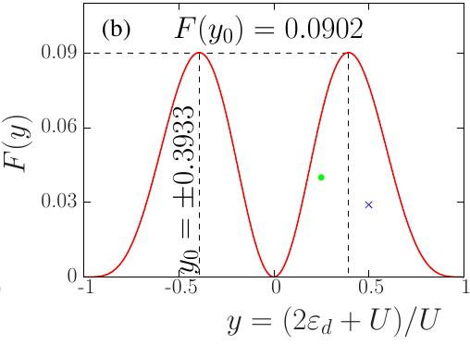
Giant peak in the AC resistance
M. Lee, R. Lopez, M.-S. Choi, T. Jonckheere, T. Martin (PRB, 2010)
Peak comes from Kondo singlet breaking
Fermi liquid approach
Filippone, Le Hur, Mora (PRL 2011)

Slide 21

Perturbation theory (second order)
Fermi liquid approach
Charge susceptibilities
Charge-spin modes
Kondo limit
remains small
charge frozen

Slide 22
Conclusion
Conclusions
Prediction of scattering theory is recovered with an exact treatment of Coulomb interaction
Novel universal resistance is predicted for a large cavity
Peak in the charge relaxation resistance for the Anderson model
Filippone, Mora (PRB 2012)
Mora, Le Hur (Nature Phys. 2010)
Filippone, Le Hur, Mora (PRL 2011)

Slide 23
Perturbation theory (second order)
Anderson model
M. Lee, R. Lopez, M.-S. Choi, T. Jonckheere, T. Martin (PRB, 2010)
At zero
magnetic field
Monte-Carlo calculation

Slide 24
Perturbation theory (second order)
Fermi liquid approach
Charge susceptibilities
Charge-spin modes
Kondo limit
remains small
charge frozen

Slide 25
Perturbation theory (second order)
Fermi liquid approach
M. Lee, R. Lopez, M.-S. Choi, T. Jonckheere, T. Martin (PRB, 2010)
Filippone, Le Hur, Mora (PRL 2011)

