Slide 1
Cavity-coupled strongly correlated nanodevices
Gergely Zaránd
TU Budapest
Quantum noise through a nanotube quantum dot:
Experiment: J. Basset, A.Yu. Kasumov, H. Bouchiat, and R. Deblock (Orsay)
Theory: P. Simon (Orsay), C.P. Moca (TU Budapest) , C.H. Chung (Taiwan)
Cavity-coupled dots:
T. Kontos (Ecole Normale)
C.P. Moca and Csaba Tőke (TU Budapest)

Slide 2
Motivation
Technological pressure to integrate nanocircuits into rf cavities
(quantum computation)
High frequency noise/conductance measurements!
Access new regions of non-equilibrium physics
New correlated states / structures ?

Slide 3
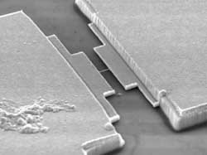
Quantum noise through a carbon nanotube
Carbon naontube =
Quantum dot
Electron spin
Schöneberger group

Slide 4




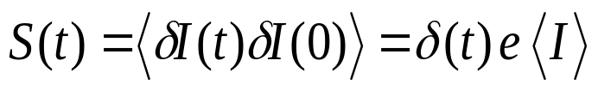
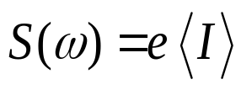
Shot noise
Cathode ray tube:
Assume independent events:
Autocorrelation of a
single pulse
„white noise”

Slide 5





Classical versus quantum region...
Point-like pulses (white noise)
Structure of pulses is visible !
This is what we look for (v = 50-100 GHz)

Slide 6





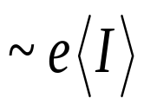




Symmetrized noise of a biased tunnel junction (V≠0 )
Non-equilibrium spectrum:
Tunnel junction
( symmetrized noise )
„quantum
noise”
Shot noise
oxide

Slide 7
Functional RG theory
Carbon naontube =
Quantum dot
Electron spin

Slide 8
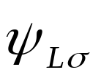
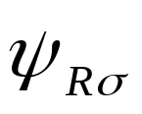






Nanotube with single electron
Kondo Hamiltonian :
Dot spin
Use pseudofermions (Abrikosov)
Do perturbative RG for !?

Slide 9



Difficulties
Kondo effect
Logarithmic singularities with „fine structure”
Standard RG is not accurate enough
Paaske, Rosch, Kroha, Wölfle:
Scaling equations (heuristic) for the vertex function:
Retarded interactions !
Current conservation???
What is ???

Slide 10

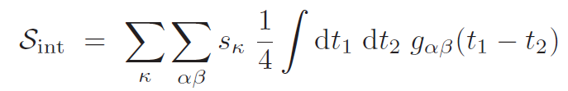







Real time path integral on the Keldysh contour
Action:
quadratic
Interaction part:
Keldysh label
Interaction initially local:
Keldysh sign:

Slide 11
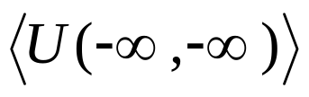


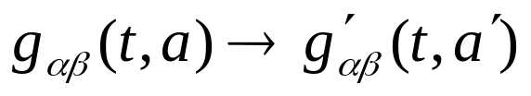
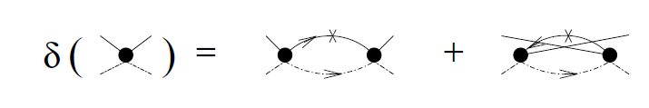
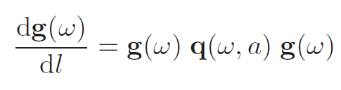
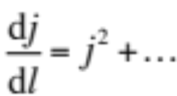



Generating RG equations
1. Expand in
2. Rescale
Cut-off function
„Standard” RG:

Slide 12
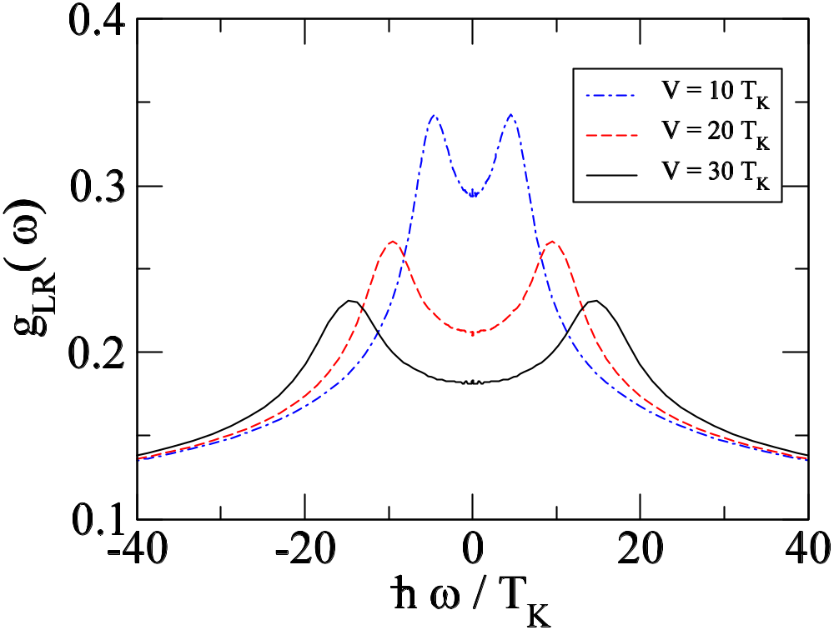
Renormalized vertex
Kroha, Wölfle, Rosch, Paaske

Slide 13


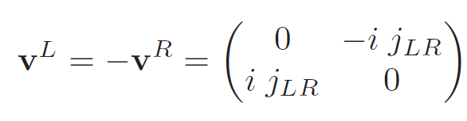
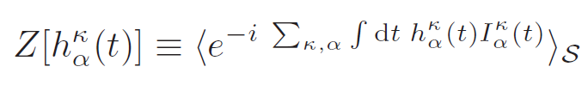






Current vertex
Current operator from equation of motion:
Current conservation
Generating functional:
RG:
1. Expand in and in
2. Rescale
and

Slide 14

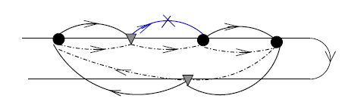
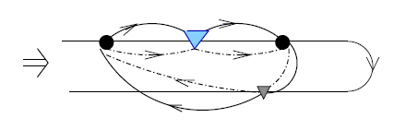

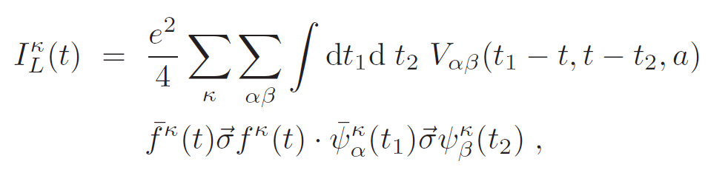
Current vertex renormalization
Current necessarily becomes non-local
time of the
measurement!
Initially:

Slide 15
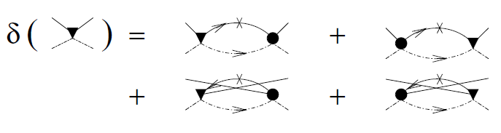
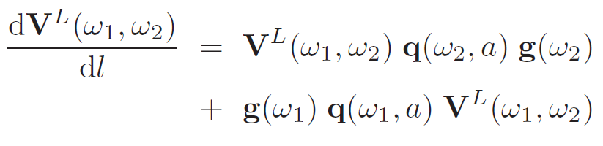



RG equations
Current vertex scaling:
Current conservation:
Automatically satisfied at the functional level !

Slide 16

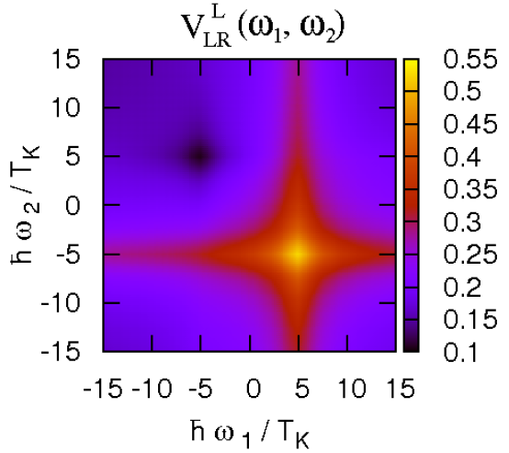
Renormalized current vertex

Slide 17
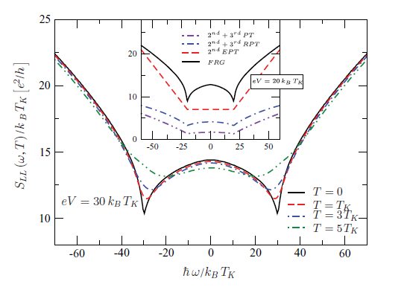
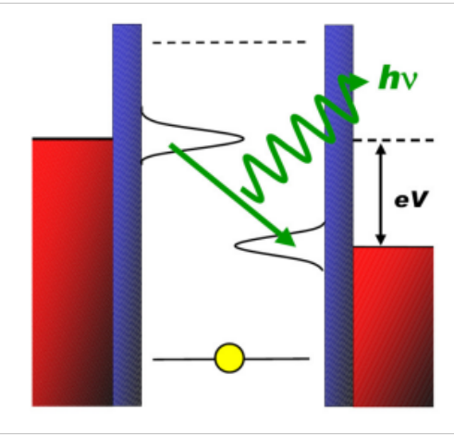
Symmetrized noise spectra
Non-equilibrium
Kondo effect

Slide 18


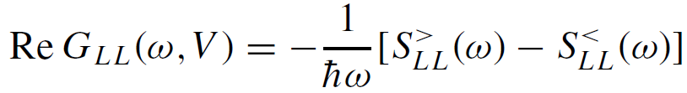
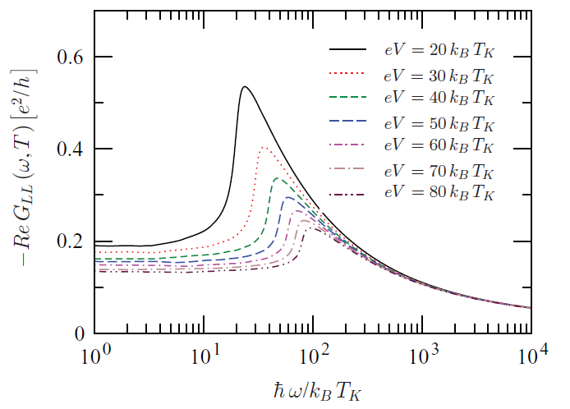


Non-equilibrium ac linear conductivity
Non-equlibrium ac-conductance
Safi:

Slide 19
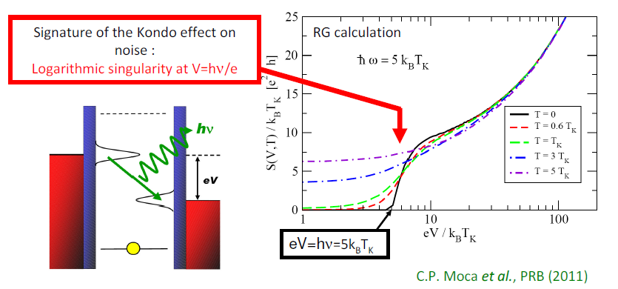
Emission noise of quantum dot

Slide 20
How to measure (quantum) noise at 70 GHz ???

Slide 21
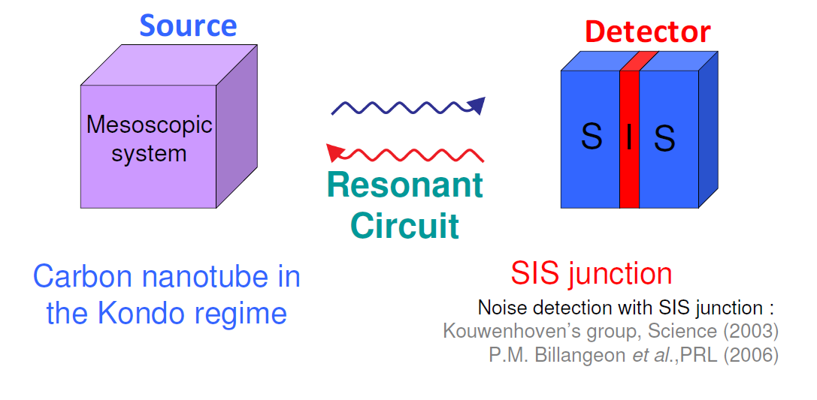
The experimental setup

Slide 22
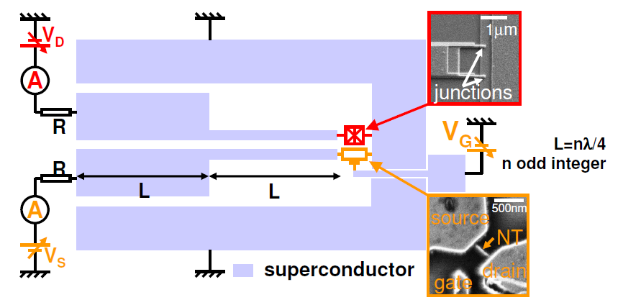
Resonant coupling betwen a Carbon nanotube and a SIS detector
¼ wavelength resonant circuit
Independent DC polarisations of the source and the detector
Coupling at eigen frequencies of the resonator (30 GHz and harmonics)
Coupling proportional to the quality factor (J. Basset et al. PRL 2010)

Slide 23
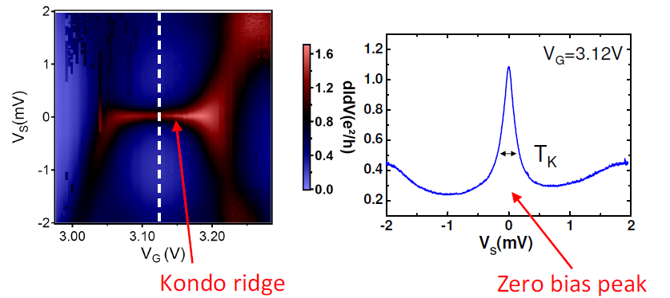
Kondo effect in nanotube
dI/dV
Noise ???

Slide 24
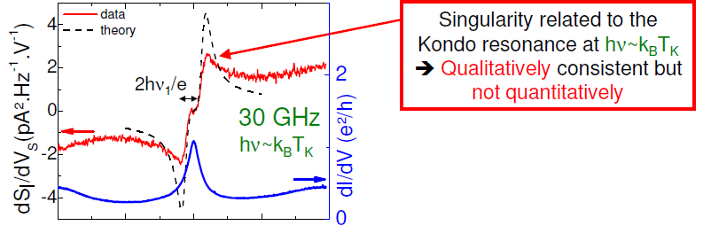

Back to experiment…

Slide 25
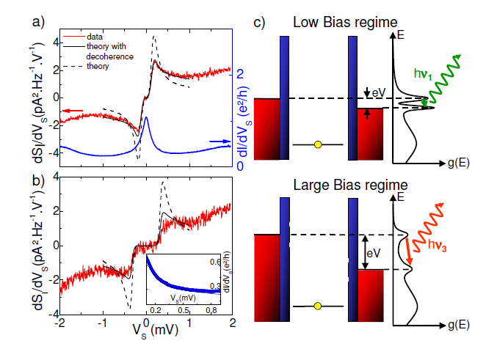


Noise data
Additional source of decoherence ???
(Monreal et al. PRB 05; Van Roermund et al. PRB 10; De Franceschi et al. PRL 02)
Independent flow of spin relaxation ???

Slide 26
Coupling quantum dots through cavities

Slide 27
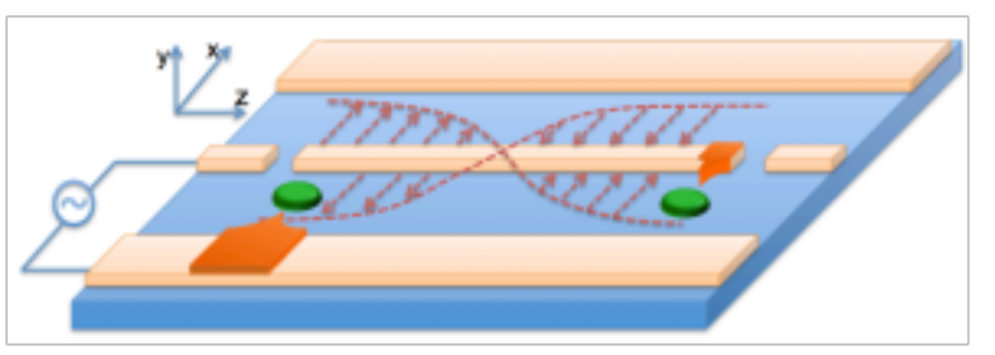
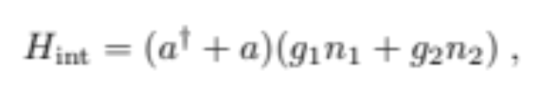
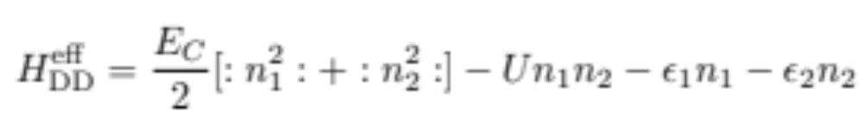

Double dot structures
Cavity mode
Dot 1
Dot 2
Quantum fluctuations
of cavity
Sign and size of U can be designed
Couplings up to

Slide 28
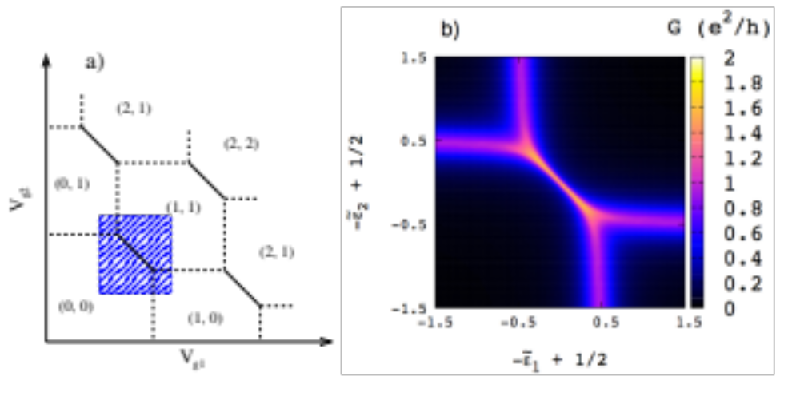
Stability diagram for attractive U
Conductance (NRG)
Stability diagram
Spinless case
Charge Kondo effect
( negative U Anderson model !)

Slide 29
Summary
Quantum noise in the Kondo regime:
Current-conserving functional RG scheme
Noise anomalies predicted and observed
Spin relaxation ?
Moca, Simon, Chung, and G.Z., PRB 83, (RC)201303 (2011);
Basset, Kasumov, Moca, G.Z., Simon, Bouchiat, Deblock, PRL 108, 046802 (2012)
Cavity-coupled quantum dots:
First controlled realization of negative U Anderson model
New quantum states (spinful case)
Moca, Tőke, Kontos, G.Z. (to be submitted)

Slide 31
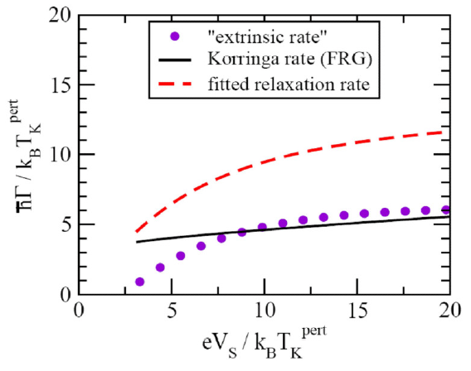
Fitted the coherence rate…
Additional source of decoherence ???
(Monreal et al. PRB 05; Van Roermund et al. PRB 10; De Franceschi et al. PRL 02)
Self-consistent treatment of spin relaxation ???

Slide 32



Conclusions
Theory:
Real time functional RG formalism
shows strong anomalies at
shows split Kondo resonance
Current-conserving scheme
Experiment:
Non-equilibrium quantum noise measurment
Logarithmic anomalies observed
Additional spin relaxation must be assumed to agree with theory
J. Basset et al, arXiv:1110.1570

Slide 33
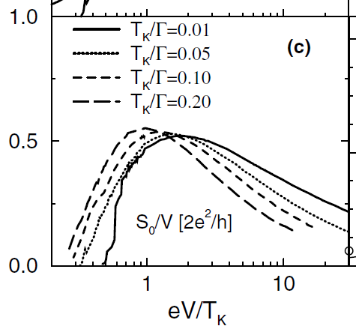





What do we know about current noise of a quantum dot?
Shot noise
Theory : Meir and Golub, PRL (2002)
Experiments:
Delattre et al., Nature Physics (2009)
Noise spectrum ?
Toulouse Limit: Schiller and Herschfield (1998)
Sindel et al, PRL (2005)
Perturbative calculations: Korb et al, PRB (2007)
Our questions ?
(non-equilibrium linear conducatence)
Explore only regime

Slide 34
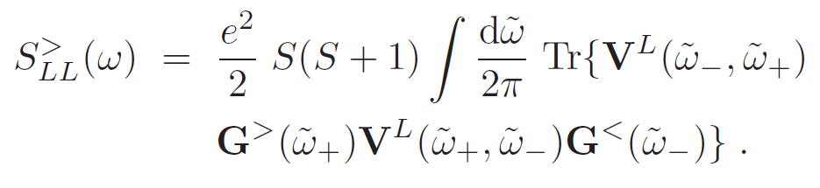


Computing the noise
Functional RG noise formula:

Slide 35
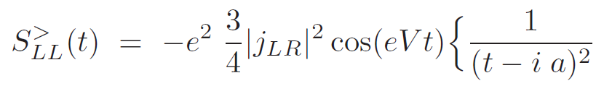
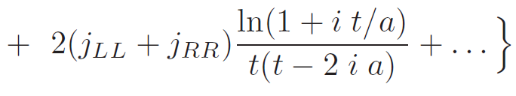
Perturbation theory

Slide 36
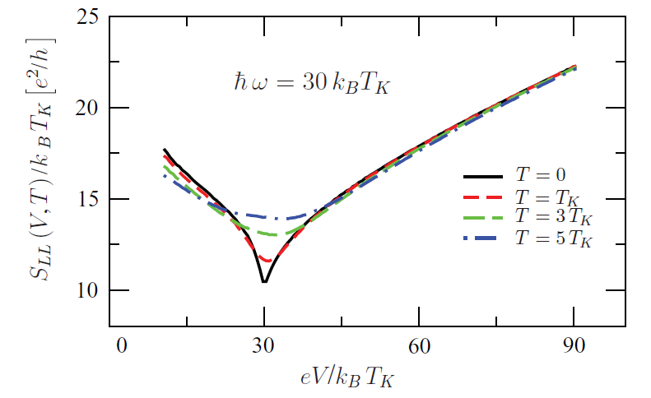
Noise spectra fixed frequency

Slide 37
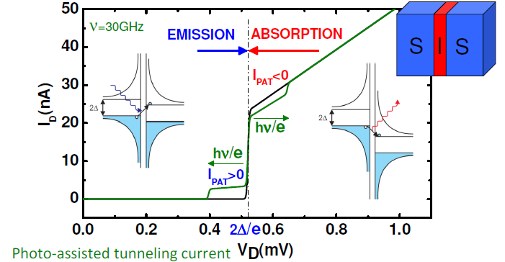

Quantum noise detection with SIS junction
Ingold and Nazarov (1992)

Slide 38
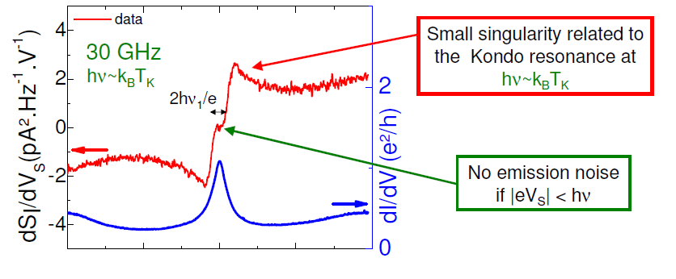
Back to experiment…

Slide 39
Back to experiment…
Theory: no free fitting parameter!
  Kondo temperature TK=1.4K TKRG=0.38K
  asymmetry a=0.67
Additional decoherence ???
(Monreal et al. PRB 05; Van Roermund et al. PRB 10; De Franceschi et al. PRL 02)

Slide 40
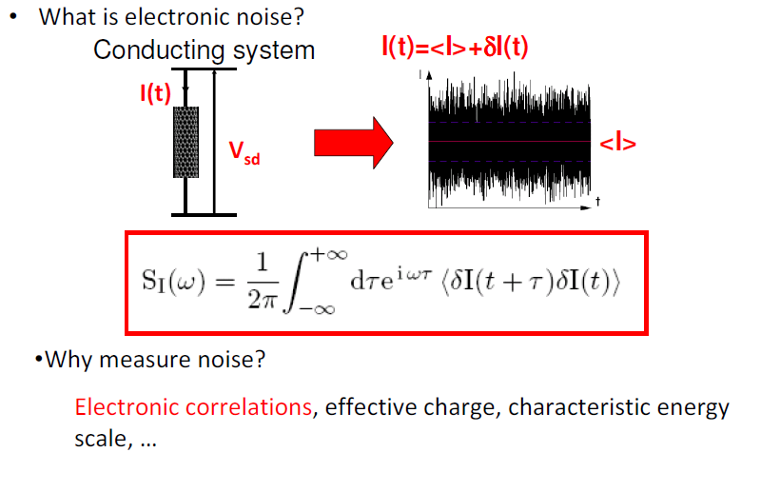
Motivation, introduction to noise
Correlations and Quantum noise ?

Slide 41




Emission noise of a tunnel junction ( V=0 )
Equilibrium (V=0)
Tunnel junction
“Emission” noise
oxide
absorbtion
emission

Slide 42

Noise of tunnel junction (V≠0 )
Non-equilibrium spectrum:
Symmetrized noise
Shot noise
Emission noise

Slide 43




Symmetrized equilibrium noise of a tunnel junction ( V=0 )
Equilibrum spectrum (V=0)
Tunnel junction
( symmetrized noise )
„quantum” noise
oxide
Thermal noise
(„white”)

